Slide 1
4³
Order of Operations
÷
( )
+
-
X
Meet Aunt Sally

Slide 2
In most languages, the meaning of words depend on the order:
Example
Sign the check
Is not the same as
Check the sign

Slide 3
When you make cereal, do you fill the bowl with milk or cereal first? Why? Turn to your neighbor and explain your thinking.

Slide 4
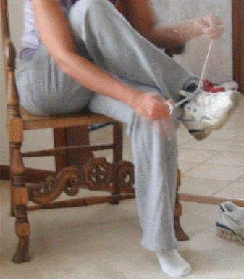
When you get dressed, do you put on your shoes or socks first? Why?

Slide 5
In our lives and in math, we need to do things in a certain order to make sure they turn out right.
Come up with two more examples from your life?

Slide 6
Compare your list with your neighbor’s list. Can you add anything to your list?

Slide 7
The Order of Operations tells us how to do a math problem with more than one operation, in the correct order.

Slide 8
HERE IS A QUESTION TO THINK ABOUT DURING THIS LESSON. You go shopping and you buy 3 shirts that are $8.00 each. Then, you buy 2 pairs of jeans that are $20 each. You also buy a pair of shoes that cost $35, but you have a coupon for $7 off them. How much money did you spend? HOW CAN WE USE ORDER OF OPERATIONS TO SOLVE THIS PROBLEM?

Slide 9
Please Excuse My Dear Aunt Sally
This will help you to remember the order of operations.

Slide 10
Please Excuse My Dear Aunt Sally
P
Parentheses ( )
E
Exponents 4³
M
D
Multiply x
Divide ÷
A
S
Add +
Subtract -

Slide 11
Please Excuse My Dear Aunt Sally
Parentheses ( )
Always do parentheses 1st.

Slide 12
Please Excuse My Dear Aunt Sally
Exponents 4³
Always do Exponents 2nd.

Slide 13
Please Excuse My Dear Aunt Sally
Multiply x
Divide ÷
Do multiplication and division 3rd, from left to right.

Slide 14
Please Excuse My Dear Aunt Sally
Add +
Subtract -
Do addition and subtraction 4th, from left to right.

Slide 15
Let’s Try Some Problems!

Slide 16
PEMDAS
14+2 - (9+1)
14+2 - 10
16 - 10
6

Slide 17
PEMDAS
3 x (9+1)
3 x(10)
3 x 10
30

Slide 18
PEMDAS
4+5 x (6-2)
4+5 x 4
4+20
24

Slide 19
PEMDAS
6+ 10 x 3 -16
6+ 30 -16
36 -16
20

Slide 20
PEMDAS
64 ÷ (9 x 3-19)
64÷(27 –19)
64 ÷ 8
8

Slide 21
PEMDAS
Where would you put your Parentheses ( ) to make this problem true?
6 x 8 - 5 = 18
6 x (8 - 5)= 18
6 x 3 = 18

Slide 22
PEMDAS
Where would you put your Parentheses ( ) to make this problem true?
42 ÷ 2 x 3 - 5 = 2
42 ÷ (2 x 3) - 5 = 2
42 ÷ (6) - 5 = 2
42 ÷ 6 - 5 = 2
7 - 5 = 2

Slide 23
LETS GO BACK TO THIS PROBLEM FROM THE BEGINNING OF THE LESSON. You go shopping and you buy 3 shirts that are $8.00 each. Then, you buy 2 pairs of jeans that are $20 each. You also buy a pair of shoes that cost $35, but you have a coupon for $7 off them. How much money did you spend?

Slide 24
HOW CAN WE USE ORDER OF OPERATIONS TO SOLVE THIS PROBLEM?
(3 x $8) + (2 x $20) + ($35 – 7)= x
$24 + $40 + $28 = $92

