Slide 1
CoViD Safety
Notes:
This presentation will analyze the data regarding staying safe from the CoViD virus.
Image Source:
https://www.petersons.com/blog/how-to-stay-safe-on-campus-five-sensible-tips/

Slide 2
Science-
Noun.
The intellectual and practical activity encompassing the systematic study of the structure and behavior of the physical and natural world through observation and experiment.
-Oxford Dictionary
Notes:
Science doesn’t care who you are, or what you believe. Science doesn’t care about your political affiliation, your race, your class, or your sexual orientation. Science is based on one thing and one thing only; data. Formulate a hypothesis, a guess, any guess. It doesn’t matter how absurd, and crazy the guess is, anything can be postulated. Test your claim. If your claim works try again, see if you can destroy it. If what you claim is the truth, nothing will be able to stop it. If what you claim is false, then something will tear it down. Keep testing and questioning until only truth remains. This is the nature of science. Science is what we will be studying this year. So put aside your preconceived notions and go where the data takes you.

Slide 3
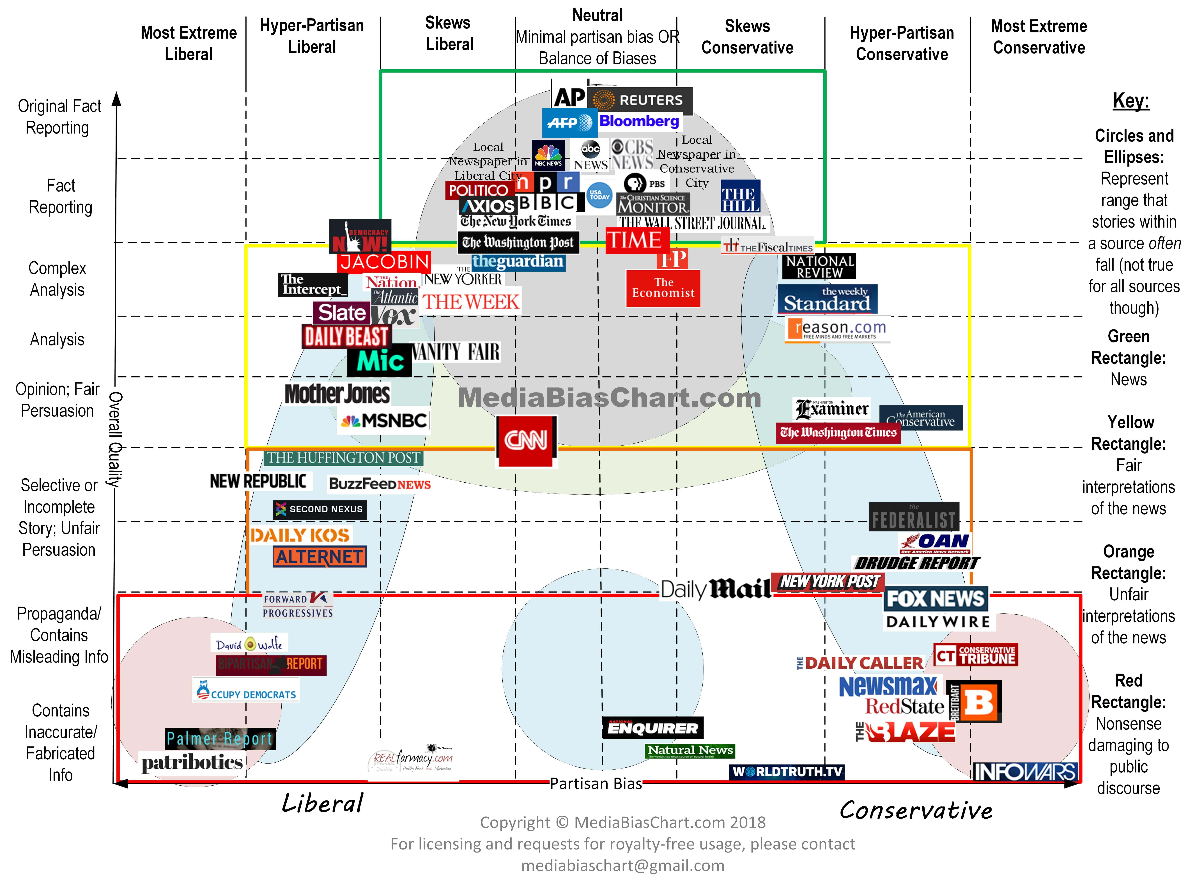
Notes:
A bias is a conscious or unconscious belief that may change your interpretation of data. We all have bias. A good scientist does everything they possible can to remove all possible biases.
The best information is a primary source, actually conducting the experiment or reading about an experiment someone conducted. Primary sources include lab notebooks, and published papers. The next best source is secondary sources like textbooks and media reportings in the green box in the middle of this chart. When dealing with any information, always ask yourself if the source is trustworthy and reliable, or if they are trying to tell a different story than the truth.
Image Source-
https://www.marketwatch.com/story/how-biased-is-your-news-source-you-probably-wont-agree-with-this-chart-2018-02-28

Slide 4
The School Plan
Notes:
This is the plan our school has put forth to counter the virus. We will investigate each point of this plan using the tools of science and decide if it is effective or not.

Slide 5
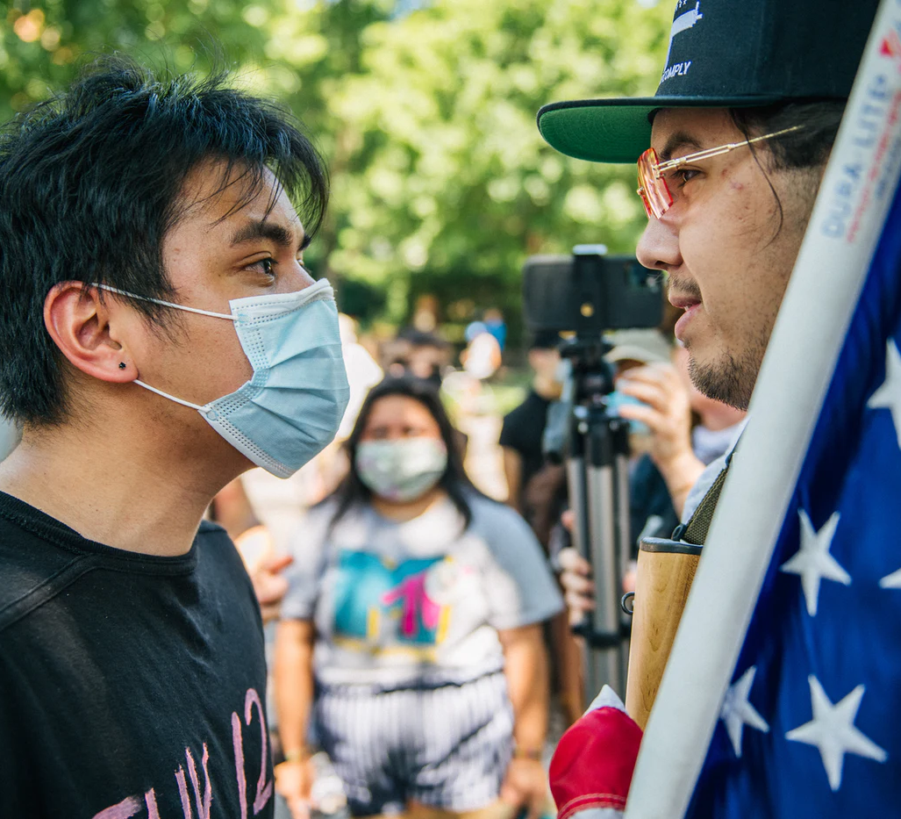
Masks: Infringement of Rights or Essential Safety Gear?
Notes:
Image Source-
https://newrepublic.com/article/158359/conservative-austerity-created-mask-wars

Slide 6
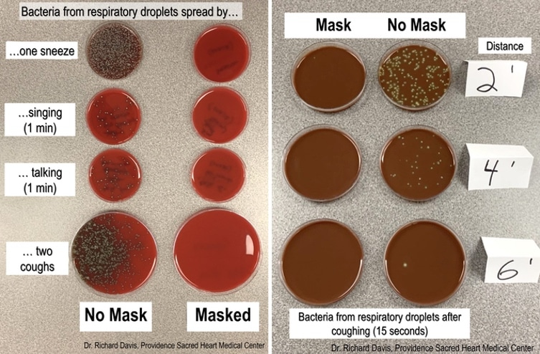
Notes:
What do you observe? How close should you stand? Which is more effective, masks or no masks?
Image Source-
https://mymodernmet.com/face-mask-demo/

Slide 7
How does it work?

Slide 8
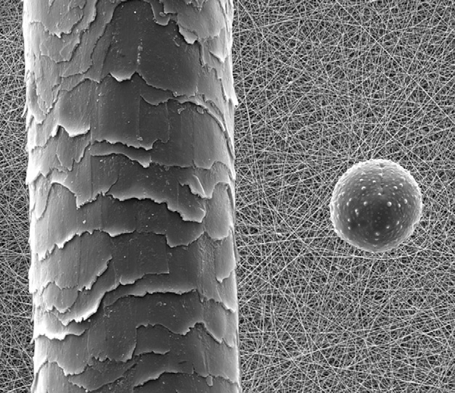
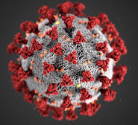
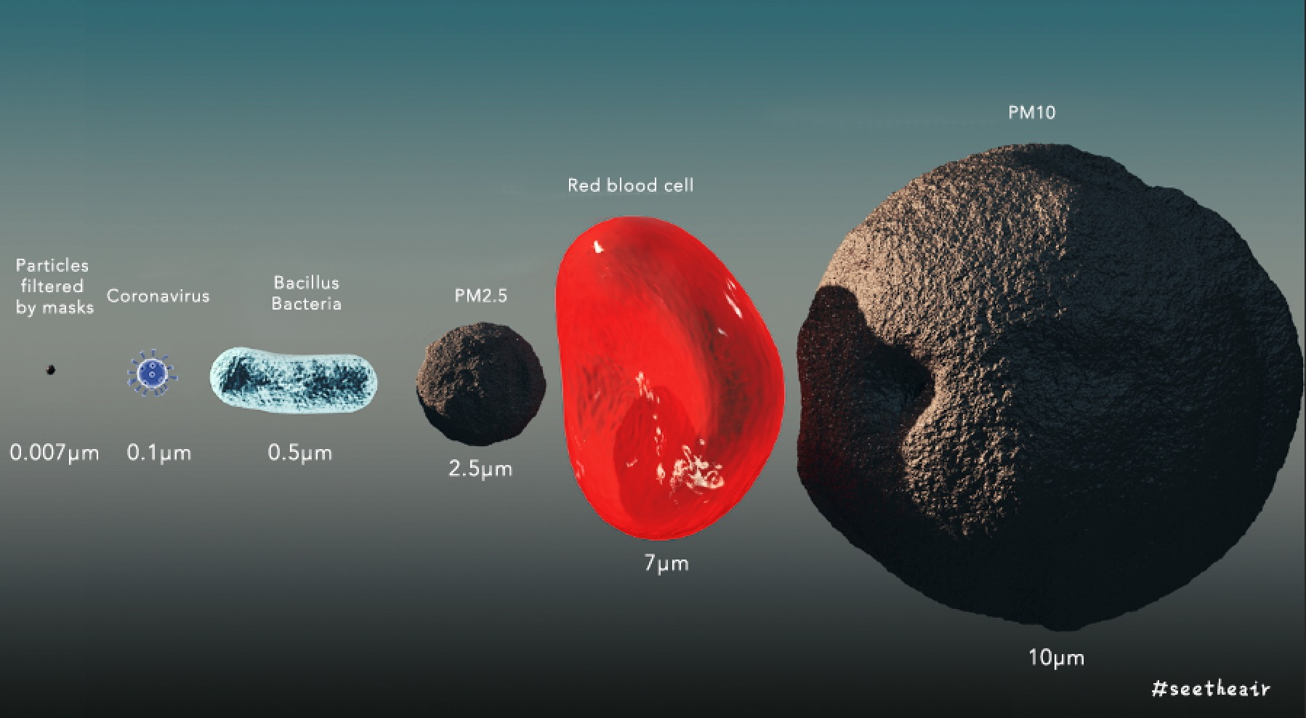
Hair
40 μm
Dust
10 μm
Blood Cell
7 μm
Corona Virus
0.1 μm
Bacteria
0.5 μm
Air Pollution
2.5 μm
Notes:
Image Sources-
https://smartairfilters.com/en/blog/can-air-purifiers-filter-out-the-coronavirus/
https://www.researchgate.net/figure/Scanning-electron-microscope-SEM-image-A-1000-of-a-human-hair-on-the-left-and-a_fig2_316750591
https://www.minnpost.com/health/2020/07/the-daily-coronavirus-update-13-more-deaths-494-new-cases-in-minnesota/

Slide 9
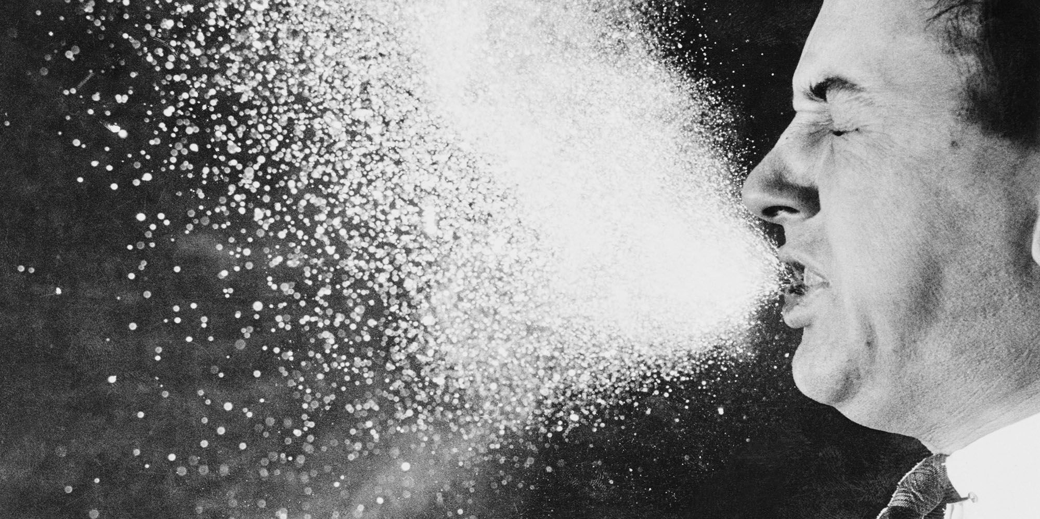
Notes:
Like Orbies floating in water. The CoViD virus particles are suspended in the droplets we breathe and sneeze. Except in the best medical grade masks, usually the openings in masks are too big to stop individual viruses, however, a mask can easily stop most of the water droplets carrying the virus.
https://www.esquire.com/lifestyle/health/a15172105/holding-back-sneeze-throat-damage/

Slide 10
https://www.nist.gov/blogs/taking-measure/my-stay-home-lab-shows-how-face-coverings-can-slow-spread-disease

Slide 11
Social Distancing
Notes:
https://attheu.utah.edu/facultystaff/what-is-social-distancing/

Slide 12
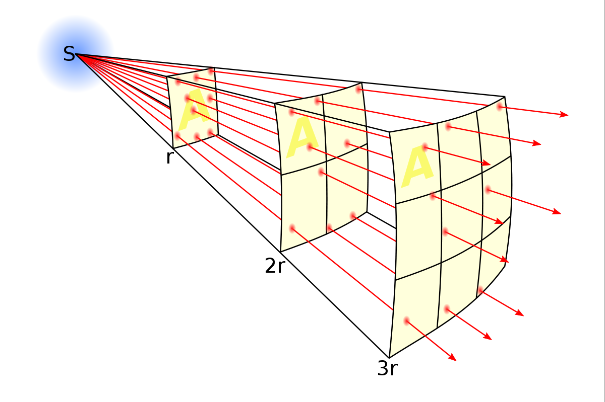
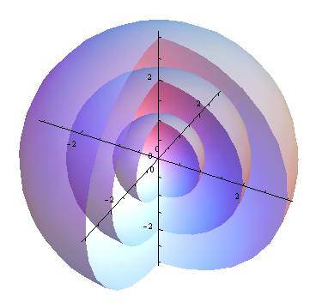
The farther away one is, the larger an area it is spread over and the more dilute it is.
Notes:
Social distancing is all about diluting virus particles. The farther away a person is, the larger volume their droplets are spread through making them more dilute, making infection less likely.
https://mathematica.stackexchange.com/questions/47713/add-coordinate-axes-to-a-3d-plot-of-concentric-spheres
https://en.wikipedia.org/wiki/Inverse-square_law

Slide 13
https://www.youtube.com/watch?v=2YuDWCX3OkM
Hand Washing

