Slide 1
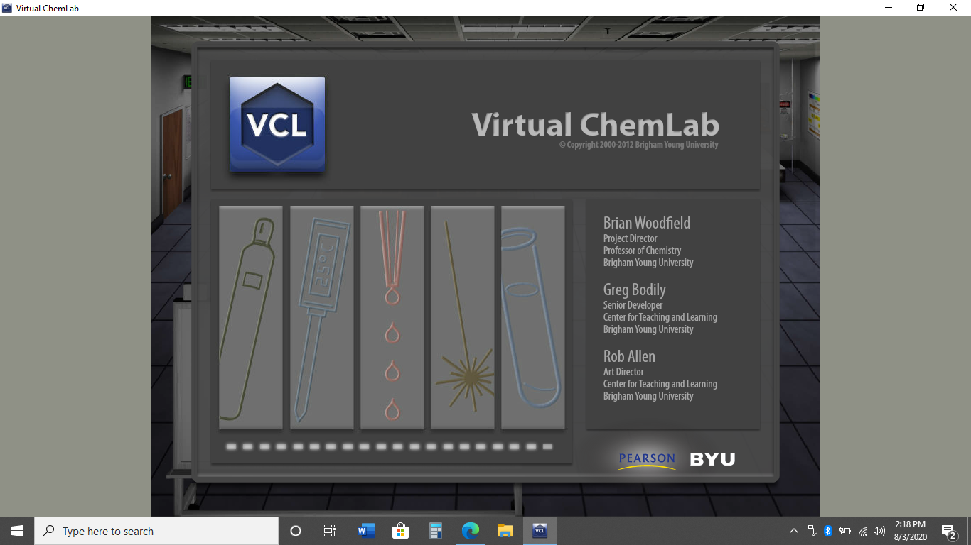
Virtual Experiment:
Chadwick’s Neutrons

Slide 2
Part I-
Background Information

Slide 3
Notes:
Image Source:
http://www.e-alyss.com/blog/james-chadwick-the-discoverer-of-neutron/

Slide 4
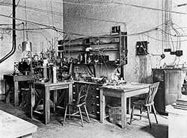
Cavendish Lab,
Cambridge England
Notes:
Chadwick was a student of Rutherford. This is the Cavendish laboratory in Cambridge England. This lab was the site of several Nobel Prize winning chemical discoveries including Ernest Rutherford, discoverer of the atomic nucleus and J. J. Thomson discoverer of the electron. The experiment we will be replicating today is simple to understand, but somewhat difficult to complete. We will be replicating it virtually using the Virtual Chem Lab produced by BYU.
Image Source:
https://www.aps.org/publications/apsnews/201402/physicshistory.cfm

Slide 5
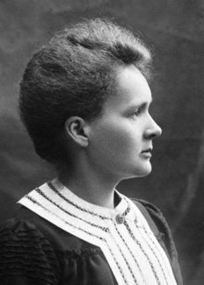
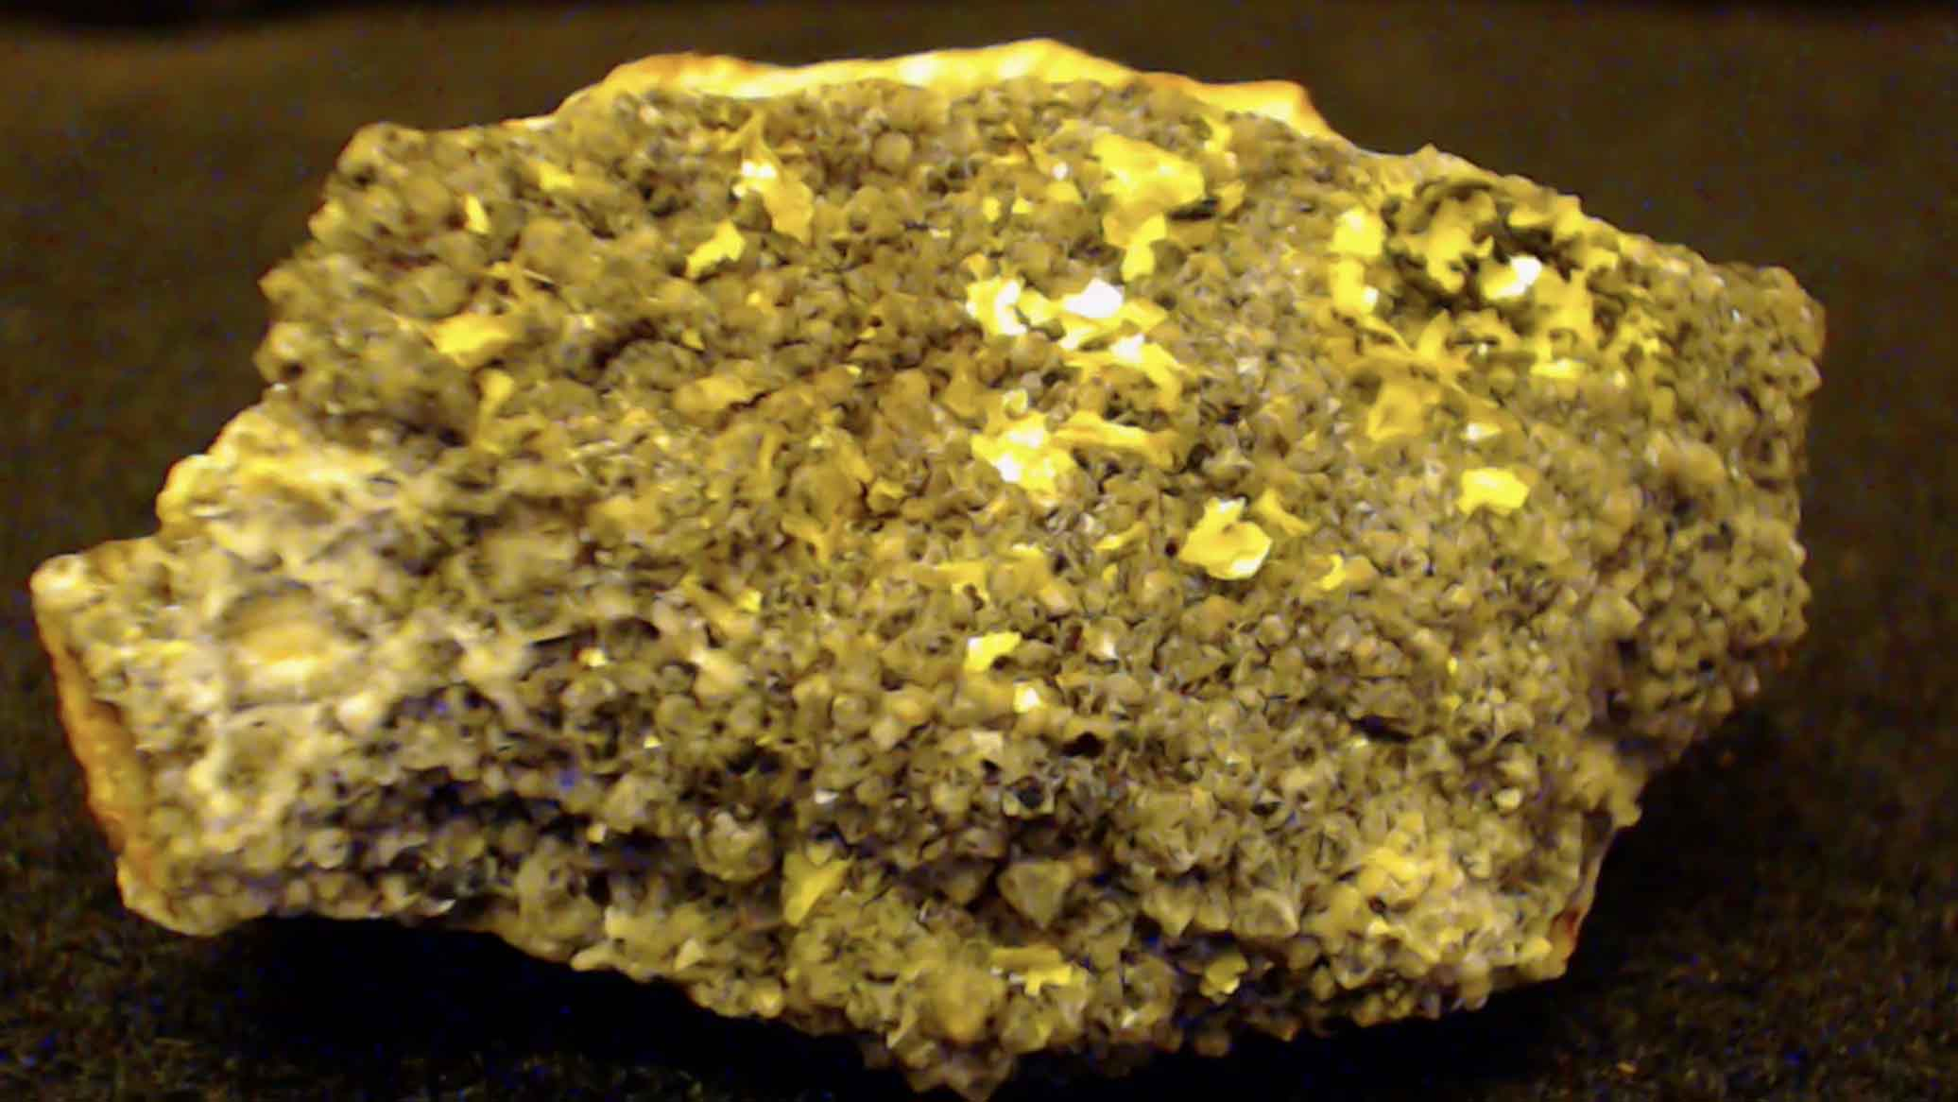
36 years earlier…
1896
Henri Becquerel went to take a picture of Uranium and found the rock took a picture of itself. Radioactivity was discovered.
Curious about the nature of radiation, Marie Curie had the idea to pass different types of radiation through a magnet to see how they behaved. She found 3 different types of radiation α, β, & γ. Alpha (α) was attracted to the negative pole of a magnet and repelled from the positive pole. Alpha particles had the shortest path length. Beta radiation (β) traveled farther than alpha and was attracted to the positive pole while being repelled by the negative pole. And finally gamma radiation (γ) was not attracted or repelled by either magnetic pole. Gamma particles also had the longest path length.
Notes:
Image Sources:
https://cowboystatedaily.com/2020/02/13/industry-leader-wyoming-uranium-industry-on-its-death-bed/
https://m.facebook.com/PhysicistPage/posts/1569894176417228
https://www.nobelprize.org/prizes/physics/1903/marie-curie/biographical/
http://chemed.chem.purdue.edu/genchem/history/gold.html

Slide 6
Notes:
Imagine sitting in the dark for hours on end counting and mapping small flashes of light and doing this for years on end. It sounds pretty tedious. This is exactly the scenario Hans Geiger found himself in in 1908. He was a graduate student working for Earnest Rutherford (who discovered the nucleus). Geiger developed a device called a Geiger Counter that could automatically measure the voltage and number of radiations.

Slide 7
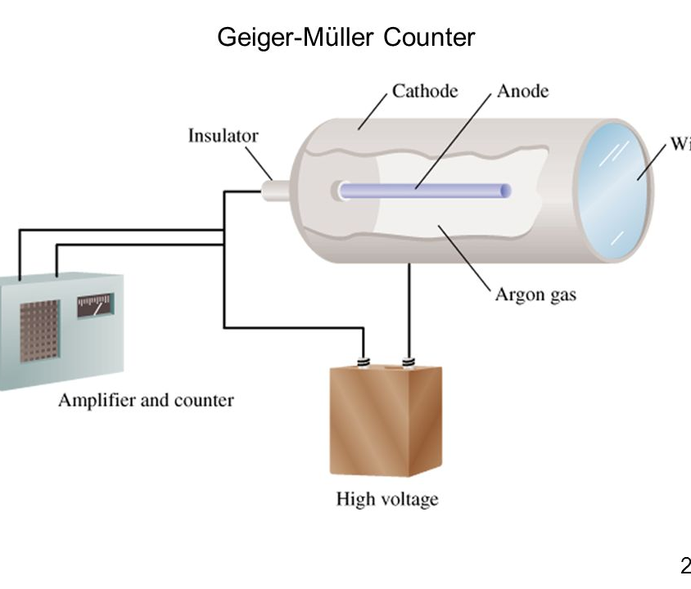
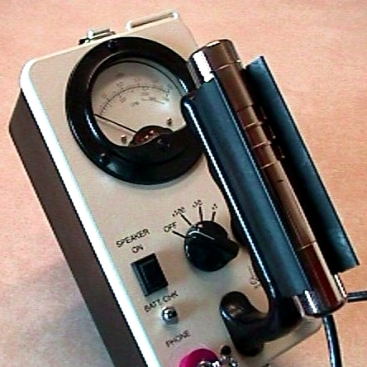
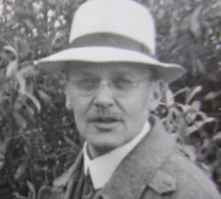
Hans Geiger’s Counter
Electricity only flows in a complete circuit. In a Geiger Counter the circuit is broken and isolated within a metal tube. Any incoming radiation will ionize the gases in the tube completing the circuit. A counter measures the voltage and the number of incoming pulses.
1908
Notes:
Image Sources:
https://slideplayer.com/slide/6999492/
https://www.aps.org/publications/apsnews/201206/physicshistory.cfm
https://www.geigercounters.com/Prospector/

Slide 8
Part II-
The experiment

Slide 9
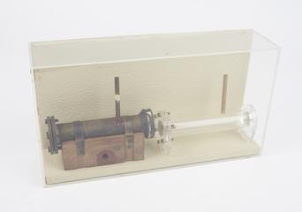
|---- 22 cm ---|
Notes:
Here is a great video that explains quite well what is happening.
https://www.youtube.com/watch?v=_7DAlvRI1M4
Image Sources:
https://collection.sciencemuseumgroup.org.uk/search/categories/nuclear-physics
http://selftution.com/who-discovered-electrons-protons-neutrons-nucleus-discovery-kids/

Slide 10
Beryllium
Paraffin
Protons
Neutrons
What Chadwick Discovered.
α particles
Emission
Chamber
α blocking
Chamber

Slide 11
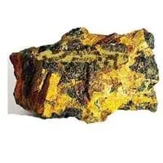
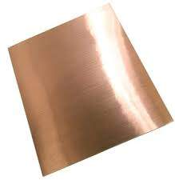
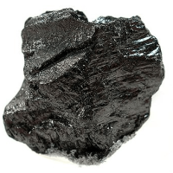
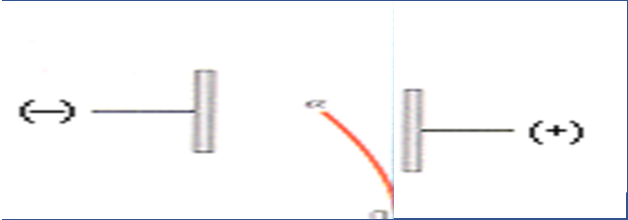
Emitter
$α$Blocker
$$Transformer$$
→
Polonium
Beryllium
Carbon
Paraffin Wax
Unaffected by a magnetic field.
Distance: 1 unit
Distance: 4 units
Notes:
Polonium was discovered to emit particles that did not travel very far and were attracted to a negative magnetic terminal. Beryllium was found to block the emissions of polonium and in the process a film of carbon was deposited on the beryllium sheet. Chadwick wondered if some invisible particle had managed to get through the beryllium and if it could be stopped by anything. He found that whatever was being emitted in the beryllium chamber was transformed by a sheet of paraffin wax. The particles in chamber 3 were found to travel 4 times as far in a magnetic field as the particles in chamber 1.
Image Sources:
Polonium-https://periodic-table.com/polonium/
Beryllium-https://www.justdial.com/Mumbai/b2b/Beryllium-Copper-Sheet/pid-327332544

Slide 12
Based on Chadwick’s observations complete the following table.
Chamber | Charge (+/-) | Relative Mass
1-Polonium Chamber (The Emitter)
2-Beryllium Chamber (The α Blocker) |  | ???
3-Paraffin Chamber (The Transformer) |  | 1
Notes:
Imagine a throwing a snowball. Throwing a giant snowball takes lots of energy. Giant snowballs do not go as far. Small snowballs go farther. Using this reasoning see if you can work out the charges and masses of the particles in each chamber of Chadwick’s experiment.
In this sense, relative means one compared to another not relative as in the sense of Einstein’s relativity.

Slide 13
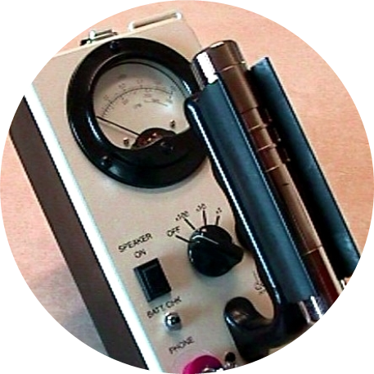
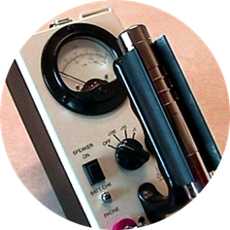
Emitter
$α$Blocker
$$Transformer$$
Polonium
Beryllium
Paraffin Wax
Voltage | 450.0 V
Counts | 16.6 MBq
Voltage | 0.00 V
Counts | 0.00 MBq
Voltage | 450.0 V
Counts | 66.4 MBq
Notes:
After determining the type of radiation in each section. Chadwick placed a Geiger Counter in each compartment to measure the voltage and number of the radiation signal. From this information he was able to demonstrate that neutrons did in fact exist. Incidentally, the leader of the Palestinians n Israel died from ingesting Polonium.
A MBq is a unit relating how many decays per second a radioactive element undergoes. 1 MBq = 1.0x10^6 decays/sec.
Here is Chadwick’s actual paper: https://www.chemteam.info/Chem-History/Chadwick-1932/Chadwick-neutron.html
Image Sources:
Polonium-https://periodic-table.com/polonium/
Beryllium-https://www.justdial.com/Mumbai/b2b/Beryllium-Copper-Sheet/pid-327332544

Slide 14
Part III-
Questions

Slide 15
*Why doesn’t a neutral particle show up on a Geiger Counter?
* What do you notice about the Geiger counts of the number of alpha (α) particles compared to the number of protons?

Slide 16
A common formula for determining speed is Speed = Length * Frequency.
* Using the length of the device and the Geiger counts, estimate the speed of the particles.

Slide 17
The energy of motion is called kinetic energy. The formula for kinetic energy = ½ mass * velocity²
*Use your estimate of particle speeds and relative masses to determine the kinetic relative kinetic energy of the particles.

Slide 18
What is the Law of Conservation of Energy?
If the energy of the α particles must be equal to the energy of the protons, which must also be equal to the energy of the neutrons, what is the relative mass of a proton compared to a neutron?

Slide 19
If you had done this lab in 1932 you would have won the 1935 Nobel Prize!!
Notes:
Image Sources:
https://www.amazon.com/Jumbo-Extra-Large-Congratulations-Greeting-Card/dp/B07P75BK9H
https://www.nobelprize.org/prizes/facts/nobel-prize-facts/

