Slide 1
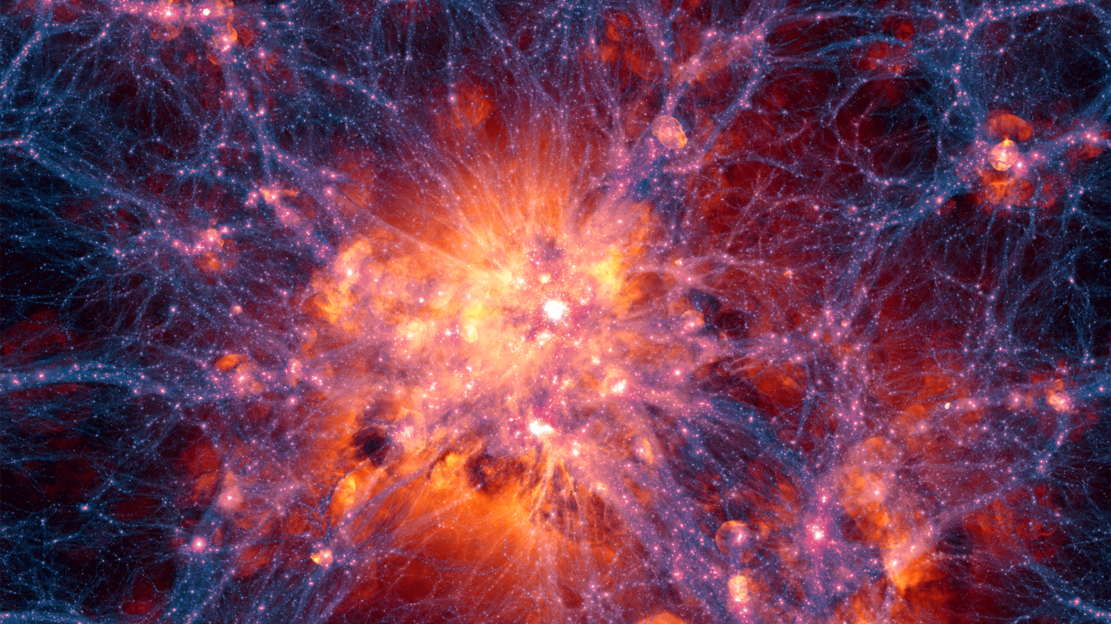
This is the universe.
(Or at least a computer simulation of it.)

Slide 2
The universe is made of 2 parts
related by a single equation.

Slide 3
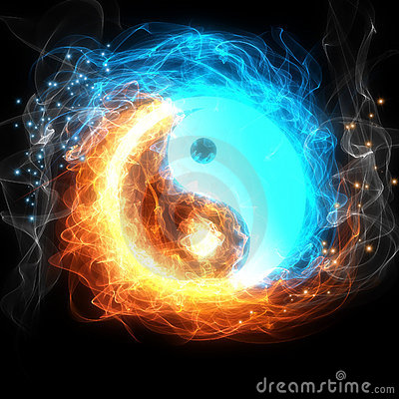
Energy is what powers the universe.
Mass is what makes up the universe.
E = mC²

Slide 4
Energy moves mass.
Mass stores energy.

Slide 5
We don’t really know what makes up energy. It might be fundamental.
Atoms, molecules, & a host of sub-atomic parts make up all matter.

Slide 6
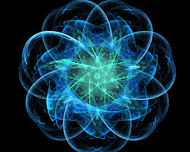
Atom
Nucleus =
(Protons +
&
Neutrons 0)
Electrons
* Not to Scale!

Slide 7
If an atom were to scale…
Hawthorn Academy
Grain of Salt
(Electron)
Basketball
(Nucleus)

Slide 8
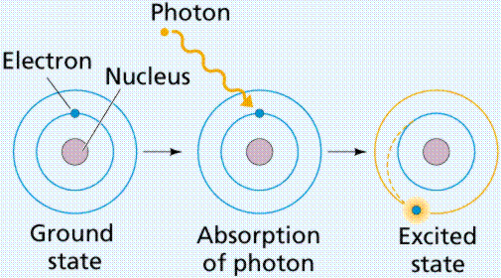
Excitation → (Absorbs Light)
← Relaxation (Emits light)

Slide 9
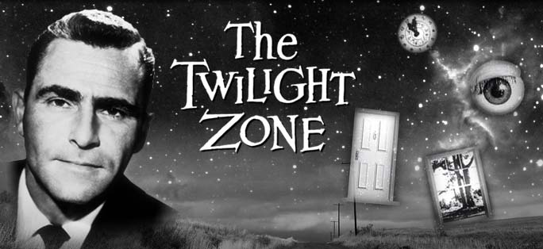
Imagine if you will…

Slide 10
Mr. Boom is an electron…

Slide 11
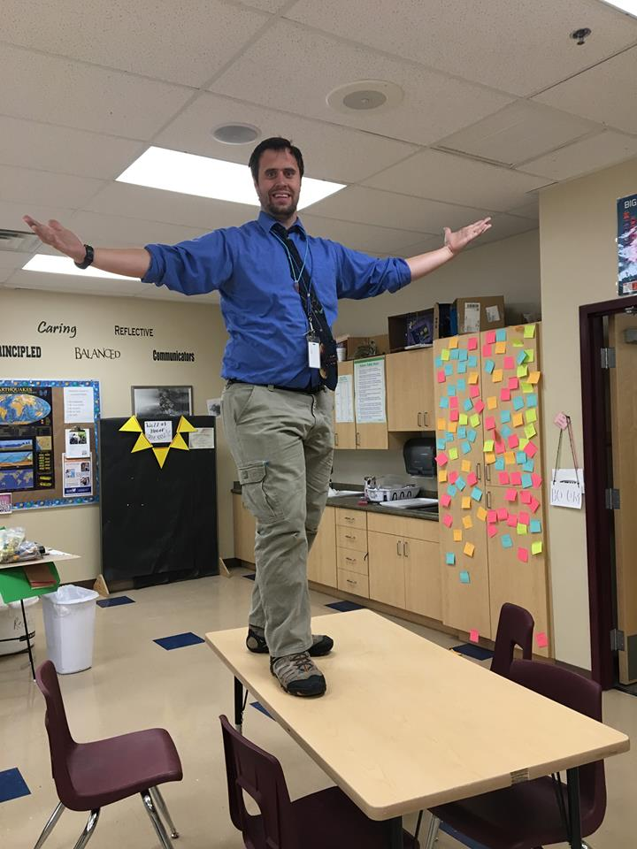
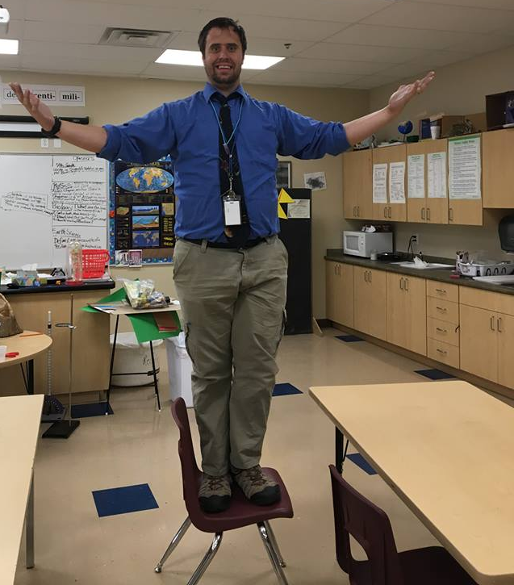
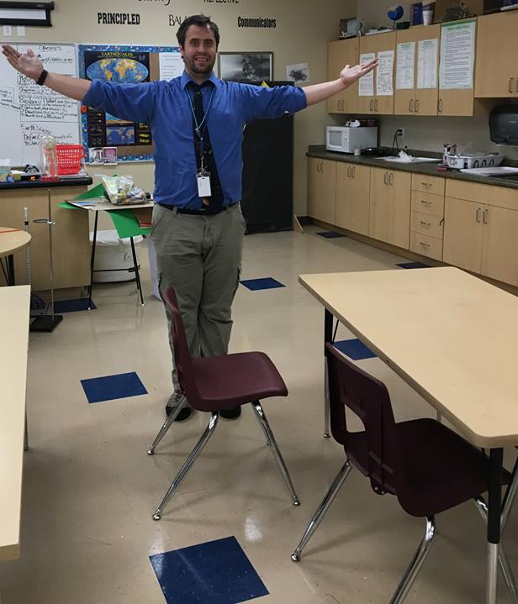
Energy
Energy
Ground State
Intermediate State
Excitation
Excited State

Slide 12
Energy
Energy
Ground State
Intermediate State
Emission
Excited State

Slide 13
Excitation → (Absorbs Light)
← Relaxation (Emits light)

Slide 14
Light is a wave.
The color of light can be thought of as
its length…
or equivalently, as its frequency.

Slide 15
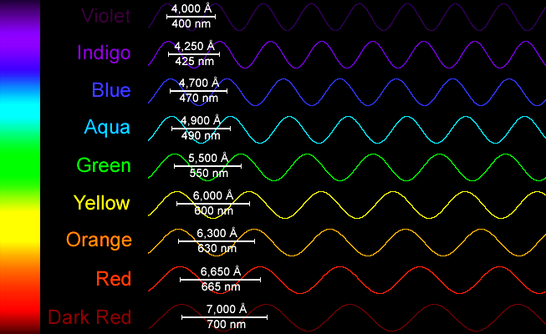
Except its
10 million times
smaller!

Slide 16
This next table, y’all should know.
I mean it. Spend some time going over it.

Slide 17
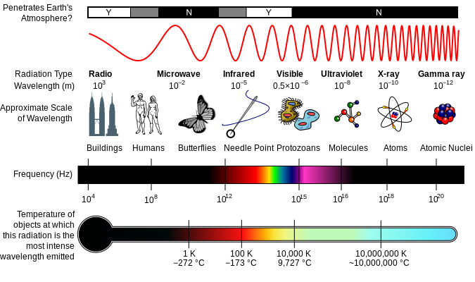

Slide 19
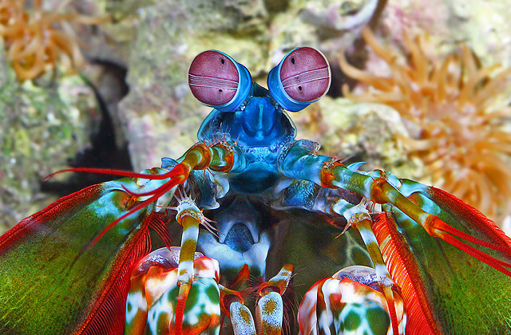

Slide 20
Reflections

Slide 21
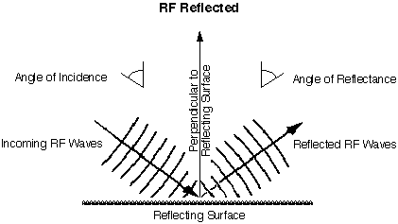

Slide 22
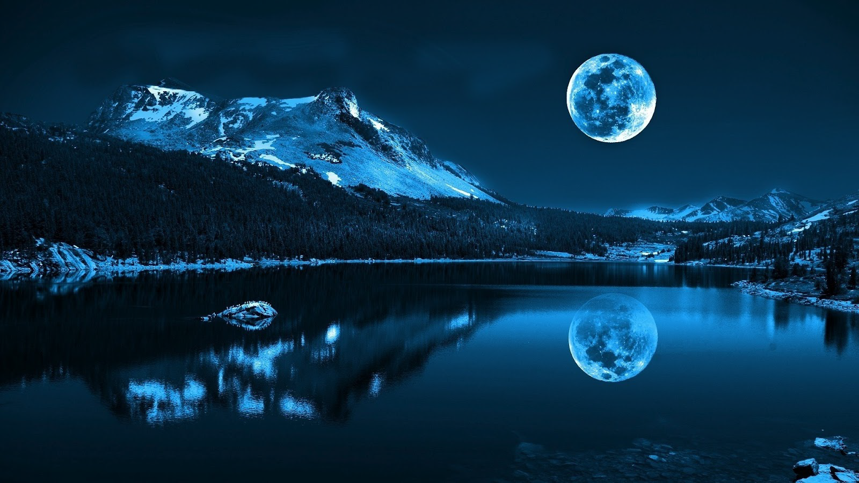

Slide 23
Refractions

Slide 24
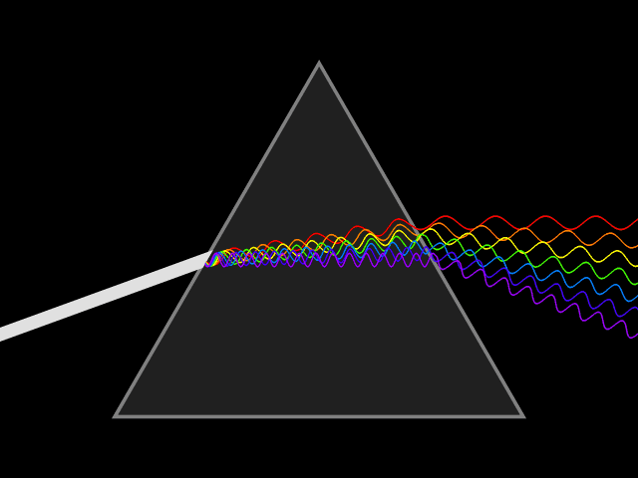
Refraction

Slide 25
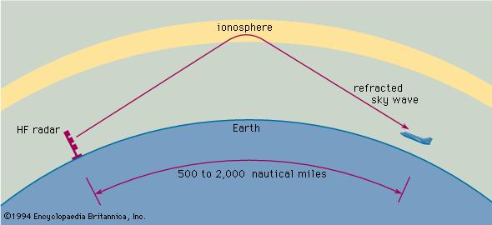
How RADAR works

Slide 26
Diffractions

Slide 27
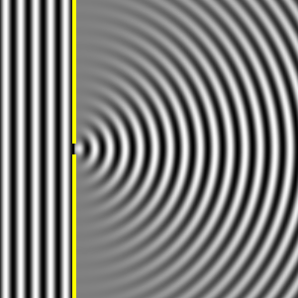
Diffraction

Slide 28
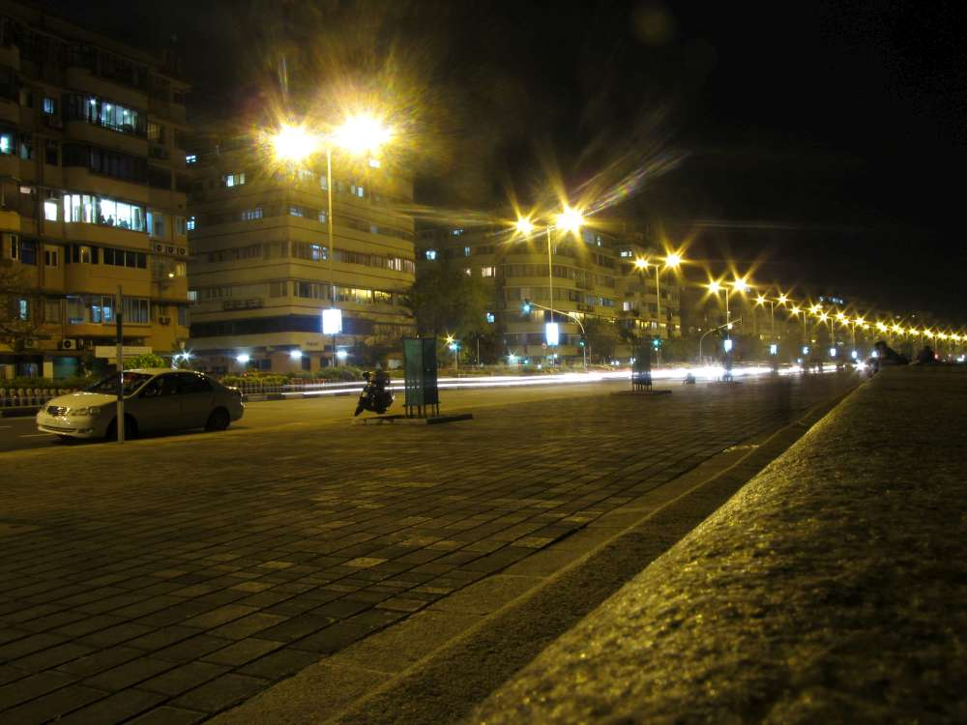

Slide 29
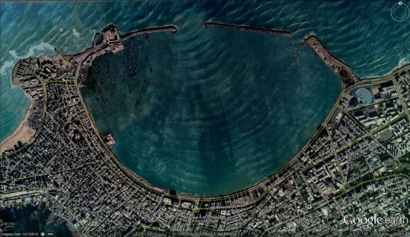

Slide 30
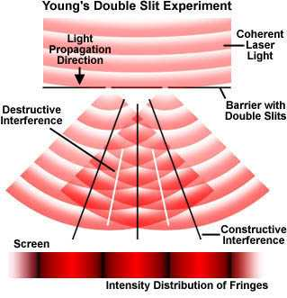
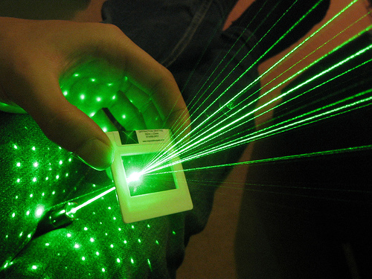
Multi-slit
diffractions

Slide 31
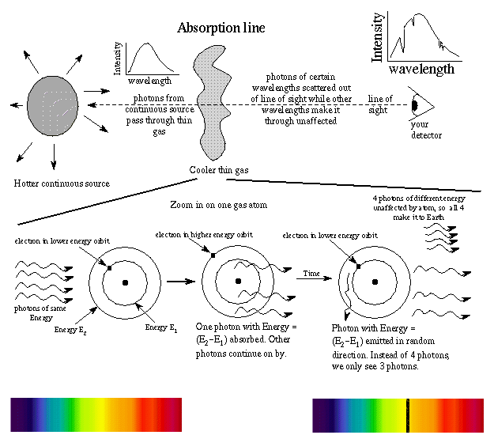

Slide 32
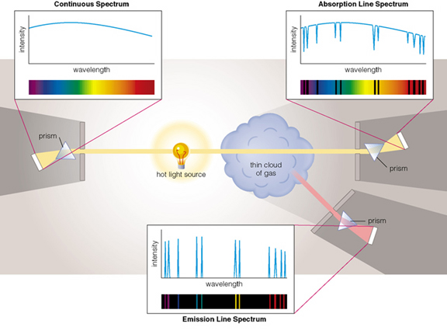

Slide 33
Continuous Spectrum
Absorption Spectrum
Emission Spectrum

Slide 34
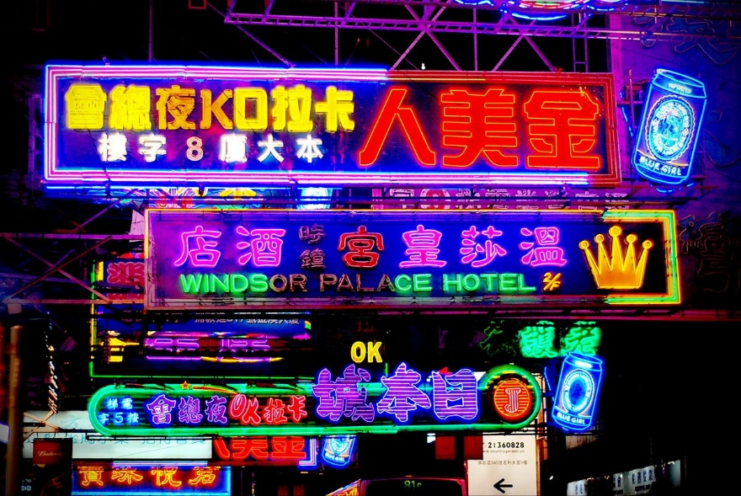

Slide 35
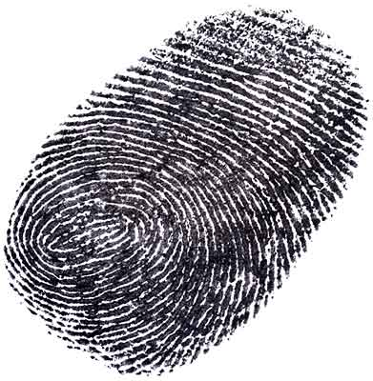
When detectives match a fingerprint,
they look carefully at the details
then they compare it to knowns.

Slide 36
When scientists match spectra,
they look carefully at the details
then they compare it to knowns.

Slide 37
Here are the known spectra…

Slide 38
http://chemistry.bd.psu.edu/jircitano/periodic4.html

Slide 39
Question 1-
This is the spectrum of the sun.
What is it made of?
* Hint: Compare it to the previous slide.

Slide 40
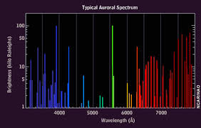
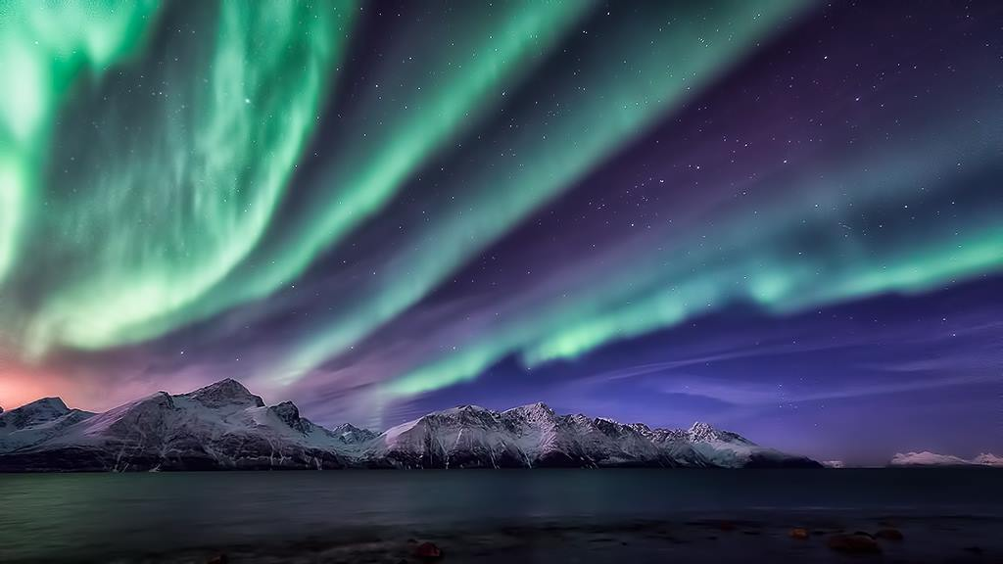
Question 2-
This is the spectra of an aurora. What is it made of?
*Hint: Go back 2 slides and compare

Slide 41
Question 3-
Materials Needed for Life | Materials Toxic to Life
Complete the table (3-5 each is good):

Slide 42
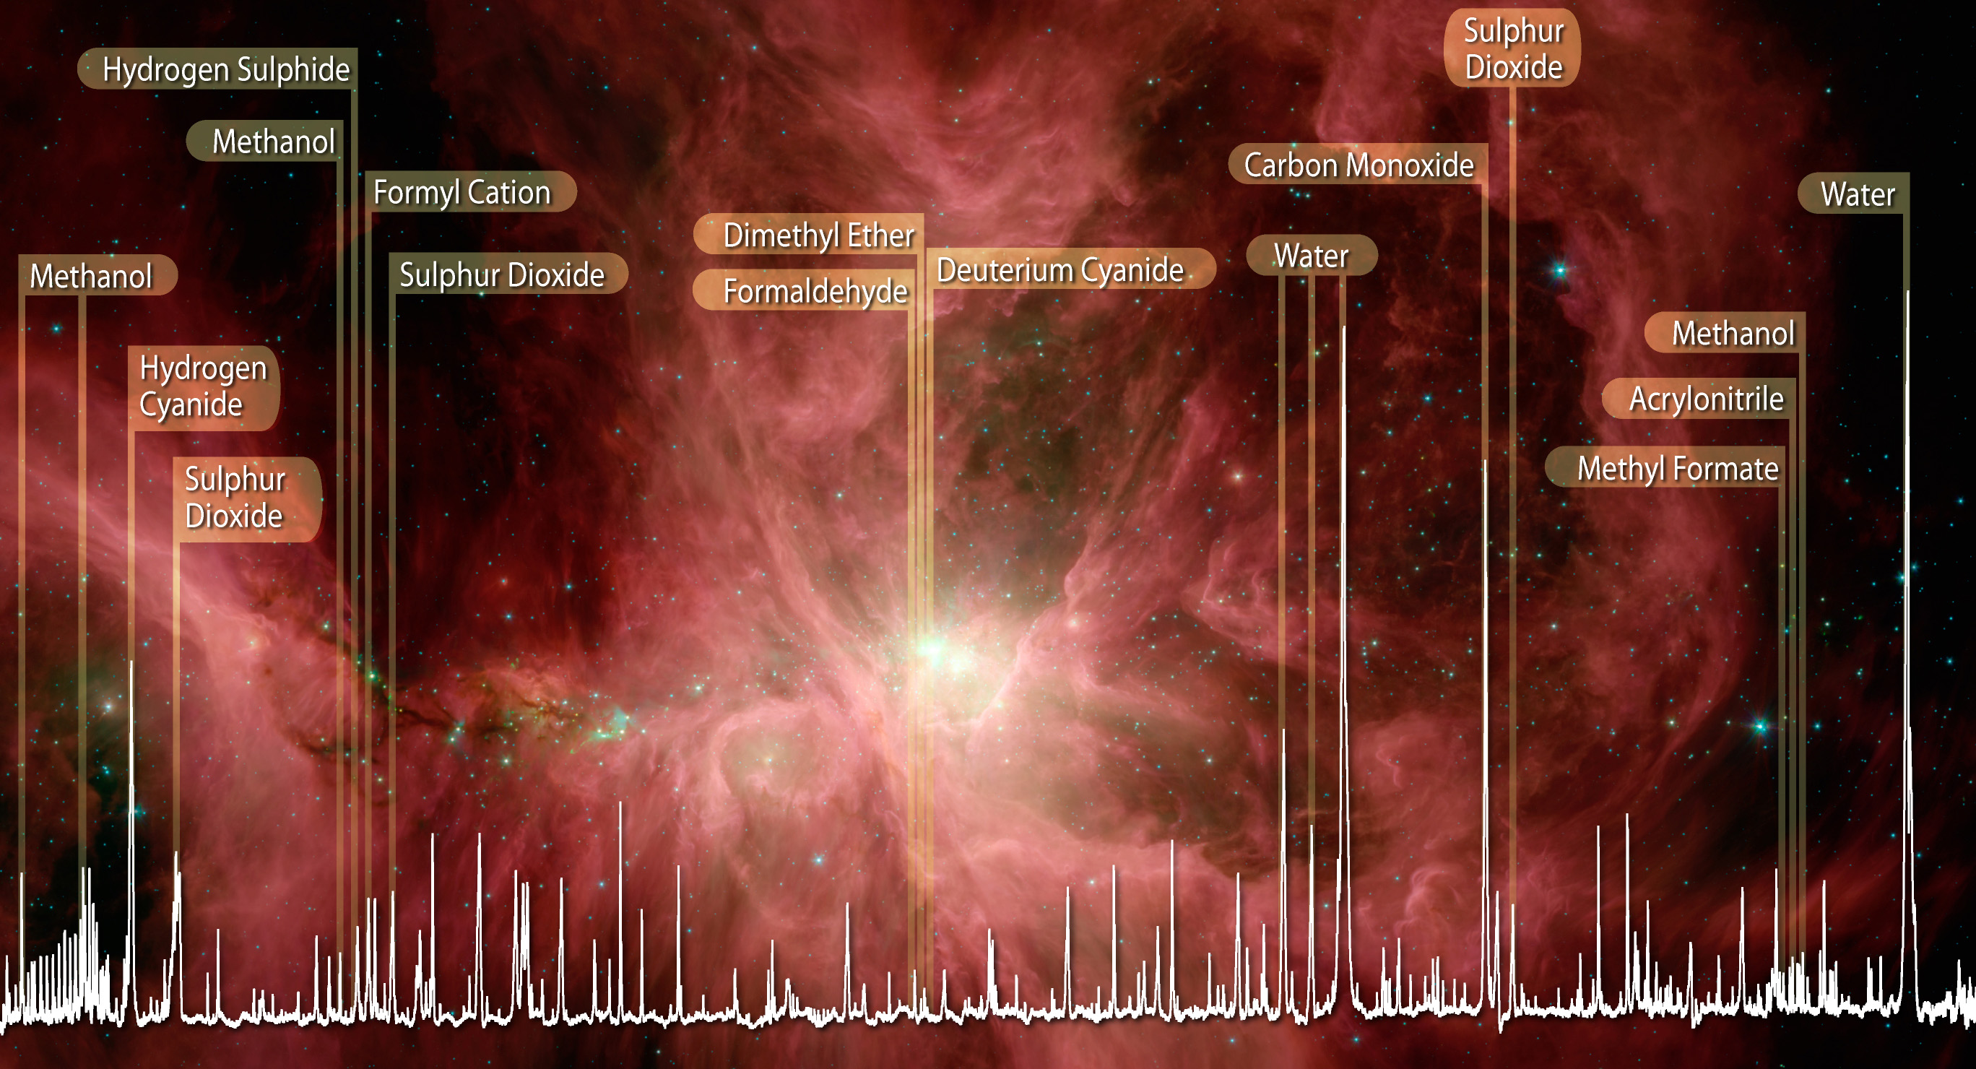
Question 4-
The picture to the right is from the Orion Nebula 1,300 light years away. Based on Question 3, do you think the Orion Nebula is a place that could support life?

Slide 43
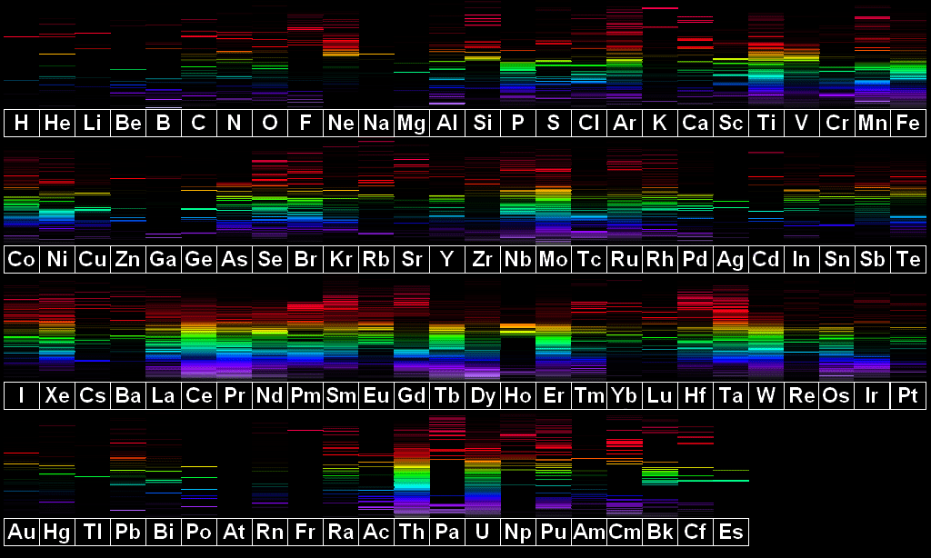
Question 5-
Pick an object. What is it made of?
What would its spectra look like?

Slide 44
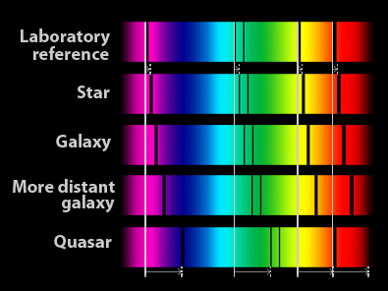
Question 6-
Here are some actual spectra.
-What do you observe?
-How does distance relate to what you see?
-Come up with a possible explanation.

Slide 45
Caution!
Access websites at your own peril.

Slide 46
Image Sources
http://www.symmetrymagazine.org/sites/default/files/styles/2015_hero/public/images/standard/illustris_box_dmdens_gasvel.png?itok=5df3svUn
cdn.wallpapersafari.com/46/50/lghgzv.png
https://www2.estrellamountain.edu/faculty/farabee/biobk/excitation.gif
http://cdn.segmentnext.com/wp-content/uploads/2015/07/Half-Life.jpg
https://alchetron.com/Viktor-Rydberg-1154841-W
https://upload.wikimedia.org/wikipedia/commons/thumb/d/df/Max_Planck_1901.GIF/220px-Max_Planck_1901.GIF
http://www.universetoday.com/wp-content/uploads/2015/02/einstein1_7.jpg
http://lasp.colorado.edu/~bagenal/3720/CLASS5/06-14.jpg
http://www.astronomynotes.com/light/absorptnb.gif

Slide 47
francescopochetti.com/tag/sky/
By Inductiveload, NASA - self-made, information by NASABased off of File:EM_Spectrum3-new.jpg by NASAThe butterfly icon is from the P icon set, P biology.svgThe humans are from the Pioneer plaque, Human.svgThe buildings are the Petronas towers and the Empire State Buildings, both from Skyscrapercompare.svg, CC BY-SA 3.0, https://commons.wikimedia.org/w/index.php?curid=2974242
https://aqua.org/~/media/Images/Animals/Mantis%20Shrimp/animals-mantisshrimp-slide1-web.jpg
https://www.wwu.edu/depts/skywise/img/light_spectrum.bmp
http://www.fieldtestedsystems.com/download/PeriodicTableOfSpectra.png
http://2.bp.blogspot.com/-NYxrSJfNJ70/VGEL4-TBXwI/AAAAAAAAICE/sueObHOSBik/s1600/spectral%2Blines%2Bwith%2Bsolar.PNG

Slide 48
http://www.softservenews.com/photos/large/1403081_560684567338875_1243713410_o.jpg
https://www.meted.ucar.edu/sign_in.php?go_back_to=http%253A%252F%252Fwww.meted.ucar.edu%252Fhao%252Faurora%252Fimages%252Fauroral_spectra.jpg#
https://www.wired.com/images_blogs/wiredscience/2010/03/moleculespectra-crop.jpg
https://upload.wikimedia.org/wikipedia/commons/f/f5/Light_dispersion_conceptual_waves.gif
https://i.stack.imgur.com/PKDR2.gif
http://biz-solutionz.com/IMG_0576.JPG
https://d2gne97vdumgn3.cloudfront.net/api/file/07s5okTC2IRlBi5vzbEA
http://galileo.phys.virginia.edu/classes/USEM/SciImg/home_files/introduction_files/doubleslit.jpg

Slide 49
https://i2.wp.com/adventuresofagoodman.com/wp-content/uploads/2013/01/Neon-signs-all-over-the-streets-of-Hong-Kong-and-Kowloon-.jpg
http://2.bp.blogspot.com/-mDuoKNroGxw/UvLZM-m5TlI/AAAAAAAAVRg/IBNe8vi2MKc/s1600/reflection.png
http://www.qrg.northwestern.edu/projects/vss/docs/media/Communications/reflection.gif
https://www.cmu.edu/police/programsandservices/ss-36224968-fingerPrint.jpg

