Slide 1
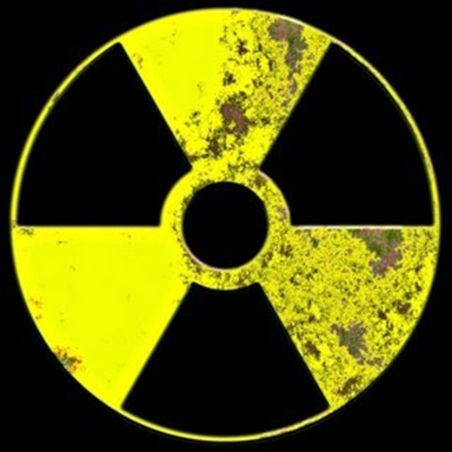
Nuclear
Science

Slide 3
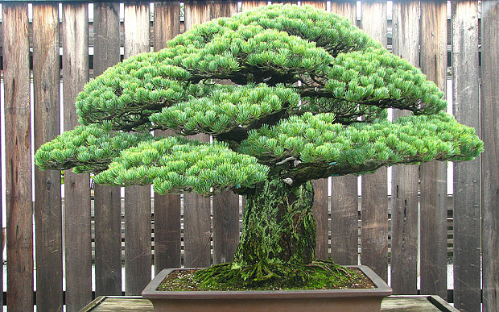
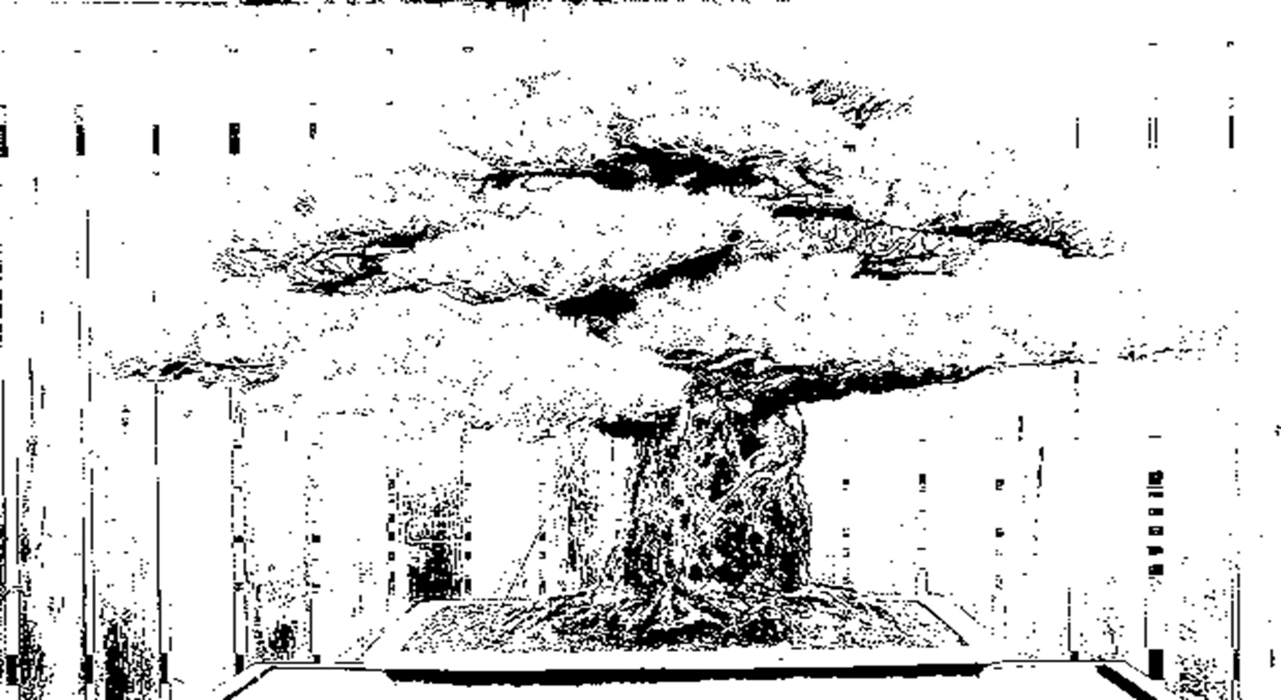
http://ourworldindata.org/data/war-peace/nuclear-weapons/
Watch the Video!

Slide 4
http://images.onset.freedom.com/ocregister/nsmyrt-abomb70.gif
http://www.conservativeoutfitters.com/blogs/news/78912385-1946-hd-video-footage-of-atomic-bomb-destruction-hiroshima-nagasaki

Slide 5
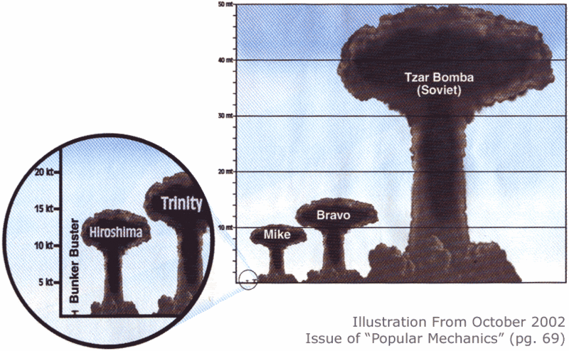

Slide 6
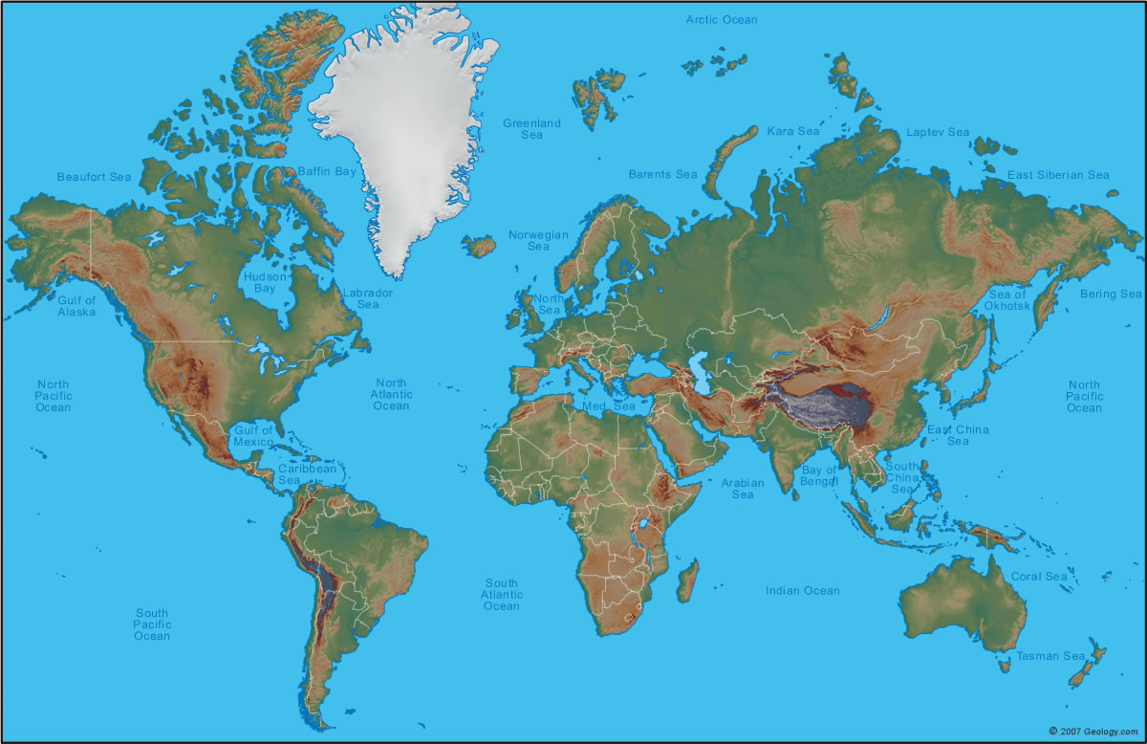

Slide 7
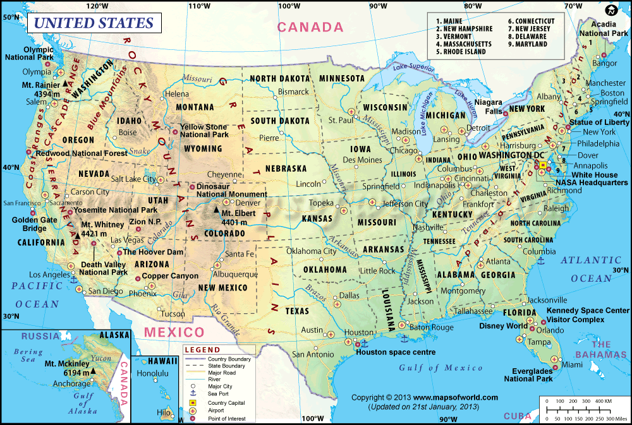

Slide 9
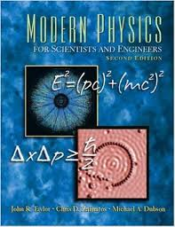
Let’s Solve Some Problems

Slide 11
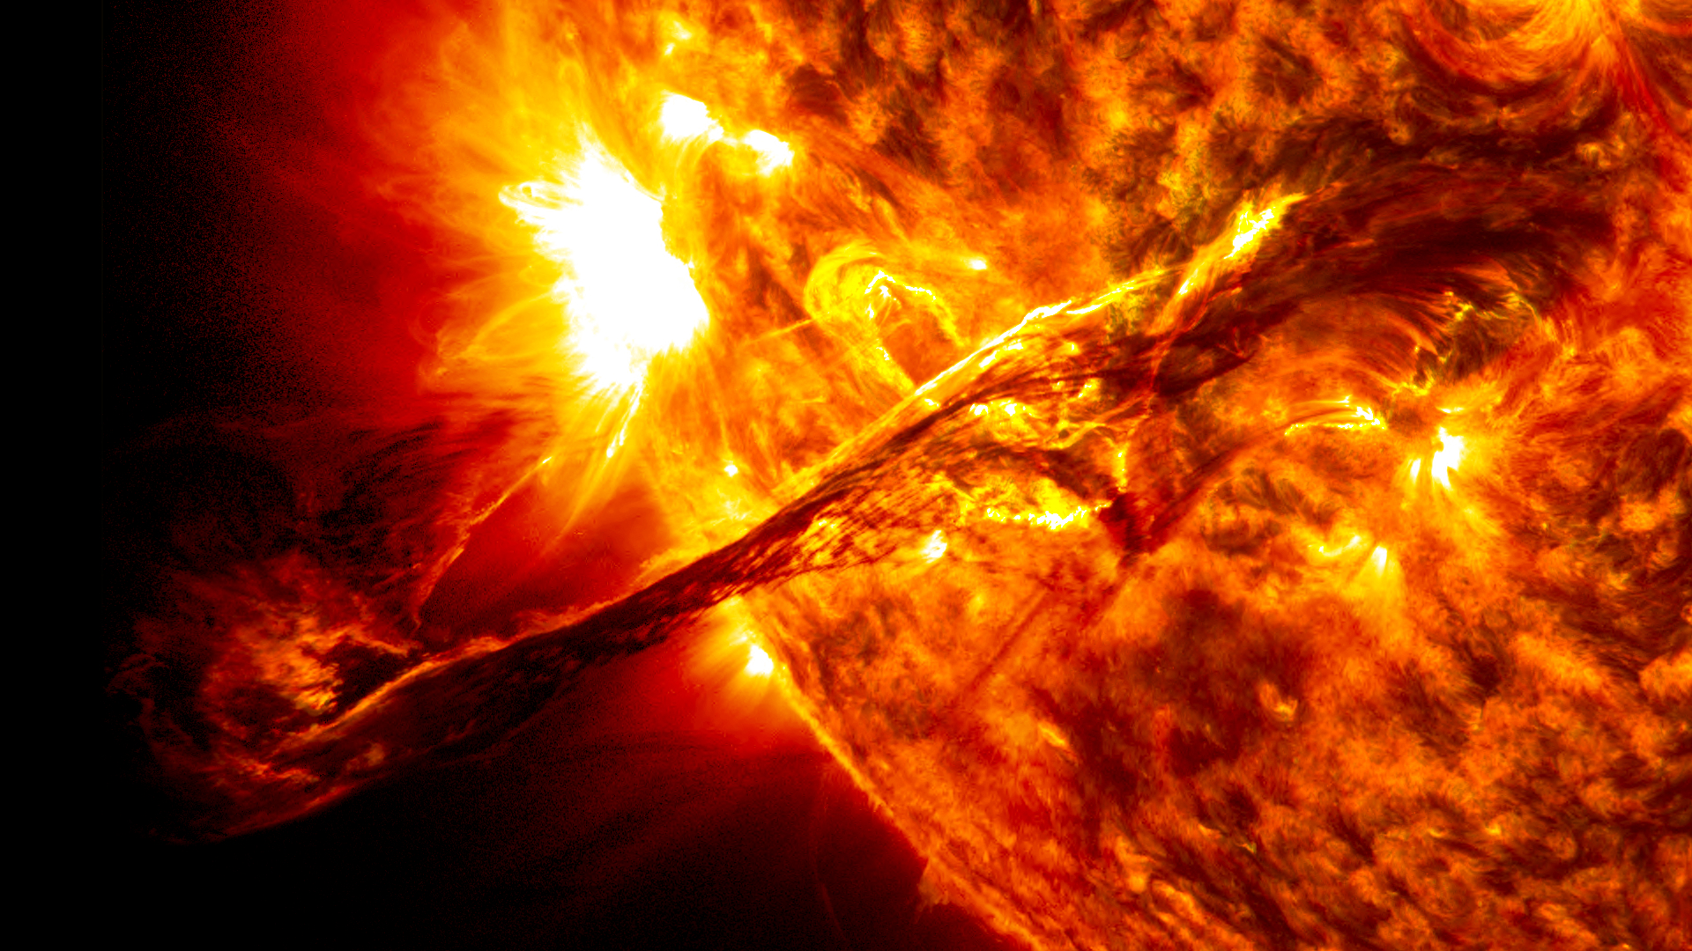
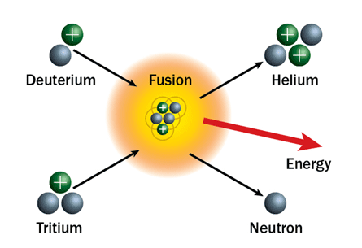
Fusion

Slide 12
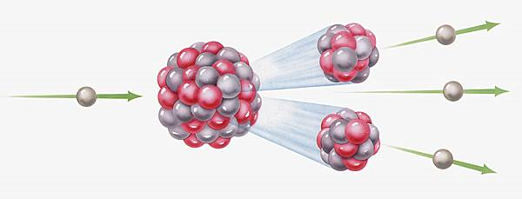
Fission

Slide 13
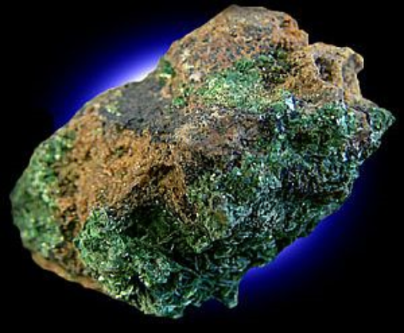
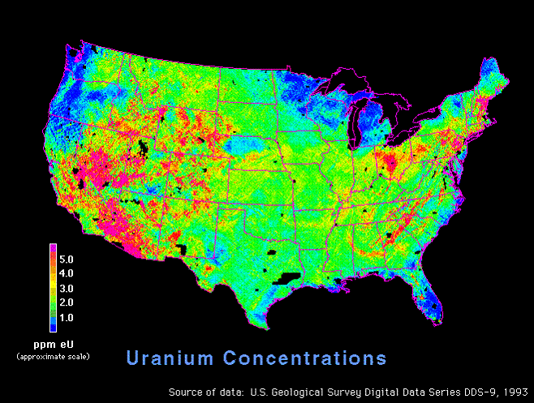
Uranium 238

Slide 15
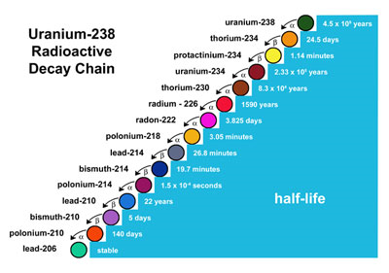

Slide 16
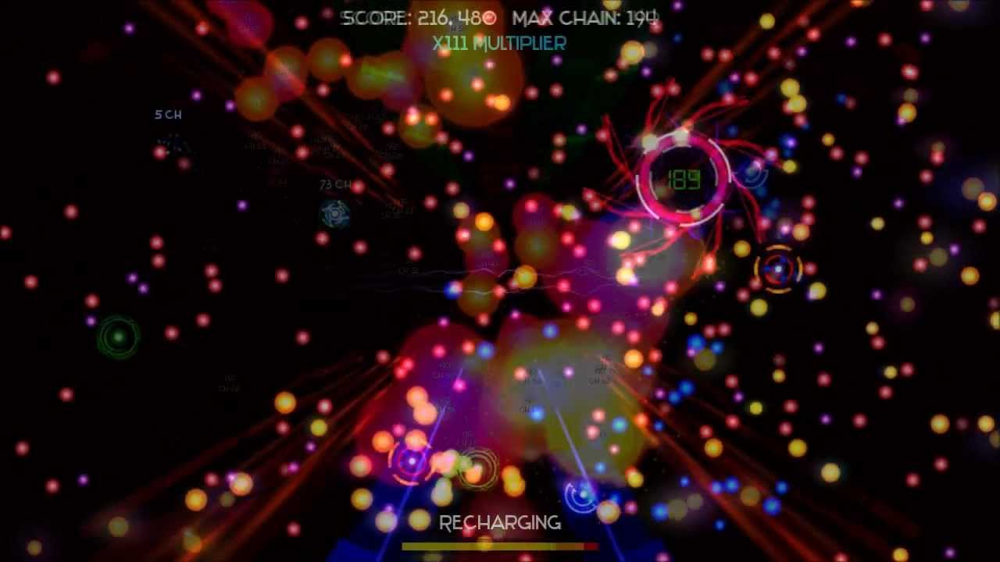
Play
http://www.yvoschaap.com/chainrxn/

Slide 17
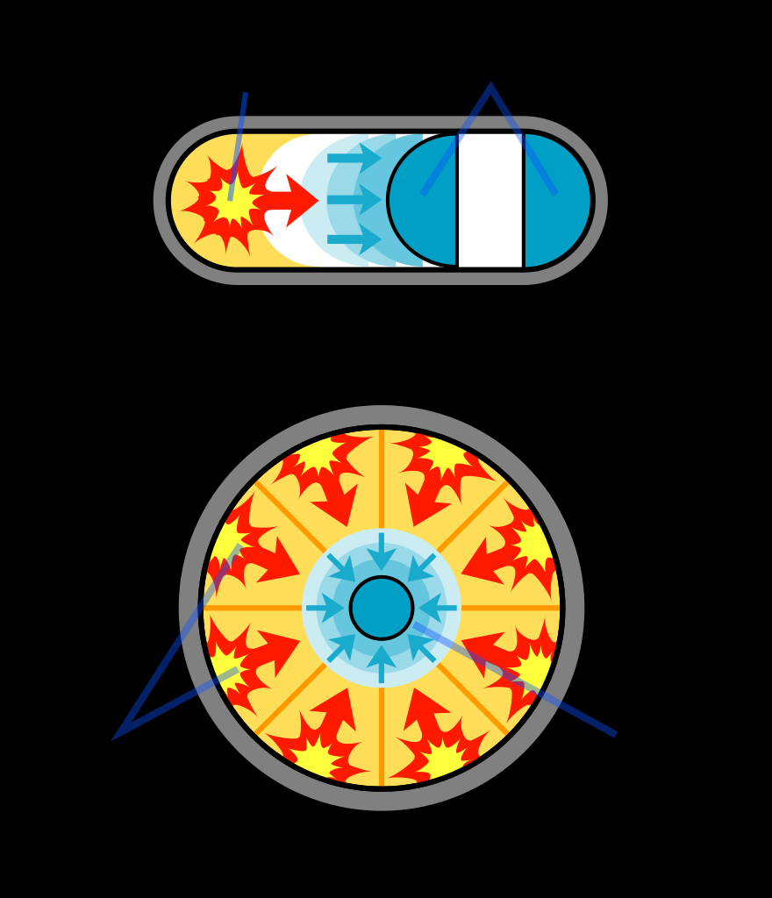

Slide 18
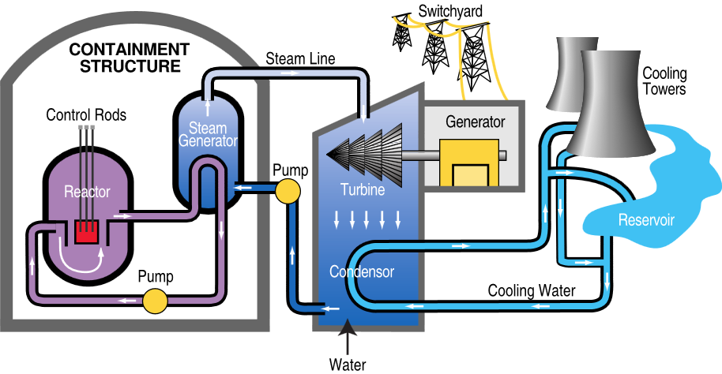

Slide 19
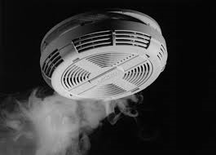
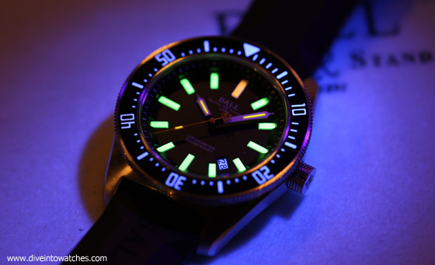
Other Uses

Slide 20
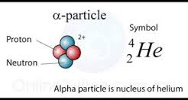
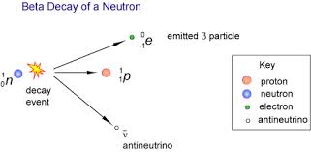
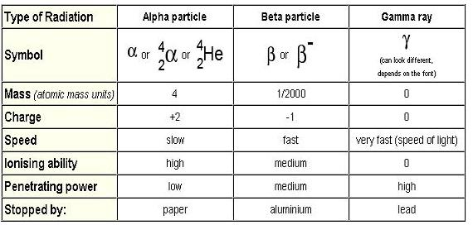
Gamma

Slide 21
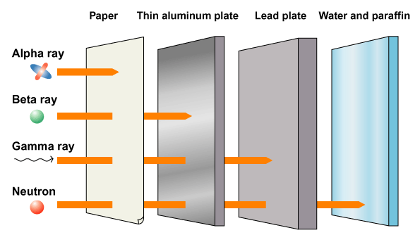
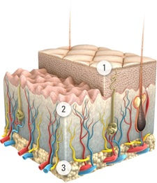
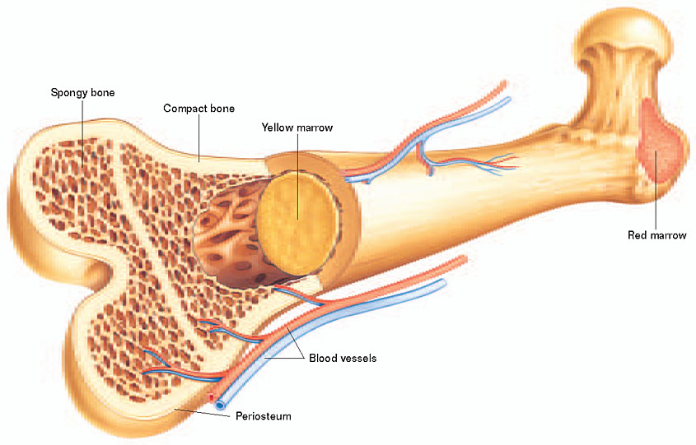
Skin
Bone

Slide 22
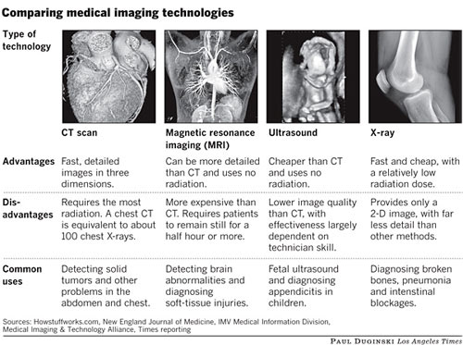

Slide 24
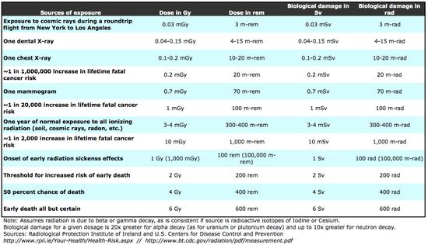
Dosages

Slide 25
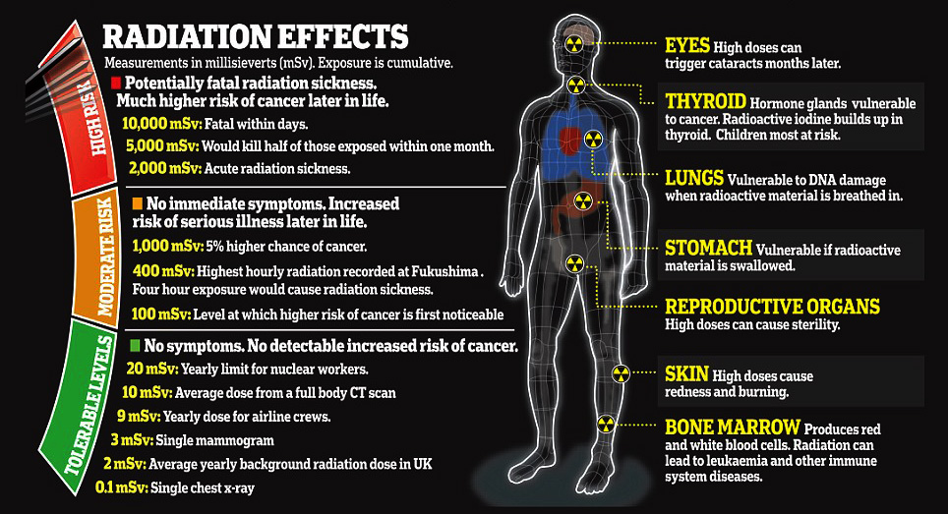

Slide 26
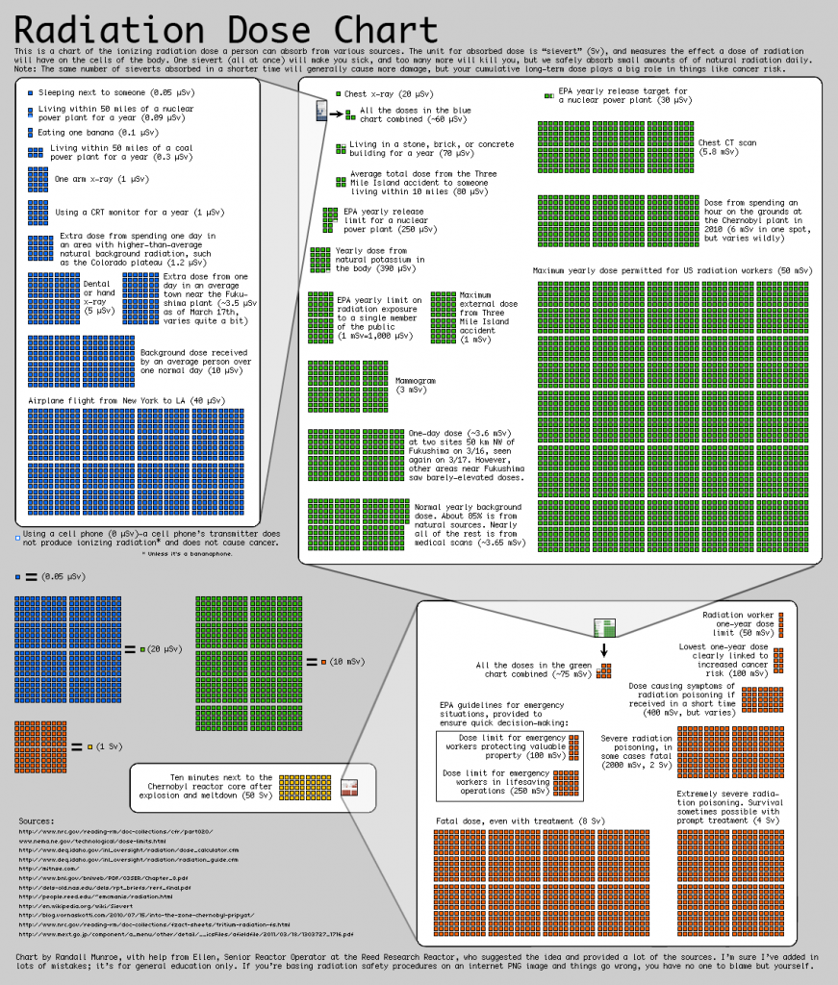

Slide 27
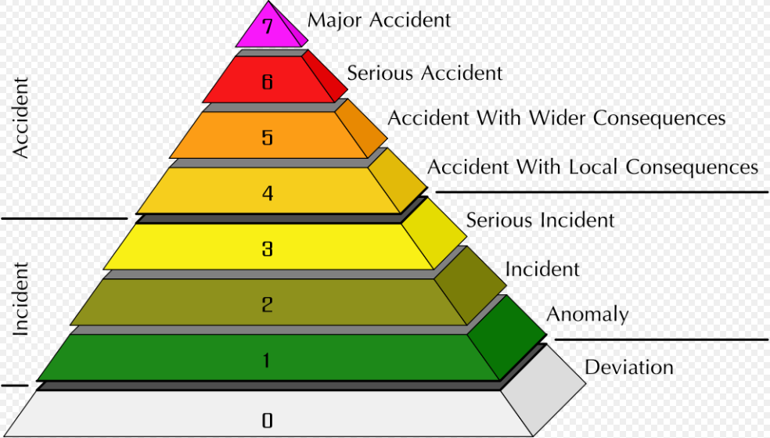
Problems
https://en.wikipedia.org/wiki/International_Nuclear_Event_Scale

Slide 28
Chernobyl

Slide 29
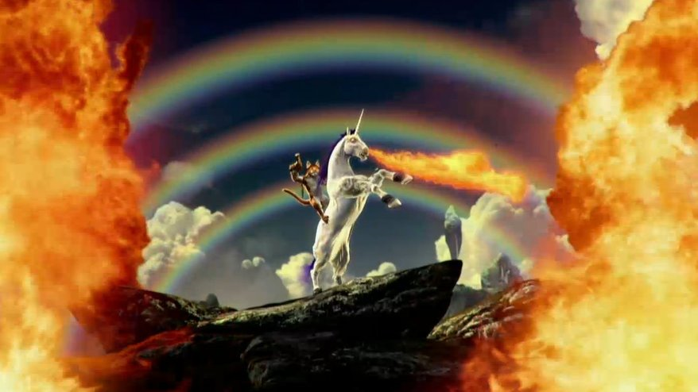

Slide 30
Sources
http://aphs.worldnomads.com/safetyhub/12392/radiation_warning_symbol_rusty_450.jpg
http://missions.llnl.gov/content/assets/images/nonproliferation_images/earthquake_lg.jpg
http://ourworldindata.org/data/war-peace/nuclear-weapons/
https://upload.wikimedia.org/wikipedia/commons/thumb/c/cb/Fission_bomb_assembly_methods.svg/880px-Fission_bomb_assembly_methods.svg.png
http://images.onset.freedom.com/ocregister/nsmyrt-abomb70.gif
https://s-media-cache-ak0.pinimg.com/originals/9e/9a/6f/9e9a6f8fec487bde9f9a64f17e90c757.jpg
http://i.telegraph.co.uk/multimedia/archive/03399/Hiroshima_Bonsai_3399547b.jpg
https://images.angelpub.com/2010/31/5427/uranium.jpg
http://energy.usgs.gov/portals/0/Rooms/uranium/images/uranium_concentrations.gif
http://int.eucerin.com/~/media/Eucerin/international/skin-concerns/ageing-skin/loss-of-density/EUCERIN-SC-ageing-skin-loss-of-density-01.jpg?mw=225

Slide 31
http://medicojockey.com/wp-content/uploads/2015/05/bone-marrow.jpg
https://geoinfo.nmt.edu/resources/uranium/images/decaychain.jpg
http://media2.fdncms.com/boiseweekly/imager/producers-guild-nominations-boyhood-i/u/magnum/3377857/film-reels.jpg
https://dr282zn36sxxg.cloudfront.net/datastreams/f-d%3Abe34d301907e32f966ebde74572a3fb0ab8098bba0b1a26810199b28%2BIMAGE_THUMB_POSTCARD%2BIMAGE_THUMB_POSTCARD.1
http://www.mapsofworld.com/usa/images2011/usa-map.gif
http://geology.com/world/world-physical-map.jpg
https://i.ytimg.com/vi/MiQlbjutkCQ/maxresdefault.jpg
http://i0.wp.com/dutchsinse.com/wp-content/uploads/2015/08/maxresdefault.jpg
http://36646d87786feafc0611-0338bbbce19fc98919c6293def4c5554.r0.cf1.rackcdn.com/images/f0ZqzI9lAX0U.878x0.Z-Z96KYq.jpg
https://qph.is.quoracdn.net/main-qimg-aa26ef9d58c54e40903d37676cfe8a35?convert_to_webp=true
https://upload.wikimedia.org/wikipedia/commons/a/a3/Giant_prominence_on_the_sun_erupted.jpg
http://www-dsm.cea.fr/Images/astImg/275_2.jpg

Slide 32
https://www.scientificsonline.com/media/images/originals/3153161_periodic_table_small_file_.jpg
http://safesoundfamily.com/wp-content/uploads/2012/12/smoke-detector-monitoring-system.jpg
https://cdn3.bigcommerce.com/s-eoxbhh/product_images/uploaded_images/fiestaware-photo.jpg?t=1421946005
http://www.watchtime.com/cms/wp-content/uploads/2015/04/Ball_Watch_Co_Master_Engineer_II_Skindiver_II_Lume_Baselworld_2015_regular.jpg
http://accesssafety.biz/wp-content/uploads/2011/03/radiation3-871x1024.png
Pages 345-351 In Earth Science Book
http://thebreakthrough.org/blog/RadiationInContext-thumb-550x316.jpg?vm=r&s=1

