Slide 1
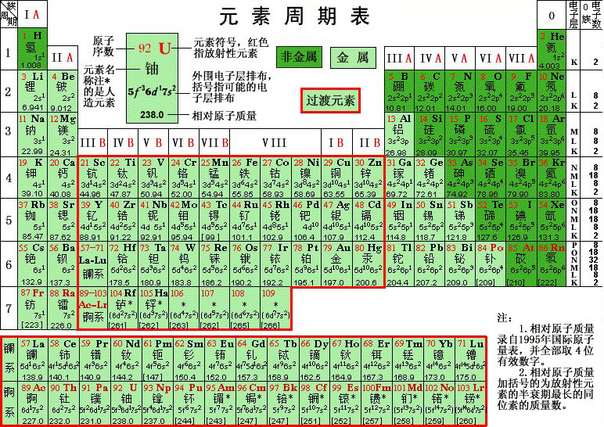
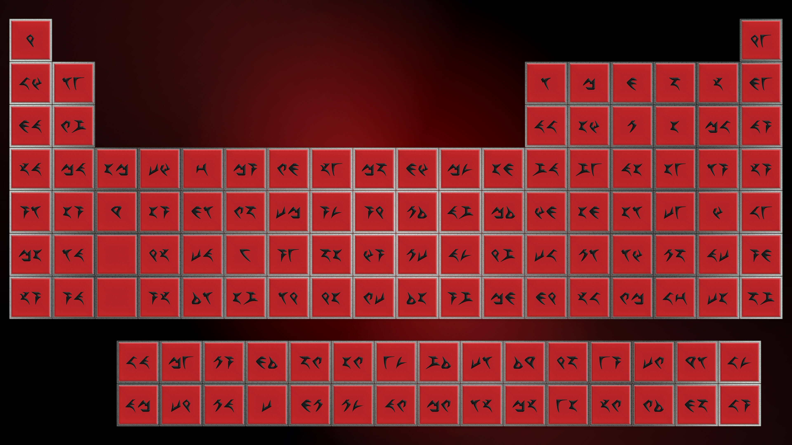
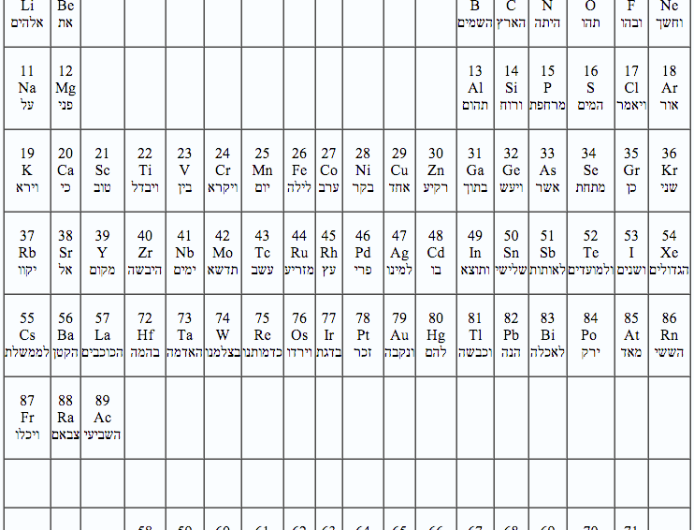
Periodic Tables
Notes:
https://www.meta-synthesis.com/webbook/35_pt/pt_database.php?Button=All_by_name

Slide 2
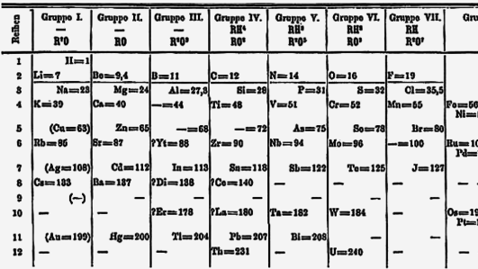
Dimitri Mendeleev, 1871

Slide 3
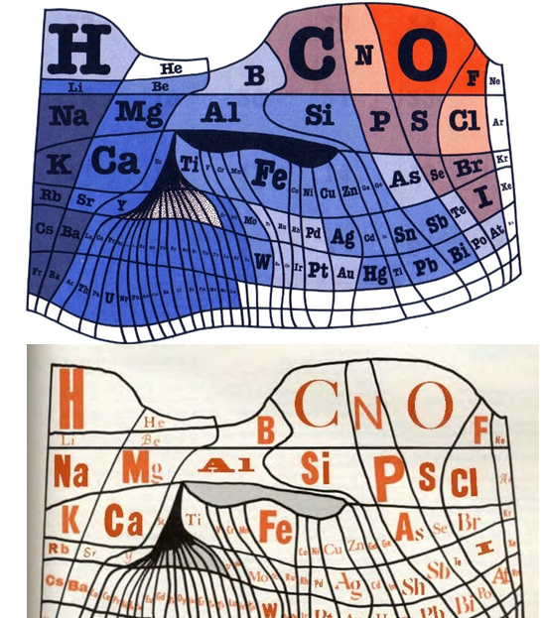
1976, William Sheehan

Slide 6
Left Step Periodic Table
Charles Janet, 1928

Slide 7
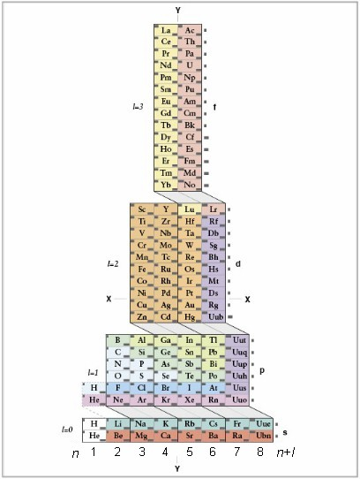
ADOMAH
Valery Tsimmerman, 2006

Slide 8
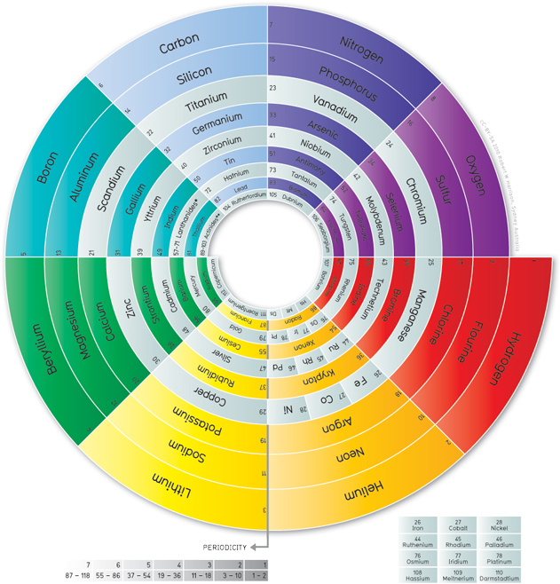
Spiral Periodic Table
Robert Harrison, 2010
Notes:
By Robert W Harrison - http://spiralperiodictable.com/, CC BY-SA 3.0, https://commons.wikimedia.org/w/index.php?curid=14653057

Slide 9
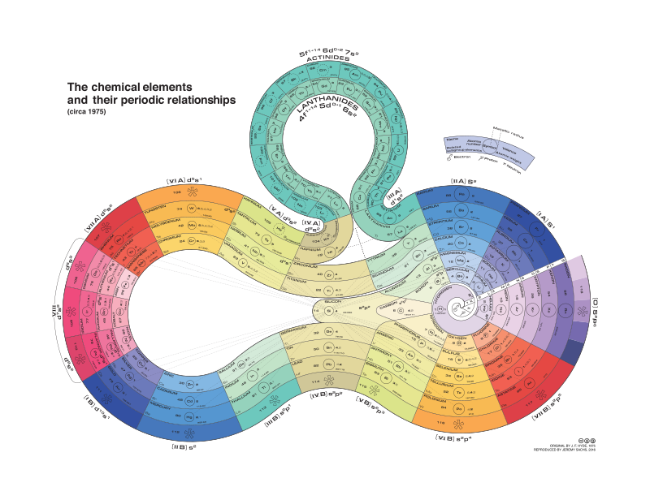
Notes:
By Rezmason - Own work, CC BY-SA 4.0, https://commons.wikimedia.org/w/index.php?curid=54218895

Slide 10
Notes:
https://elements.vanderkrogt.net/multidict.php

Slide 11
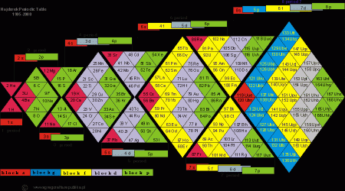

Slide 12
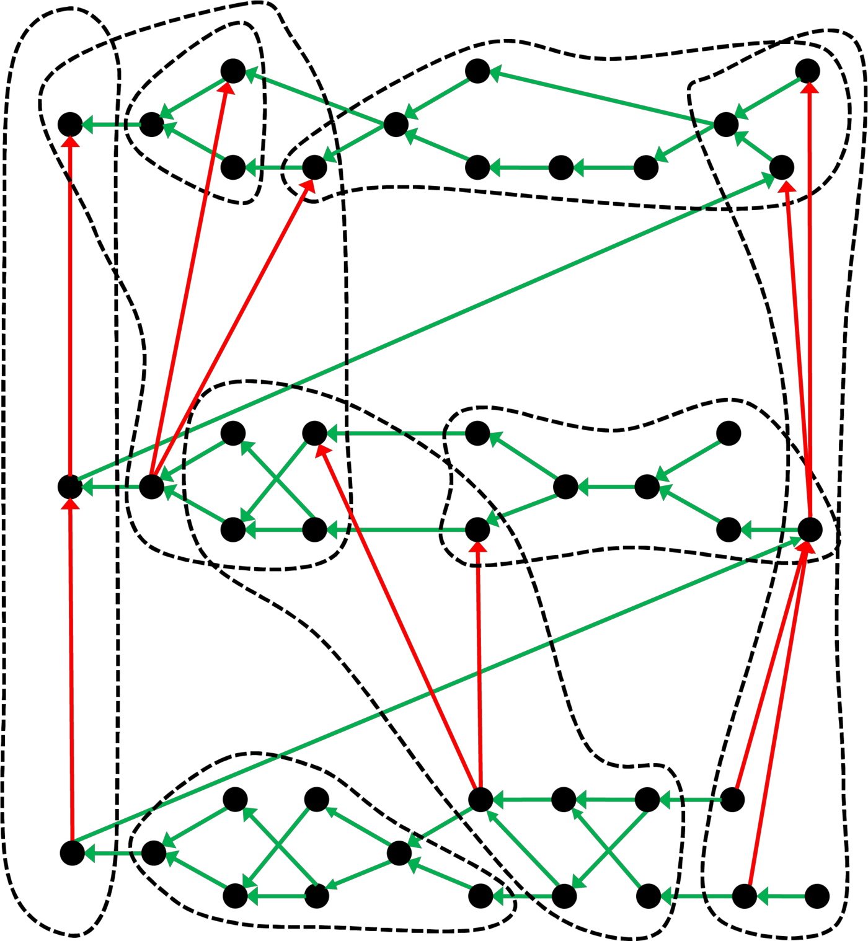

Slide 13
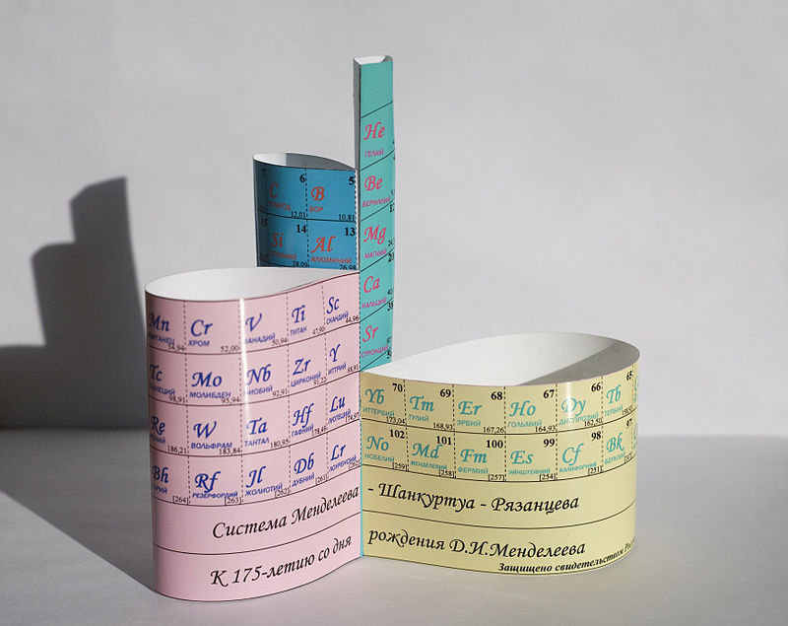
Notes:
By Тимохова Ольга - http://secology.narod.ru/medflower1.html, CC BY-SA 3.0, https://commons.wikimedia.org/w/index.php?curid=9387176

Slide 14
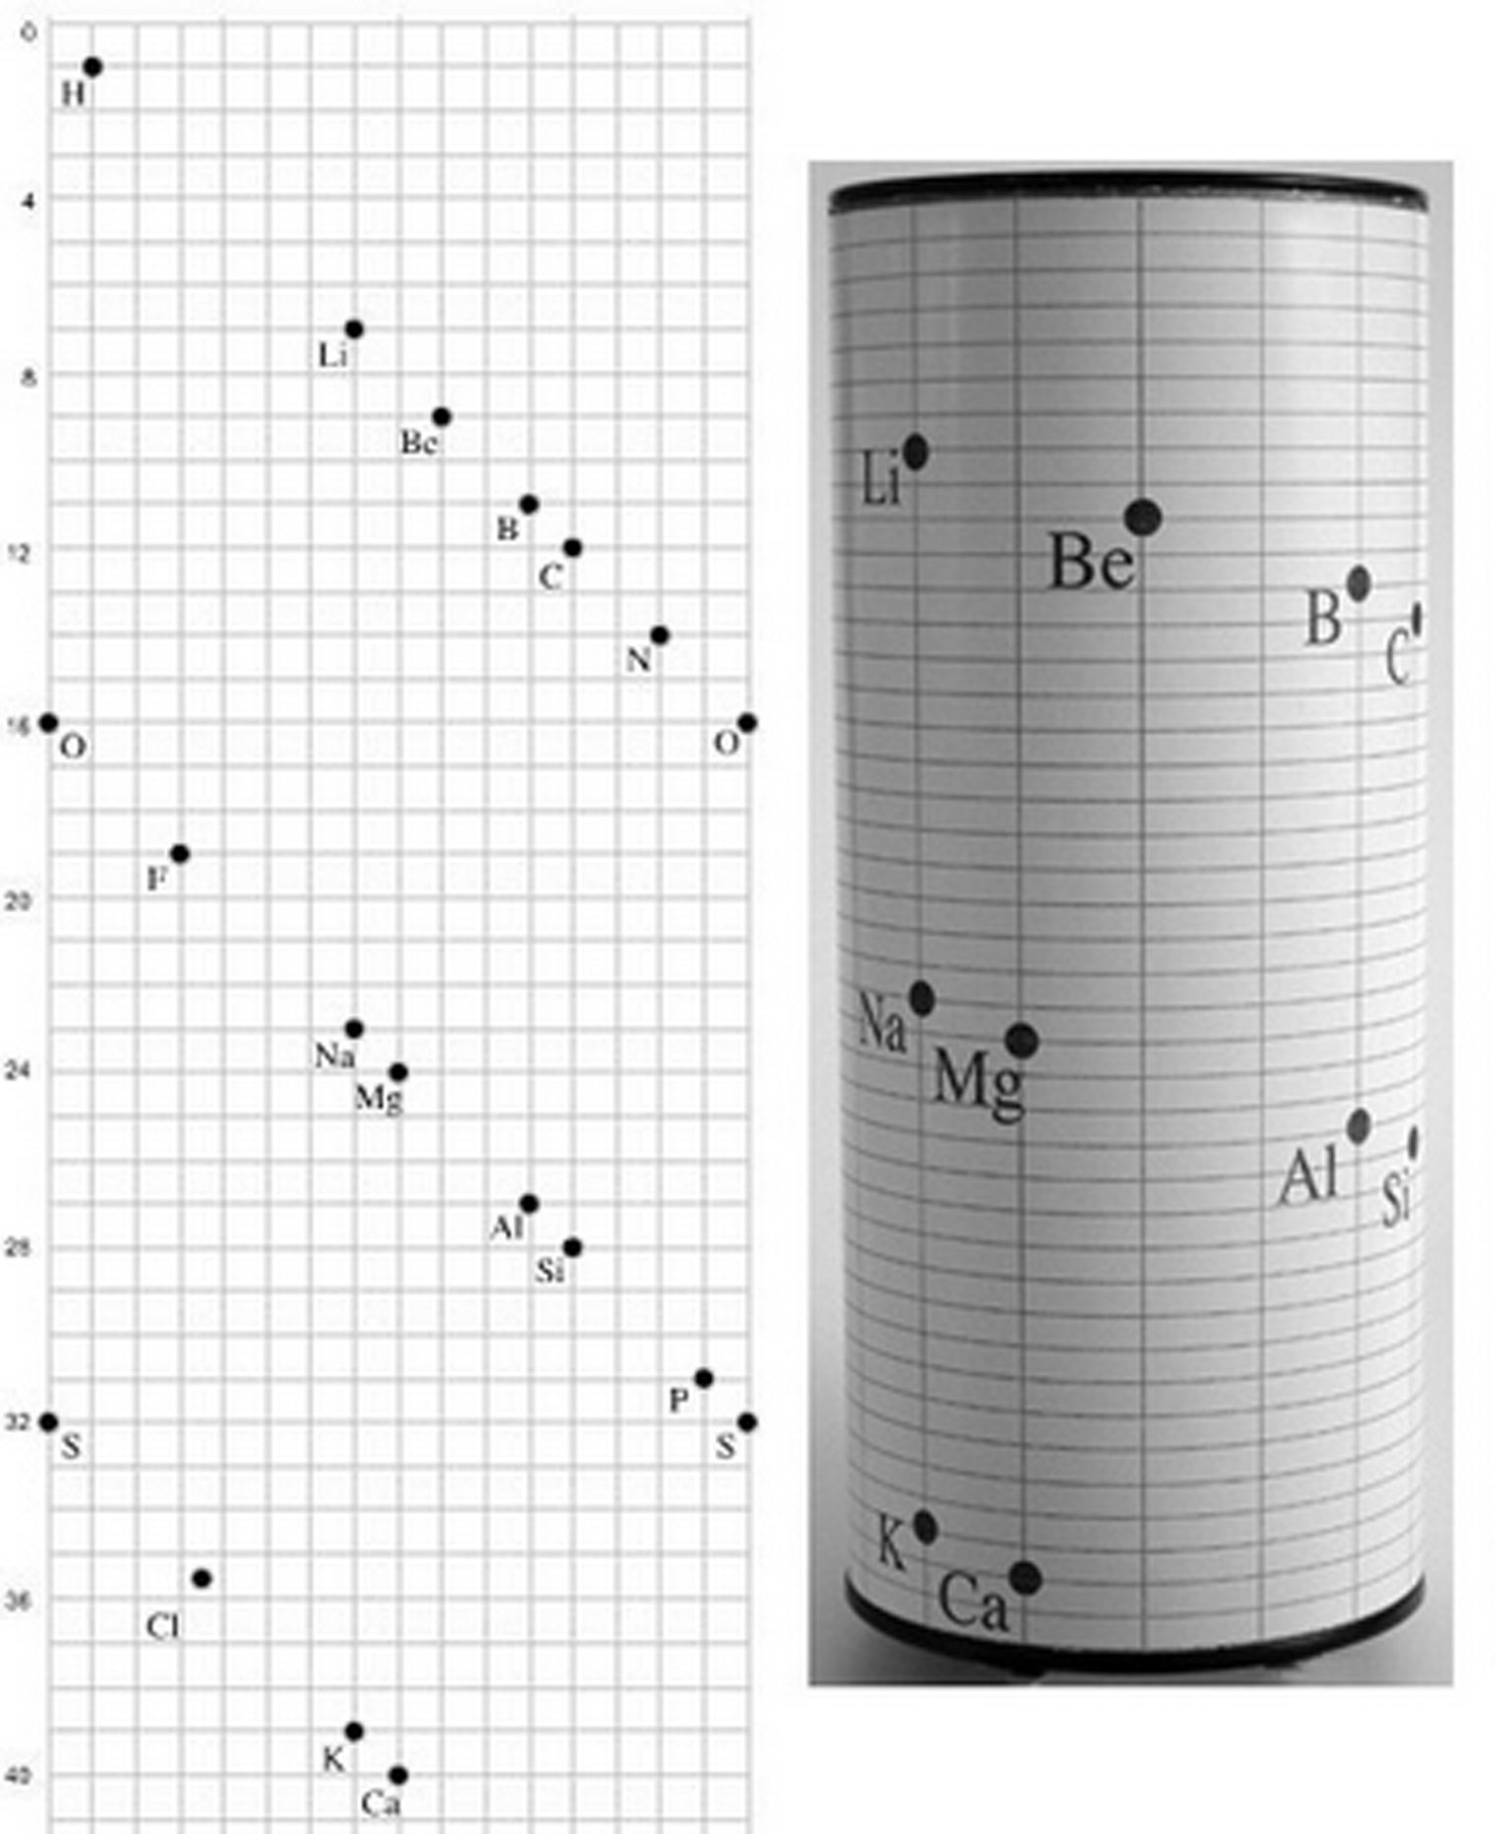
De Chancourtois,
1862
Notes:
https://www.labnews.co.uk/article/2029799/alternative-periodic-tables

Slide 15
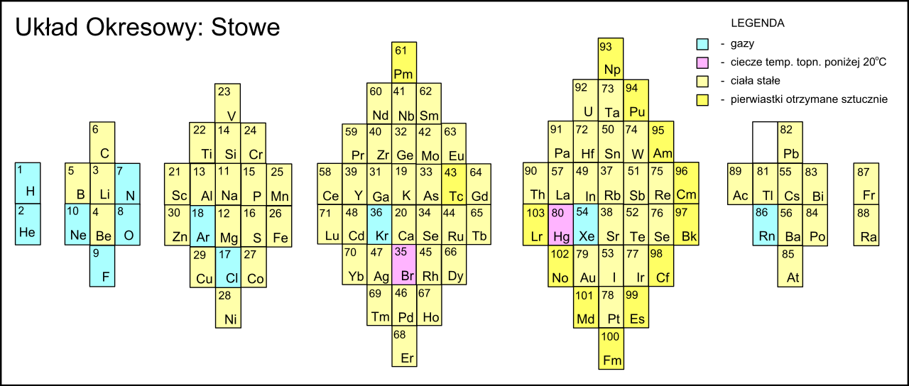
Notes:
By Bastianow (vector version) - This W3C-unspecified vector image was created with Inkscape.Based on version graphics from Scholten J.&quot;Secret Lanthanides&quot;, 2005, ISBN 90-74817-16-5;, CC BY-SA 4.0, https://commons.wikimedia.org/w/index.php?curid=3112708

Slide 16
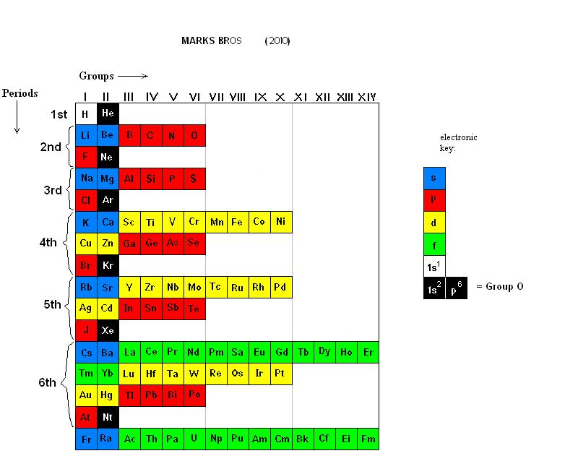
Notes:
By Johnmarks9 - Own work, CC BY-SA 3.0, https://commons.wikimedia.org/w/index.php?curid=18920884

Slide 17
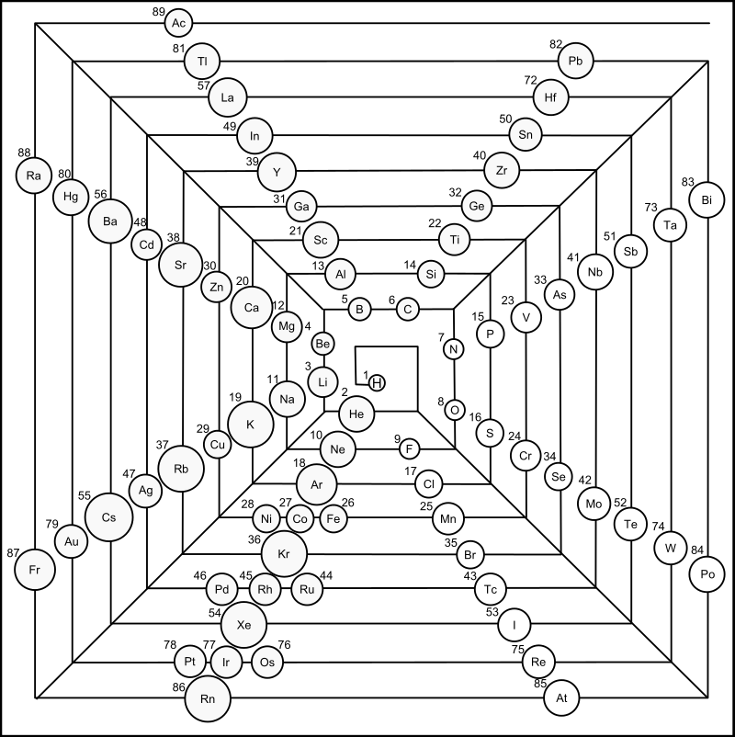
Scholten, 2005
Notes:
By Bastianow (vector version) - This W3C-unspecified vector image was created with Inkscape.Based on version graphics from Scholten J.&quot;Secret Lanthanides&quot;, 2005, ISBN 90-74817-16-5;, CC BY-SA 4.0, https://commons.wikimedia.org/w/index.php?curid=3112639

Slide 18
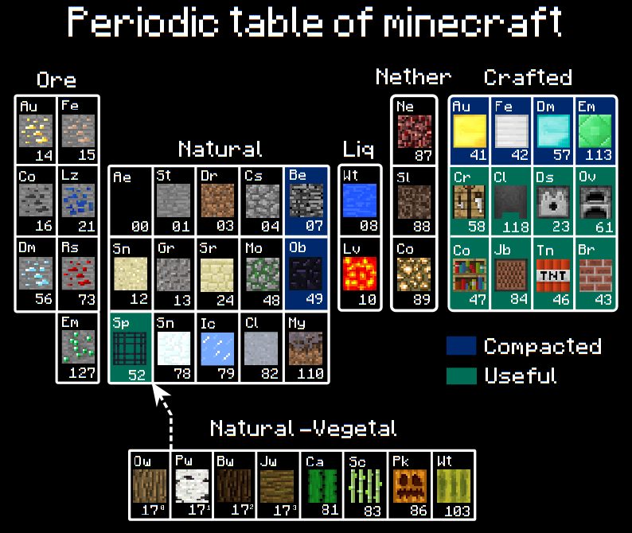

Slide 19
