Slide 1
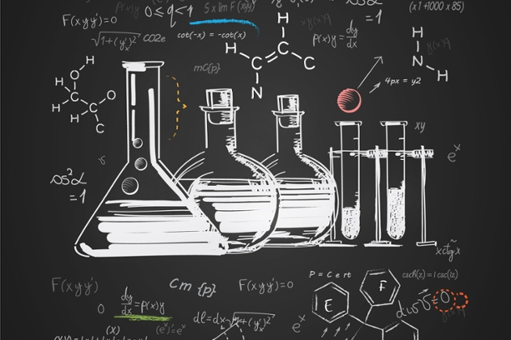
Understanding Chemistry

Slide 2
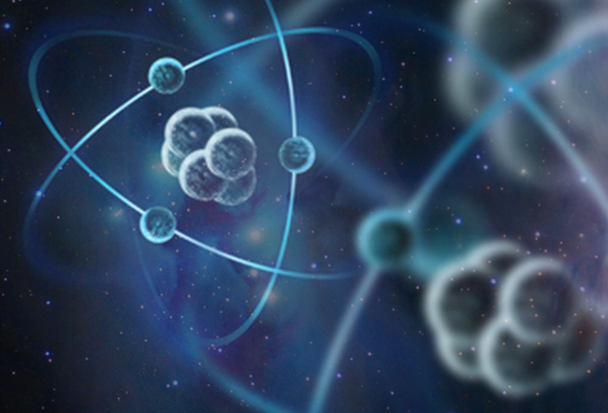
All the world is made of atoms.
Understanding them is the realm of chemistry.

Slide 3
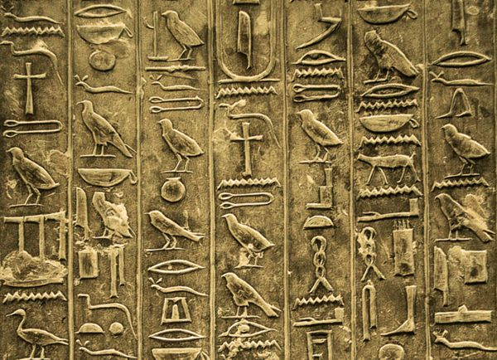
Letters, numbers, and symbols all have their own meanings in Chemistry.

Slide 4
We’ll begin with the letters.

Slide 5
Each chemical element is given a 1,2 or 3 letter abbreviation.
Capitalization is important!

Slide 7
When elements are connected together it is called a molecule.

Slide 8
Chemists have many ways of showing how elements bond.

Slide 9
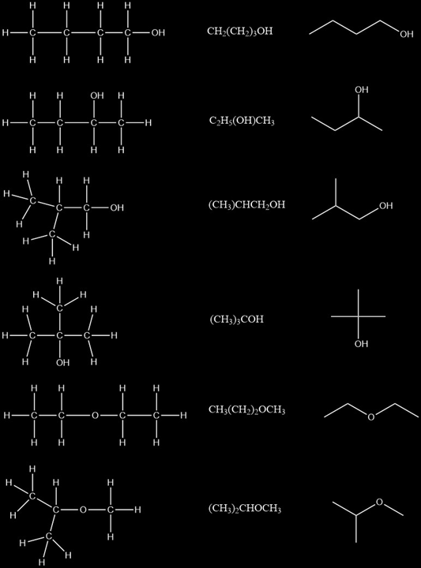
How the atoms in a molecule are arranged determine the shape. The shape determines the chemical properties. Shape is important. A square key will not work in a round lock.

Slide 10
Structural
Formula
Molecular
Formula
Condensed
Formula
Why have 3 ways of writing the same compound?
What are the advantages/disadvantages of each?

Slide 11
Examine these 6 compounds carefully.
How many Hydrogens (H) are in each?
How many Oxygen (O) are in each?
How many carbon are in each?
Structural
Formula
Molecular
Formula
Condensed
Formula
1.
2.
3.
4.
5.
6.

Slide 12
Look at the way the molecular formulas are written.
What do the numbers seem to mean?
What clues can you gather about the structure of a compound based on how the molecular formula is grouped?
Structural
Formula
Molecular
Formula
Condensed
Formula

Slide 13
Structural
Formula
Molecular
Formula
Condensed
Formula
How many bonds does each Hydrogen make?
How many bonds does an oxygen make?
How many bonds does a carbon form?

Slide 14
Using the rules you have discovered, draw what
C₆H₁₂O₆
might look like.
Rings, lines, and branches are all ok.

Slide 15
When lots of molecules are joined together it is called a macromolecule. These can be BIG! A single macromolecule of DNA has over 250 million smaller molecules called
nucleic acid monomers making it up.

Slide 16
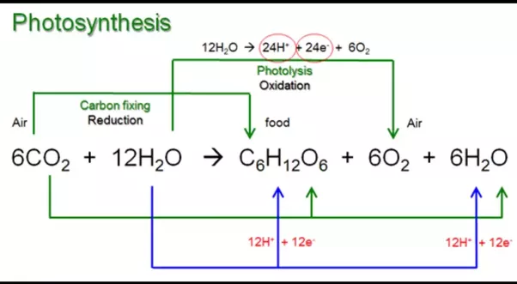
Consider the most famous reaction in all of biology…
(g)
(l)
(s)
(g)
(g)

Slide 17
(g)
(l)
(s)
(g)
(g)
Reactants
Products

Slide 18
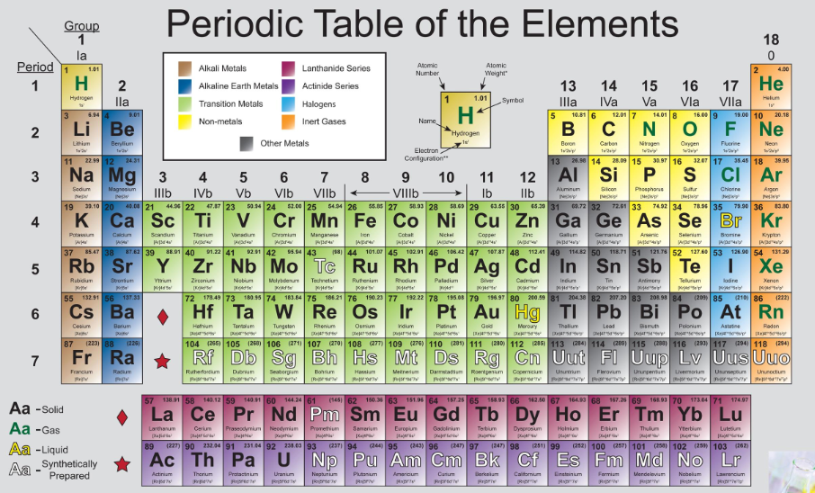
Water
Carbon Dioxide

Slide 19
Photosynthesis
6CO + 6H O
2
2

Slide 20
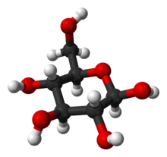
Oxygen
Oxygen
C H O + 6O
Glucose
Oxygen
Oxygen
6
12
6
2
Oxygen
Oxygen

Slide 21
On the reactants side, how many total …
a. Carbon
6
b. Hydrogen
12
C. Oxygen
18

Slide 22
On the products side, how many total …
a. Carbon
6
b. Hydrogen
12
C. Oxygen
18

Slide 23
1
1
2
4
2
5
6CO + 6H O
2
2
3
6

Slide 24
C H O + 6O
6
12
6
2

Slide 25
Carbon
Carbon
6 x 1 = 6
1 x 6 = 6
Hydrogen
Hydrogen
12 x 2 = 24
(1 x 12) + (6 x 2) = 24
(6 x 2) + (12 x 1) = 24
(1 x 6) + (6 x 2) + (6 x 1) = 24
Oxygen
Oxygen
Reactants
Products

Slide 26
What do you notice about the reactants and products?
This is called “The Law of Conservation of Mass.”

Slide 27
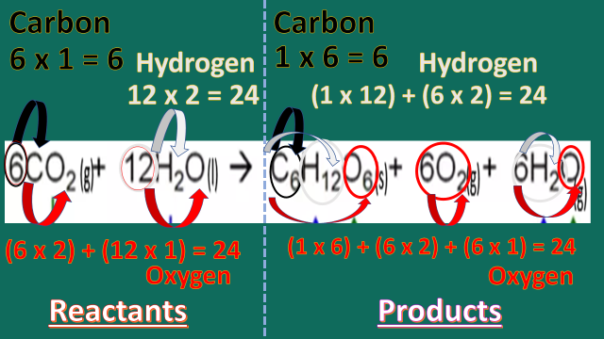
???

Slide 28
X + 3 = 5 + 3
In math, if the same thing is added to both sides, what can you do?

Slide 29
Look at the equation again.
(g)
(l)
(s)
(g)
(g)

Slide 30
There are actually 3 ways to write an equation in chemistry.

Slide 31
What is the difference between these equations?

Slide 32
+, --, (aq), (s), (l), (g)
???

Slide 33
Symbol | Name & Meaning
(aq) | Aqueous—it means dissolved in water.
(s) | Solid
(l) | Liquid
(g) | Gas

Slide 34
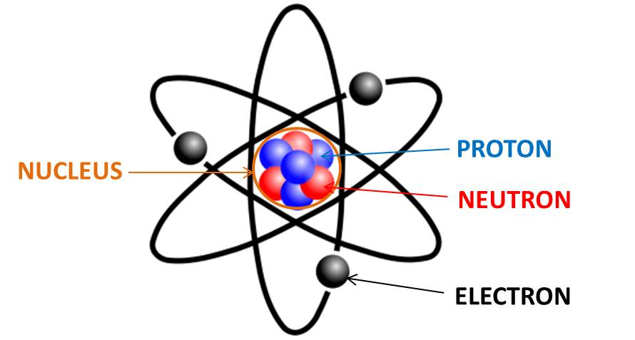
Atoms
+ Charge
0 Charge
-- Charge
* Not to scale!
These are what’s important.

Slide 35
– (-1) = ???
In math, what happens if you loose a negative?
It becomes…

Slide 36
+ (-1) = ???
In math, what happens if you gain a negative?
It becomes…

Slide 37
The charge on this cation is 1+
+ Charge
0 Charge
-- Charge
So in chemistry this would become…
This is called “Oxidation.”

Slide 38
The charge on this anion is 1--
+ Charge
0 Charge
-- Charge
And this would be…
This is called “Reduction.”

Slide 39
Why is it reduction,
It gained an electron?
???

Slide 40
+ (-1) = ???
In math, what happens if you gain a negative?
It becomes…

Slide 41
The charge on this anion is 1--
+ Charge
0 Charge
-- Charge
And this would be…
This is called “Reduction.”

Slide 42
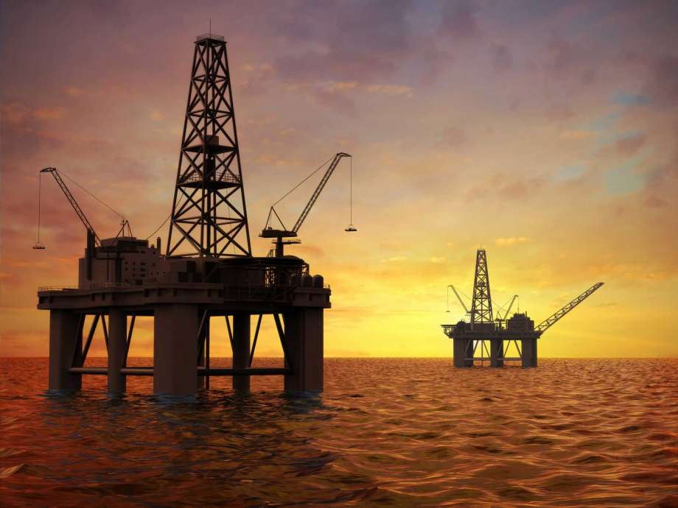
Oil Rig
Oxidation involves loss.
Reduction involves gain.

Slide 43
(g)
(l)
(s)
(g)
(g)
The blue and green arrows show half reactions.
One part of the reaction is gaining electrons.
The other part is giving up electrons.
Can you tell what is being oxidized, and what is being reduced?

Slide 44
The grand summary
Half reactions showing where electrons flow.
- Charge means gain/+ charge means loss of electrons.
Coefficients refer to how many of the molecule are in the reaction.
The arrow shows the direction the reaction is progressing. If the arrow goes both ways it means it is in equilibrium.
Reactants
Products
(g)
(l)
(s)
(g)
(g)
Capital letters refer to the elements.
Subscripts refer to how many in a group are attached to a central atom. Here two oxygen are attached to the carbon.
The symbols (aq), (s), (l), and (g) refer to the physical state of the compound.

Slide 45
Homework:
Your assignment is to research “Cellular Respiration.” Describe in words exactly what is happening, and compare the products and reactants with photosynthesis.

Slide 46
Sources
Chemistry Minor. University of Nebraska. Retrieved from https://www.unomaha.edu/college-of-arts-and-sciences/chemistry/academics/minors.php Accessed 8/2/2018
https://futurism.com/are-atoms-mostly-empty/
http://www.artyfactory.com/egyptian_art/egyptian_hieroglyphs/hieroglyphs.htm
https://osfa.washington.edu/wp/sprc/finding-childcare-providers/questions-to-ask/
https://slideplayer.com/slide/7676983/

Slide 47
https://chem.libretexts.org/Textbook_Maps/Organic_Chemistry/Map%3A_Organic_Chemistry_(McMurry)/Chapter_01%3A_Structure_and_Bonding/1.12%3A_Drawing_Chemical_Structures
http://www.whoinventedfirst.com/who-discovered-the-atom/
https://www.houstonchronicle.com/business/energy/article/Malware-on-oil-rig-computers-raises-security-fears-4301773.php

