Slide 1
Balancing Chemical Equations
Notes:
Image Source: https://www.inc.com/jim-schleckser/seven-secrets-of-successful-people-to-living-a-balanced-life.html

Slide 2
In this activity we will be exploring how reactions behave and how to balance them.

Slide 3
Reactions can be classified based on how they behave.

Slide 4
Examples
1.
__Fe + __S₈ → __FeS
2.
_H₂O → _H₂ +_O₂
3.
_Zn + _HCl → _ZnCl₂ + _H₂
4.
_ NaCl + 2 AgNO₃ →
_NaNO₃ + _AgCl

Slide 5
For a reaction to be balanced, the charge must be equal before and after and there must be the same number of all atoms involved before and after.

Slide 6
These reactions aren’t balanced
Fe + S₈ → FeS Before (Reactants) After (Products)
Fe: 1 S: 8 | Fe: 1 S: 1
H₂O → H₂ + O₂ Before (Reactants) After (Products)
H: 2 O: 1 | H: 2 O: 2
Zn + HCl → ZnCl₂ + H₂ Before (Reactants) After (Products)
Zn: 1 H: 1 Cl: 1 | Zn: 1 H: 2 Cl: 2
NaCl + 2AgNO₃ → AgCl +NaNO₃ Before (Reactants) After (Products)
Na: 1 Cl: 1 Ag: 2 N: 2 O: 6 | Na: 1 Cl: 1 Ag: 1 N: 1 O: 3
`

Slide 7
There are 4 main strategies for balancing chemical reactions
Method | Pros | Cons
Guess & Check | Quickest & easiest | Doesn’t guarantee a solution
Solve an Equation | Guarantees a solution | Somewhat difficult may not balance charge
Oxidation Numbers | Balances charge | Requires calculation of oxidation numbers
Half Reactions | Easiest to see what is happening | Turns one reaction into two.
1.
2.
3.
4.

Slide 8
1. Guess & Check
Most numbers in chemistry are small whole numbers, so to balance, look at the equation, guess a number, compute the consequences and repeat. Stop when everything balances.

Slide 9
NOTICE: There are 8 Sulfur on the left and only 1 on the right. How can we fix this?
Let’s add an 8 in front of FeS and see what happens.
Fe + S₈ → FeS Before (Reactants) After (Products)
Fe: 1 S: 8 | Fe: 1 S: 1

Slide 10
Putting an 8 in front of the FeS means there are also 8 iron. This suggests there should be an 8 in front of the iron on the reactants side as well.
Fe + S₈ → 8 FeS Before (Reactants) After (Products)
Fe: 1 S: 8 | Fe: 8 S: 8

Slide 11
After adding the 8 to the Fe, all atoms are the same before and after. This chemical reaction is now balanced.
8 Fe + S₈ → 8 FeS Before (Reactants) After (Products)
Fe: 8 S: 8 | Fe: 8 S: 8
√

Slide 12
If you need help with this method check out…
https://www.youtube.com/watch?v=oDVswHfZJzY

Slide 13
2. Solve a system of equations
Consider the following chemical reaction…
Since there are 2 hydrogen on each side that means that 2a = 2b or a =b. There is just one oxygen on the left, but two on the right so a = 2c, which means that a is double c. If a=1 then since a=b, b=1, but c would need to be ½ since ½*2=1. So, instead let a=2, that means b=2 and c=1.
Thus we can balance the equation by writing.
aH₂O → bH₂ + cO₂
Before (Reactants) After (Products)
Before (Reactants) | After (Products)
H: 4 O: 2 | H: 4 O: 2
2H₂O → 2H₂ + O₂
Before (Reactants) After (Products)
* Note there is a 1 here, but in chemistry we don’t write coefficients of 1.

Slide 14
If you need help with this method check out…
https://www.youtube.com/watch?v=6kDc6Jb44D8

Slide 15
3. Balancing reactions using oxidation numbers
We have encountered oxidation numbers previously in the “Chemical Naming” PowerPoint we explored earlier.

Slide 16
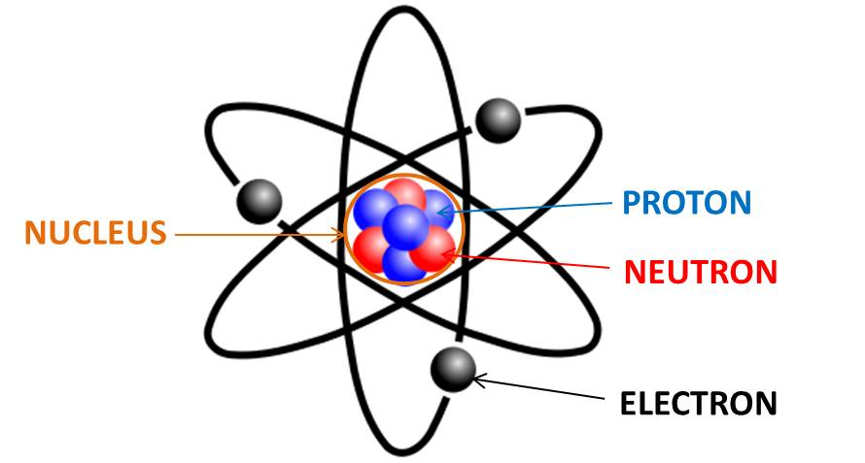
Atoms
+ Charge
0 Charge
-- Charge
* Not to scale!
These are what’s important.

Slide 17
– (-1) = ???
In math, what happens if you loose a negative?
It becomes…

Slide 18
+ (-1) = ???
In math, what happens if you gain a negative?
It becomes…

Slide 19
The charge on this cation is 1+
+ Charge
0 Charge
-- Charge
So in chemistry this would become…
This is called “Oxidation.”

Slide 20
The charge on this anion is 1--
+ Charge
0 Charge
-- Charge
And this would be…
This is called “Reduction.”

Slide 21
Oil Rig
Oxidation Involves Loss
Reduction Involves Gain

Slide 22
As a reminder…

Slide 23
Let’s calculate oxidation numbers for each compound.
Zinc is in elemental form, so it has an oxidation number of 0. Chlorine makes a -1 anion, so hydrogen in HCl must be +1. Chlorine stays as -1 and since there are two chlorines, Zinc must be a +2. H₂ is two of the same element whose total charge is 0, so each H must be 0.
Zn + HCl → ZnCl₂ + H₂
0
+1
-1
+2
-1
0
Hydrogen gained 1 electron each.
Zinc lost 2 electrons.
Chlorine remains the same.
To balance the electrons lost, 2HCl are needed.

Slide 24
* Remember if there is no # in front, it is a 1.
Zn + 2HCl → ZnCl₂ + H₂
Zn + HCl → ZnCl₂ + H₂ Before (Reactants) After (Products)
Zn: 1 H: 2 Cl: 2 | Zn: 1 H: 2 Cl: 2
√
Balanced

Slide 25
If you need help with this method check out…
Determining oxidation number
https://www.youtube.com/watch?v=zpCy7KwqDO8
Balancing the reaction
https://www.youtube.com/watch?v=mvbPtQfAfUQ

Slide 26
4. Balancing reactions using half reactions
1.) Start by determining the oxidation numbers. We already know the oxidation numbers for this reaction, so we will use it again.
2.) Identify what changed.
Zn + HCl → ZnCl₂ + H₂
0
+1
-1
+2
-1
0
Hydrogen gained 1 electron, gain is reduction (You’re gaining a negative.).
Zinc lost 2 electrons, loss is oxidation.
Chlorine remains the same.

Slide 27
3.) Split the reaction into its oxidation part and its reduction part.
Oxidation Half Reaction
Reduction Half Reaction
(This is the part of the reaction that is giving up electrons.)
(This is the part of the reaction that is gaining electrons.)
Zn → Zn²⁺
H⁺→ H₂
4.) Balance the elements.
Zn → Zn²⁺
2H⁺→ H₂
When electrons are the same, your equation is balanced.
5.) Balance the charges by adding electrons to each side.
Zn → Zn²⁺ +2e⁻
2e⁻ +2H⁺ → H₂

Slide 28
If you need help with this method check out…
https://www.youtube.com/watch?time_continue=144&v=fdbrhQAM9Gw&feature=emb_logo

Slide 29
Your turn.
Balance this equation using the method of your choice.
NaCl + 2AgNO₃ → AgCl +NaNO₃
Before (Reactants) After (Products)

