Slide 1
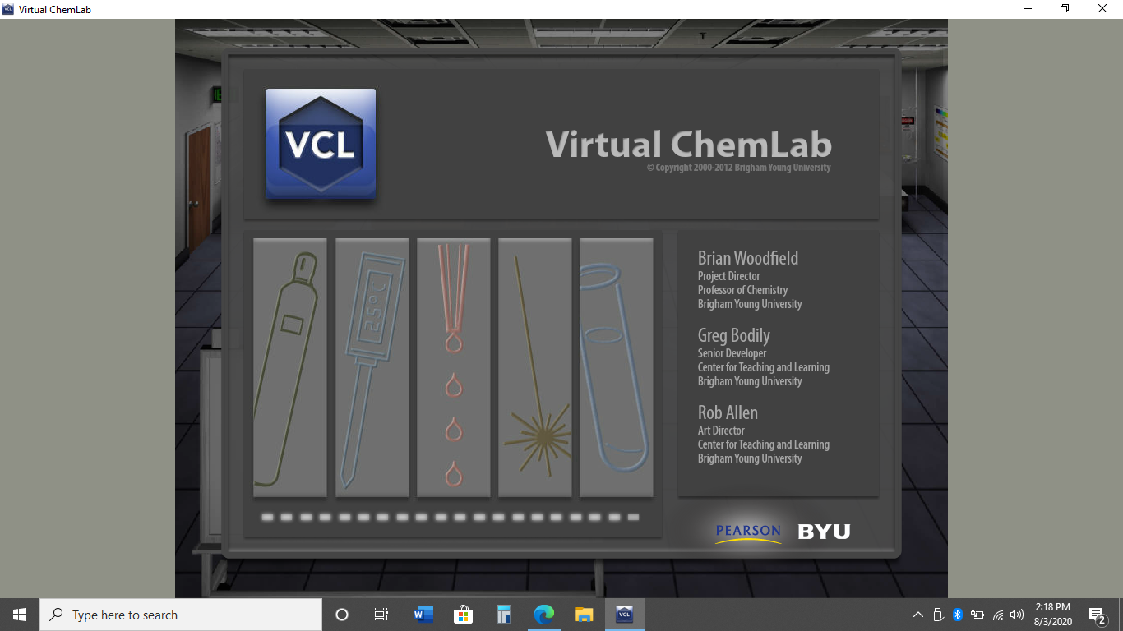
Virtual Experiment:
Ernest Rutherford’s Gold Foil

Slide 2
Part I-
Background Information

Slide 3
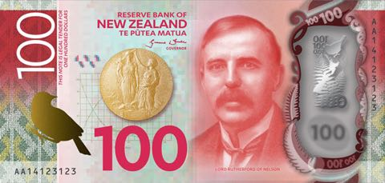
1871-1937
Notes:
Earnest Rutherford is so famous, he and his Nobel Prize are pictured on New Zealand’s 100 bank note (~$66 US). The story of Rutherford’s death is somewhat unusual. His scientific achievements over the years had earned him the rank of lord. This meant that no one who wasn’t a lord could touch him. He died waited for a knighted dr. to make the trip from London.
Image Source:
https://nzpocketguide.com/who-are-the-people-on-the-new-zealand-banknotes/

Slide 4
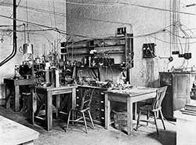
Thomson &
Rutherford Lab
Notes:
This is the Cavendish laboratory in Cambridge England. This lab was the site of several Nobel Prize winning chemical discoveries including Ernest Rutherford, discoverer of the atomic nucleus and J. J. Thomson discoverer of the electron. The experiment we will be replicating today is simple to understand, but somewhat difficult to complete. We will be replicating it virtually using the Virtual Chem Lab produced by BYU.
Image Source:
https://www.aps.org/publications/apsnews/201402/physicshistory.cfm

Slide 5
Part II-
Understanding α-Particles

Slide 6
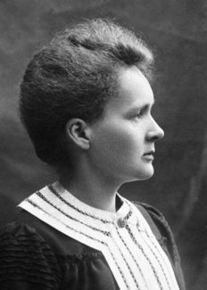
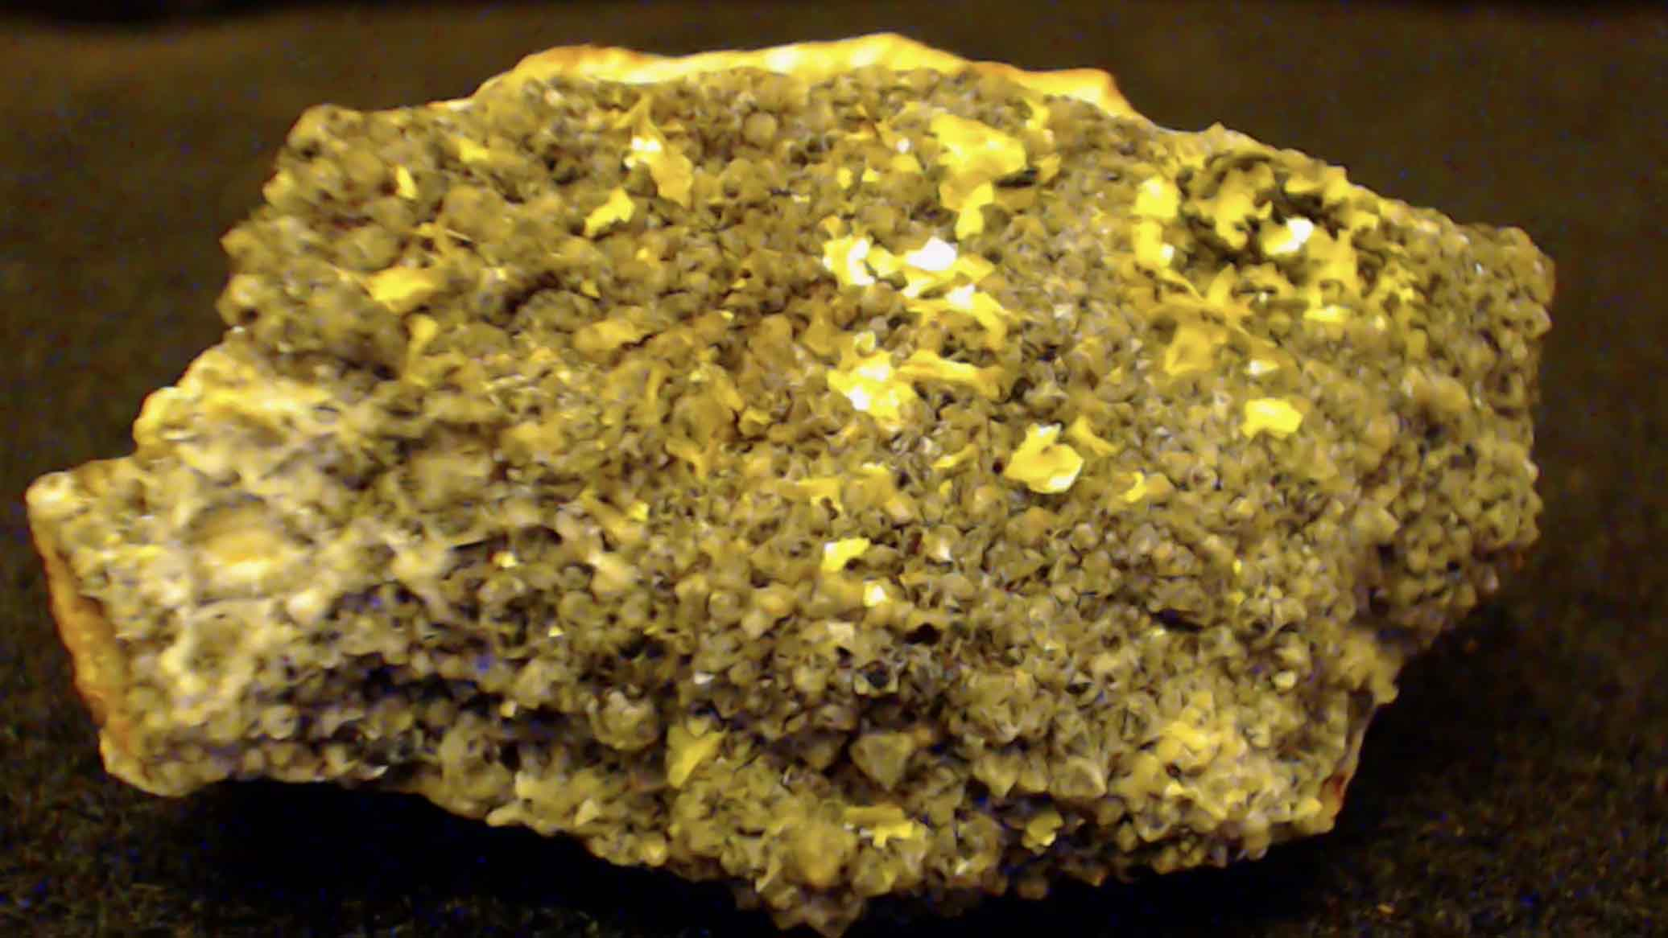
15 years earlier…
1896
Henri Becquerel went to take a picture of Uranium and found the rock took a picture of itself. Radioactivity was discovered.
Curious about the nature of radiation, Marie Curie had the idea to pass different types of radiation through a magnet to see how they behaved. She found 3 different types of radiation α, β, & γ. Alpha (α) was attracted to the negative pole of a magnet and repelled from the positive pole. Alpha particles had the shortest path length. Beta radiation (β) traveled farther than alpha and was attracted to the positive pole while being repelled by the negative pole. And finally gamma radiation (γ) was not attracted or repelled by either magnetic pole. Gamma particles also had the longest path length.
Notes:
Image Sources:
https://cowboystatedaily.com/2020/02/13/industry-leader-wyoming-uranium-industry-on-its-death-bed/
https://m.facebook.com/PhysicistPage/posts/1569894176417228
https://www.nobelprize.org/prizes/physics/1903/marie-curie/biographical/
http://chemed.chem.purdue.edu/genchem/history/gold.html

Slide 7
Use the results of Marie Curie’s experiment to rank the masses of each different type of radiation from heaviest to lightest.
Explain your reasoning.

Slide 8
What are the charges of each different type of radiation?

Slide 9
Part III-
The experiment

Slide 10
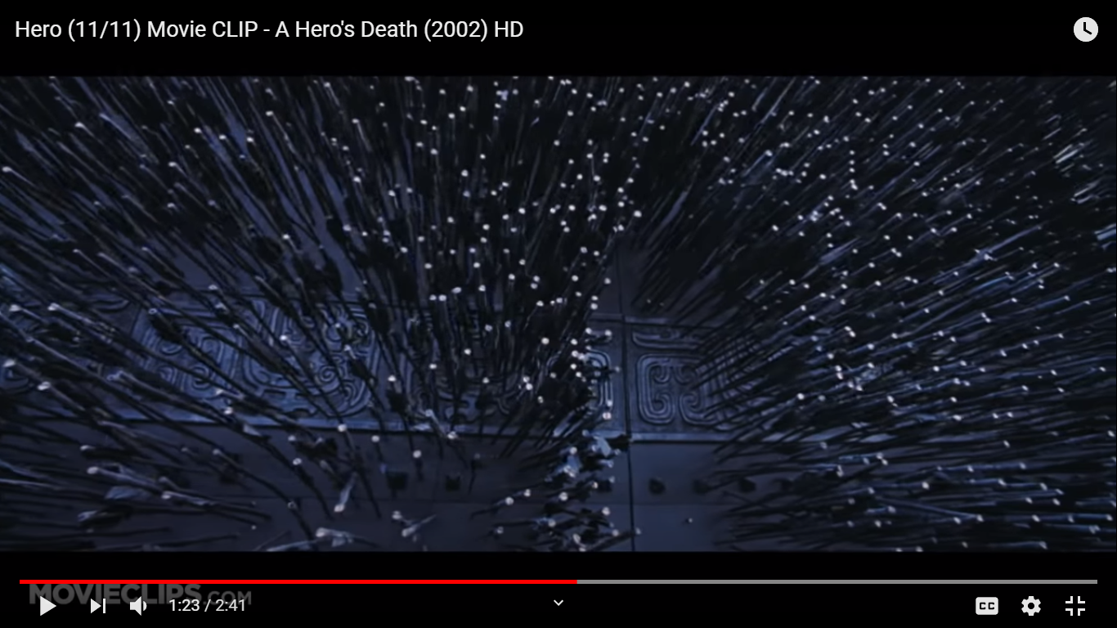
What happened here?
How can you tell?
Notes:
This is a screenshot from the movie Hero. It is a fantastic movie. I highly recommend everyone should watch it, However, you will never be graded on it.

Slide 11
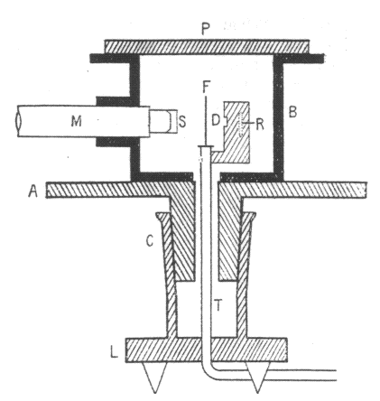
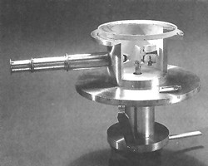
Geiger-Marsden Apparatus
A-turntable, B- Protective cylinder, C-Seal, D-Focus, F-Metal foil, M-Microscope, P-Observing plate, R-Radium, S-Zinc sulfide screen, T-Vacuum pump.
Notes:
This device is called a Geiger (Yes, it’s the same person who invented a Geiger Counter) Marsden Apparatus. It is named for two of the graduate students of Rutherford, Hans Geiger and Ernest Marsden. The apparatus consists of a zinc-sulfide screen that would light up when exposed to a charge, this was visible by a microscope. The viewing could be rotated at any angle to the metal foil. The idea was to bombard the foil with alpha particles and similar to the arrow example on the previous page infer what was happening at the atomic level based on what bounced and what passed through the foil. This is the experiment we will be replicating today.
Image Source:
https://upload.wikimedia.org/wikipedia/en/2/24/Geiger-Marsden_apparatus_photo.jpg

Slide 12
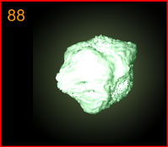
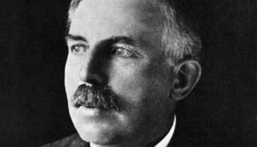
Americium
Radium
Notes:
When Rutherford conducted this experiment in 1911 he used Radium as an alpha particle emitter. We will be using Americium, the same element found in smoke detectors. Neither element is stable. Both emit large amounts of radiation.
Image Sources:
https://commons.wikimedia.org/wiki/File:Am-241_pellet.jpg

Slide 13
The Experiment
Screen Number | Angle (Deg.)
1 | +135
2 | +90
3 | +45
4 | 0
5 | -45
6 | -90
7 | -135
Screen 1
2
3
4
Emitter
Foil
6
5
7

Slide 14
1
2
3
4
5
6
7
Aluminum
Notes:
Here is a sample of what is observed on each screen using aluminum foil. Each sample was recorded after 20 seconds. Rutherford’s foils were only 0.00004 cm or about 250 times thinner than a regular sheet of paper!

Slide 15
1
2
3
4
Gold
5
6
7
Notes:
To see Rutherford’s actual data follow the link below
https://www.math.ubc.ca/~cass/rutherford/r.pdf

Slide 16
Metal | Scintillations
Aluminum | 0
Iron | 0
Copper | 0
Silver | 0
Tin | 0
Platinum | 1
Gold | 1
Metal | Scintillations
Aluminum | 0
Iron | 1
Copper | 1
Silver | 3
Tin | 1
Platinum | 10
Gold | 11
Part 1.
Metal | Scintillations
Aluminum | 0
Iron | 0
Copper | 0
Silver | 0
Tin | 0
Platinum | 1
Gold | 1
Metal | Scintillations
Aluminum | 0
Iron | 1
Copper | 1
Silver | 3
Tin | 1
Platinum | 10
Gold | 6
Notes:
Scintillations refer to how many times the screen lit up at each station after 20 s.

Slide 17
Metal | Scintillations
Aluminum | 5
Iron | 17
Copper | 33
Silver | 64
Tin | 38
Platinum | 120
Gold | 151
Metal | Scintillations
Aluminum | 6
Iron | 32
Copper | 53
Silver | 70
Tin | 49
Platinum | 190
Gold | 300
Metal | Scintillations
Aluminum | 5
Iron | 34
Copper | 37
Silver | 61
Tin | 42
Platinum | 145
Gold | 104
Part 2.

Slide 18
Use the data from the previous two slides to make a graph showing number of scintillations as a function of angle.
Be sure to include a title, legend and axis labels.

Slide 19
*Where do most particles end up?
*What happens as atomic mass increases?
*What was the charge of an α particle?
*What could repel an α particle?

Slide 20
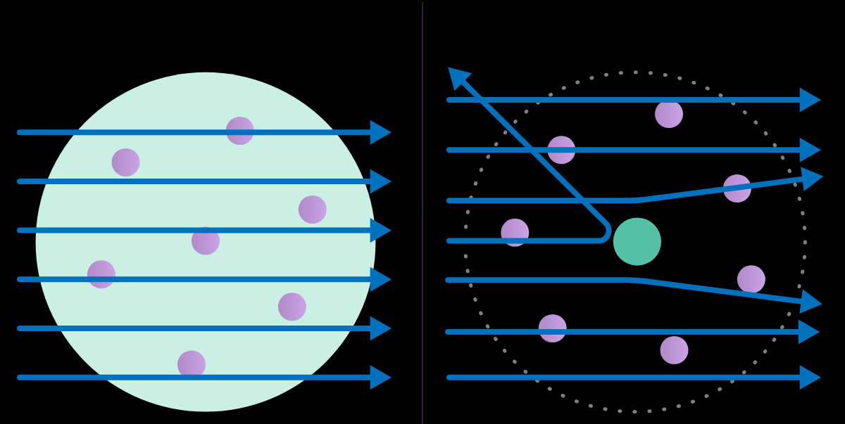
Thomson Model
Rutherford Model
Explain how Rutherford’s model accounts for your observations, while Thomson’s model does not.
Notes:
Both models of the atom are approximately 10^-10 m across. Thomson’s model is called the “Plum Pudding Model.” It involves a cloud of positive charge interspersed with negatively charged electrons. Rutherford’s model concentrates the positive charge into a tiny nucleus approximately 10^-15 m across. The electrons orbit around the nucleus like planets orbiting the sun. Rutherford’s model is often called the “Solar System Model,” or the “Planetary Model.”
Image Source:
https://www.khanacademy.org/science/chemistry/electronic-structure-of-atoms/history-of-atomic-structure/a/discovery-of-the-electron-and-nucleus

Slide 21
* Why does Rutherford only make foils out of metals?
Notes:
Hint: How easy is it to make a thin sheet out of a rock?

Slide 22
If you had done this lab in 1911 you would have won a Nobel Prize!!
Notes:
Image Sources:
https://www.amazon.com/Jumbo-Extra-Large-Congratulations-Greeting-Card/dp/B07P75BK9H
https://www.nobelprize.org/prizes/facts/nobel-prize-facts/

