Slide 1
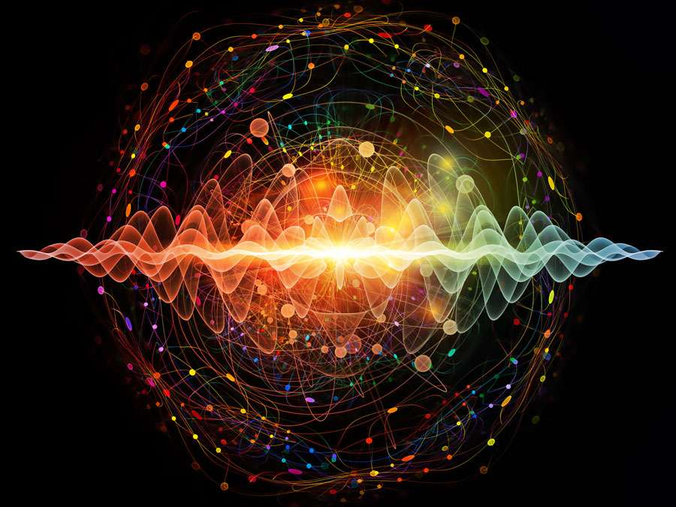
Quantum Mechanics
&
Chemistry
Quantum Mechanics. (n.d.). Retrieved October 22, 2019, from https://www.britannica.com/quiz/quantum-mechanics.

Slide 2

By
John Boom
#001209947
John Boom (2014). Retrieved October 22, 2019, from Facebook.com

Slide 3


Slide 4
John Boom (2018) retrieved October 22,2019 from jboom07.wix.com/mrboomscience

Slide 5
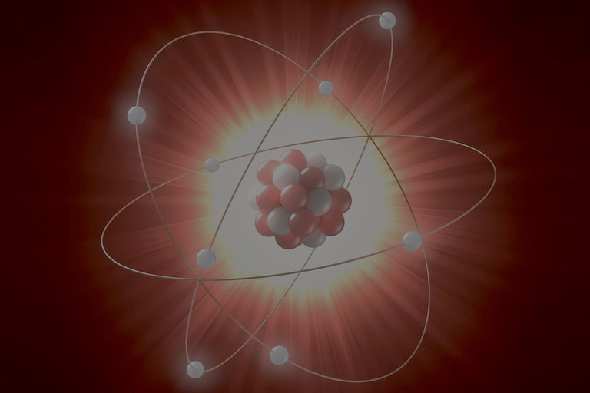
Helmenstine, T. (2019, June 5). Understand the Difference Between Atomic Mass and Mass Number. Retrieved October 22, 2019, from https://www.thoughtco.com/atomic-mass-and-mass-number-606105.
Both Quantum Physicists & Chemists are interested in atoms.

Slide 6
Chemists want to know about bond angles
Quantum Physicists want to know about the position of electrons*.

Slide 7

*Um…. Actually, due to both the quantum nature of an electron and the Heisenberg Uncertainty Principle, it is impossible to localize an electron. Instead, quantum physicists prefer to speak of collapsing the Schrodinger wave probability function associated with an electron of a given energy and quantum address.
Keveney, B. (2017, September 29). 'Young Sheldon's Iain Armitage has cute fish tale that stars Jane Fonda. Retrieved October 22, 2019, from https://www.usatoday.com/story/life/tv/2017/09/29/young-sheldons-iain-armitage-has-cute-fish-tale-stars-jane-fonda/715200001/.

Slide 8


Slide 9
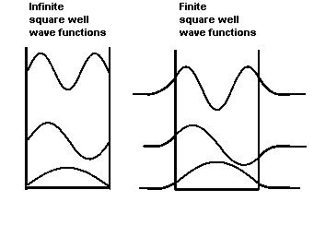
Quantum Mechanics begins with a wave in a box.
(n.d.). Retrieved October 22, 2019, from http://electron6.phys.utk.edu/phys250/modules/module 2/1d_problems.htm.

Slide 10
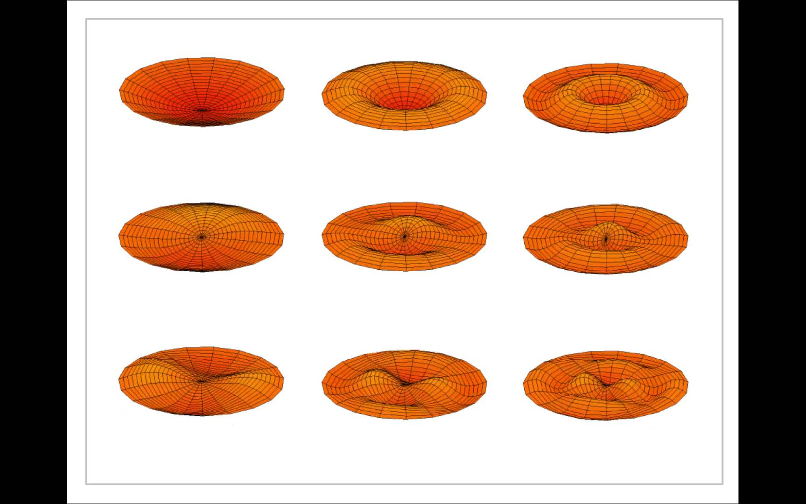
This leads to vibrating drumheads and Bessel functions.
Drum Head Vibrations. (n.d.) Retrieved October 22, 2019, from https://www.youtube.com/watch?v=dB1wWx58bFg

Slide 11
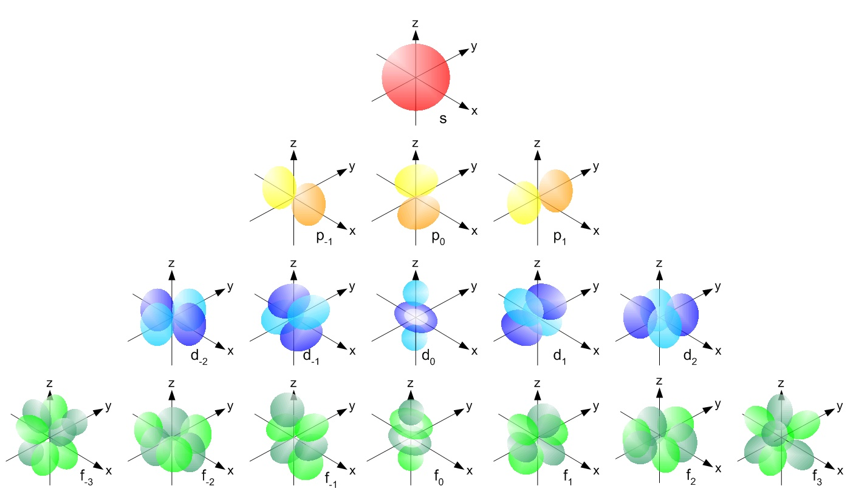
Spherical Harmonics are introduced
Dale & Dale (2019)

Slide 12
The calculus comes out and all understanding is lost.
So you think YOU'RE confused about quantum mechanics? (2015, May 2). Retrieved October 22, 2019, from https://newatlas.com/confusion-basic-nature-quantum- mechanics/26216/.

Slide 13
Chemists take a different approach.

Slide 14
Each element on the periodic table is given an address. These addresses are made up of 4 numbers. They can be thought of as tenants in an apartment.

Slide 15
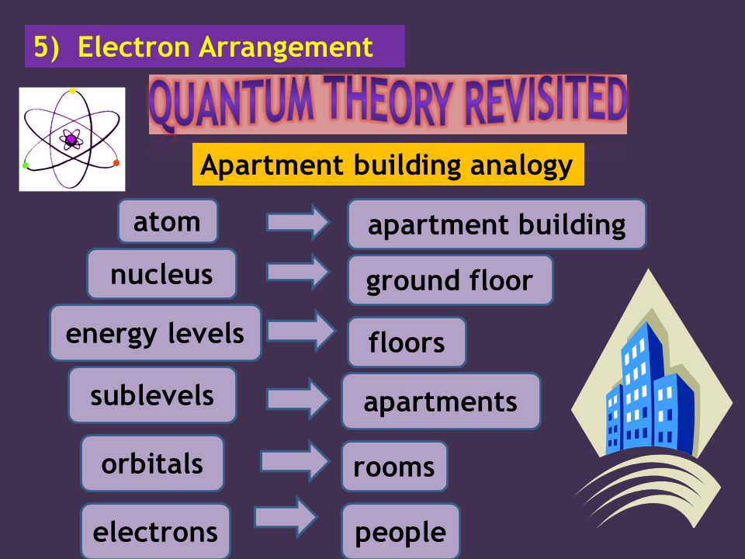
*
* Max 2 people per room. Fire marshal's orders.
Periodic Table. - ppt video online download. (n.d.). Retrieved October 22, 2019, from https://slideplayer.com/slide/5235111/.

Slide 16
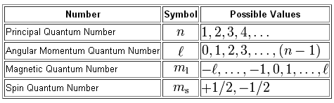
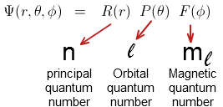
Chemical Meaning | Physical Interpretation
Shell level (also called K,L,M, & N) | Electron energy level or number of electron orbit
Subshell shape | The electron angular momentum
Orbital shape | Magnetic Orientation
Electron spin direction | Spin up or spin down

Slide 17
So the chemists plug their addresses into the periodic table.

Slide 18
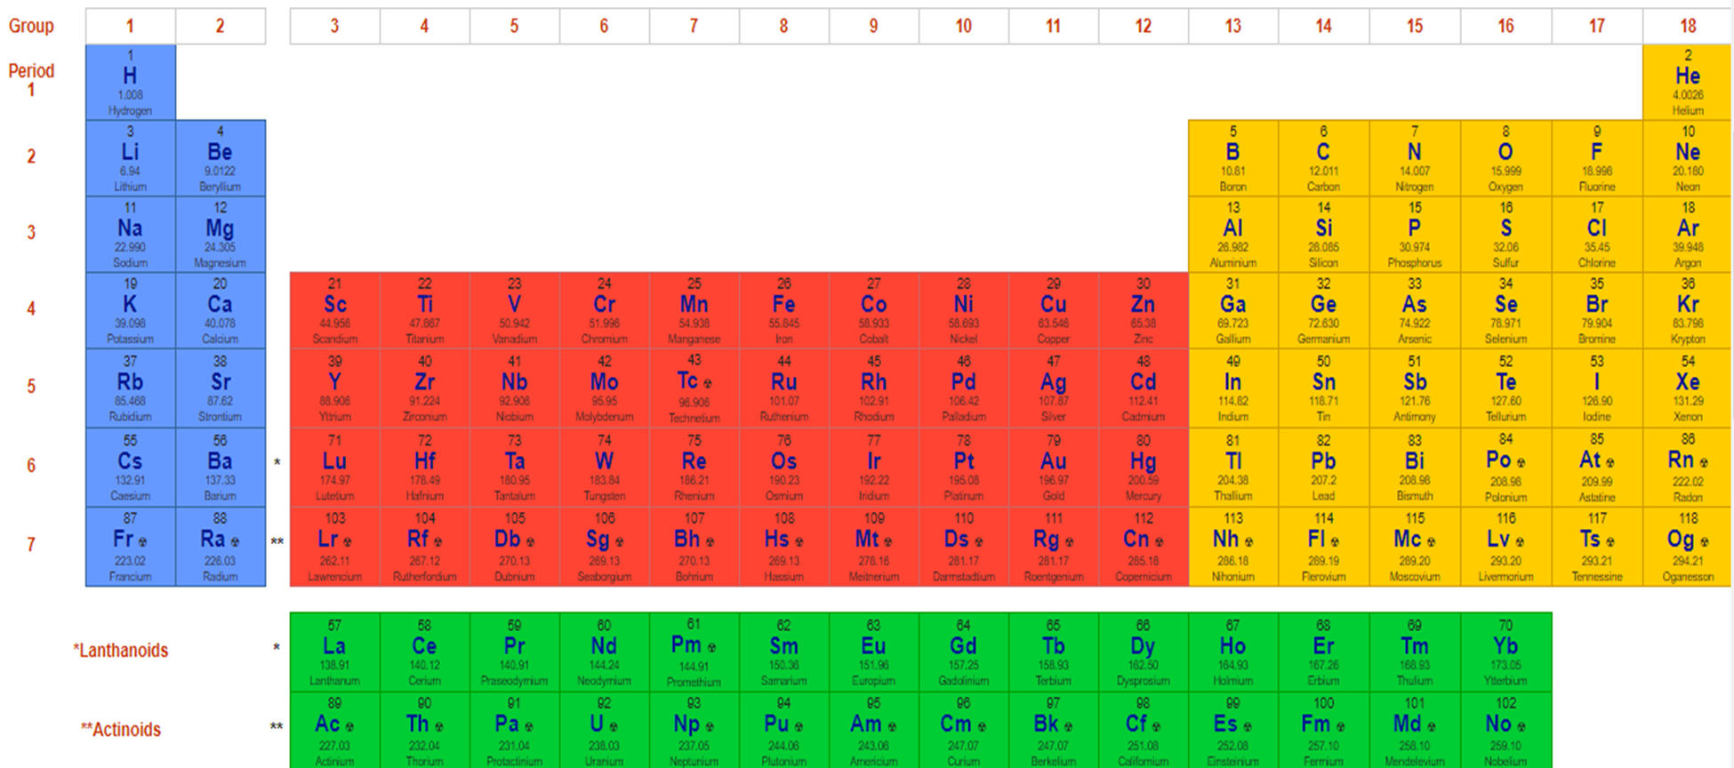
Principle Quantum Number
Or Shell
n =
Periodic Table. - ppt video online download. (n.d.). Retrieved October 22, 2019, from https://slideplayer.com/slide/5235111/.

Slide 19
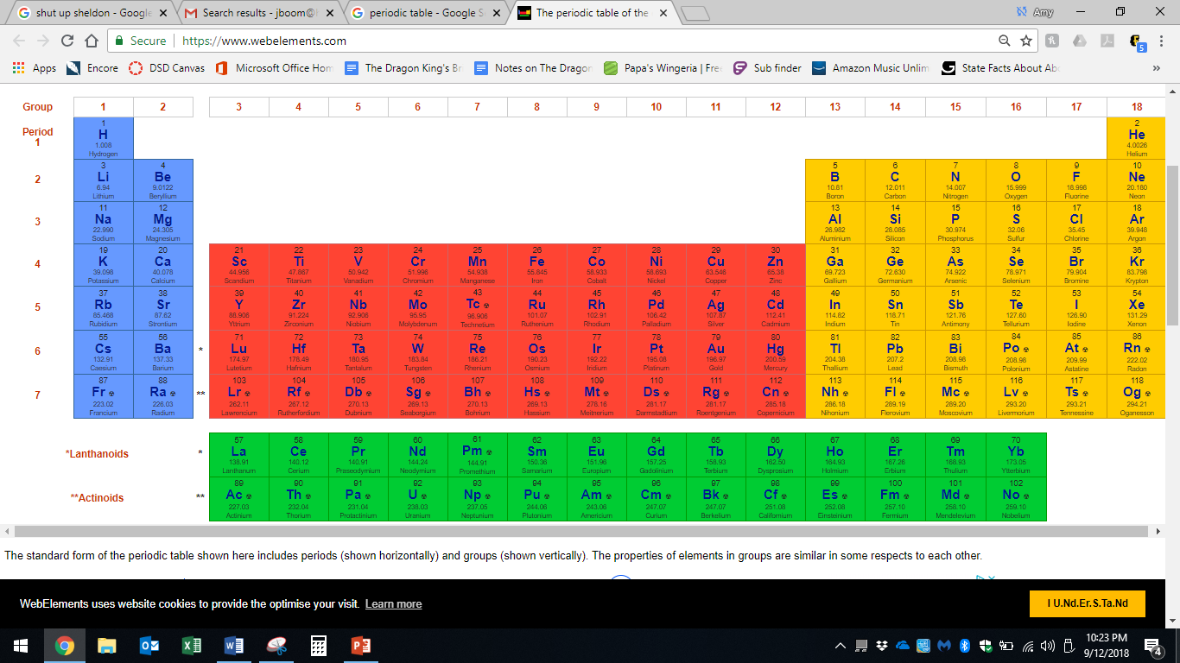
l = Angular Quantum Number
Subshell shape
Periodic Table. - ppt video online download. (n.d.). Retrieved October 22, 2019, from https://slideplayer.com/slide/5235111/.
s = 0
p = 1
d = 2
f = 3

Slide 20
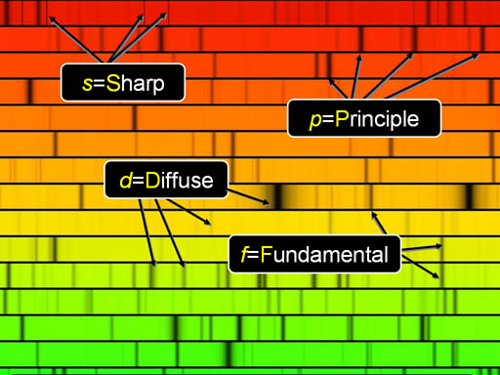
s = sharp
p = principle
d = diffuse
f = fundamental
Each atom gives off its own bar code of light. The sub shells are named for the characteristics of their spectral lines.

Slide 21

The Subshell shapes are…
Dale & Dale (2019)
s = sphere
p = peanut
d = daisy
f = What the f?
Remember those spherical harmonics the physicists calculated? Turns out they represent the shapes of the atomic subshells.

Slide 22
These are the magnetic quantum numbers, or the orientations of the orbitals.
Periodic Table. - ppt video online download. (n.d.). Retrieved October 22, 2019, from https://slideplayer.com/slide/5235111/.
0
0
Electrons are added left to right, top to bottom, in accordance with…
0
0
-1
0
1
-1
0
1
0
0
-1
0
1
-1
0
1
0
0
-2
-1
0
1
2
-2
-1
0
1
2
-1
0
1
-1
0
1
0
0
-2
-1
0
1
2
-2
-1
0
1
2
-1
0
1
-1
0
1
The Aufbau Principle
0
0
-2
-1
0
1
2
-2
-1
0
1
2
-1
0
1
-1
0
1
0
0
-2
-1
0
1
2
-2
-1
0
1
2
-1
0
1
-1
0
1
-3
-2
-1
0
1
2
3
-3
-2
-1
0
1
2
3
-3
-2
-1
0
1
2
3
-3
-2
-1
0
1
2
3

Slide 23
The magnetic quantum numbers are the solutions to the Bessel Functions that match how the electrons are vibrating.
Drum Head Vibrations. (n.d.) Retrieved October 22, 2019, from https://www.youtube.com/watch?v=dB1wWx58bFg

Slide 24
+1/2
-1/2
Electron Spins
+1/2
-1/2
+1/2
-1/2
Hund’s Rule
+1/2
-1/2
Periodic Table. - ppt video online download. (n.d.). Retrieved October 22, 2019, from https://slideplayer.com/slide/5235111/.

Slide 25
The Pauli Exclusion Principle says no electrons can share the same quantum address.

Slide 26
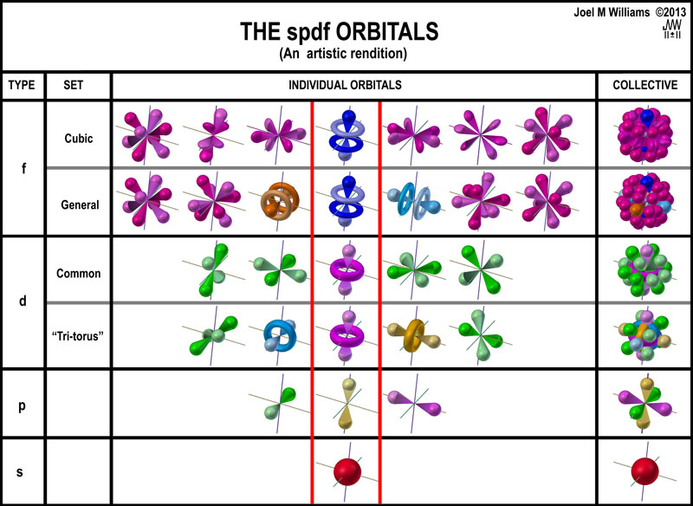
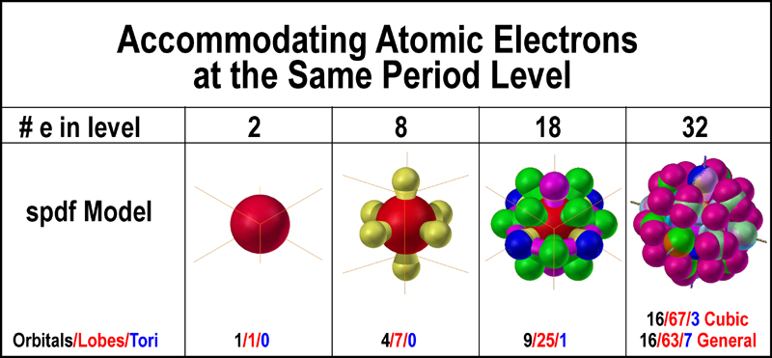
Here’s what it looks like when you put it all together.
Polymath07. (2010, July 1). They point every which way. Retrieved October 22, 2019, from http://polymath07.blogspot.com/2010/06/they-point-every-which-way.html.

Slide 27
The electron configuration is the combination of all numbers previous to each atom.
1s1
Represents unpaired electrons.
1s2
2s1
2s2
Represents paired electrons.
2p2
2p3
2p1
2p4
2p5
2p6
Example: Cl⁻ = [Ne]3S² 3P⁶
3s1
3s2
3p1
3p2
3p3
3p4
3p5
3p6
4s1
4s2
3d1
3d2
3d3
3d4
3d5
3d6
3d7
3d8
3d9
3d10
4p2
4p3
4p4
4p5
4p6
4p1
5s1
5s2
4d1
4d2
4d3
4d4
4d5
4d6
4d7
4d8
4d9
4d10
5p1
5p2
5p3
5d4
5d5
5d6
6s1
6s2
5d1
5d2
5d3
5d4
5d5
5d6
5d7
5d8
5d9
5d10
6p1
6p2
6p3
6p4
6p5
6p6
7s1
7s2
6d1
6d2
6d3
6d4
6d5
6d6
6d7
6d8
6d9
6d10
7s1
7s2
7s3
7s4
7s5
7s6
4f1
4f2
4f3
4f4
4f5
4f6
4f7
4f8
4f9
4f10
4f11
4f12
4f13
4f14
5f1
5f2
5f3
5f4
5f5
5f6
5f7
5f8
5f9
5f10
5f11
5f12
5f13
5f14
Periodic Table. - ppt video online download. (n.d.). Retrieved October 22, 2019, from https://slideplayer.com/slide/5235111/.

Slide 28
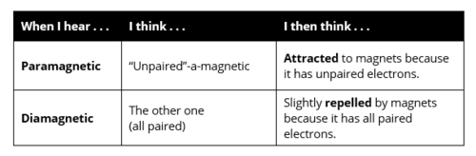
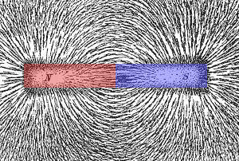
Notes:
https://quizlet.com/405812540/periodic-table-flash-cards/
https://www.explainthatstuff.com/magnetism.html

Slide 29
Chemistry gives you the picture.
Physics gives you the math.
I recommend both.

Slide 30
Image Sources
Boom (2018) retrieved October 22,2019 from jboom07.wix.com/mrboomscience
Boom (2014). Retrieved October 22, 2019, from Facebook.com
Dale, DaleDale 3, & CR DrostCR Drost 25.6k22 gold badges2323 silver badges7171 bronze badges. (1966, December 1). What is the relationship between spherical harmonics and the schrodinger equation? Retrieved October 22, 2019, from https://physics.stackexchange.com/questions/278571/what-is- the-relationship-between-spherical-harmonics-and-the- schrodinger-equation.
Drum Head Vibrations. (n.d.) Retrieved October 22, 2019, from https://www.youtube.com/watch?v=dB1wWx58bFg
Helmenstine, T. (2019, June 5). Understand the Difference Between Atomic Mass and Mass Number. Retrieved October 22, 2019, from https://www.thoughtco.com/atomic-mass-and-mass-number-606105.
Keveney, B. (2017, September 29). 'Young Sheldon's Iain Armitage has cute fish tale that stars Jane Fonda. Retrieved October 22, 2019, from https://www.usatoday.com/story/life/tv/2017/09/29/young- sheldons-iain-armitage-has-cute-fish-tale-stars-jane- fonda/715200001/.

Slide 31
(n.d.). Retrieved October 22, 2019, from http://electron6.phys.utk.edu/phys250/modules/module 2/1d_problems.htm.
Polymath07. (2010, July 1). They point every which way. Retrieved October 22, 2019, from http://polymath07.blogspot.com/2010/06/they-point-every- which-way.html.
Periodic Table. - ppt video online download. (n.d.). Retrieved October 22, 2019, from https://slideplayer.com/slide/5235111/.
Quantum Mechanics. (n.d.). Retrieved October 22, 2019, from https://www.britannica.com/quiz/quantum-mechanics.

Slide 32
So you think YOU'RE confused about quantum mechanics? (2015, May 2). Retrieved October 22, 2019, from https://newatlas.com/confusion-basic-nature-quantum- mechanics/26216/.

