Slide 1
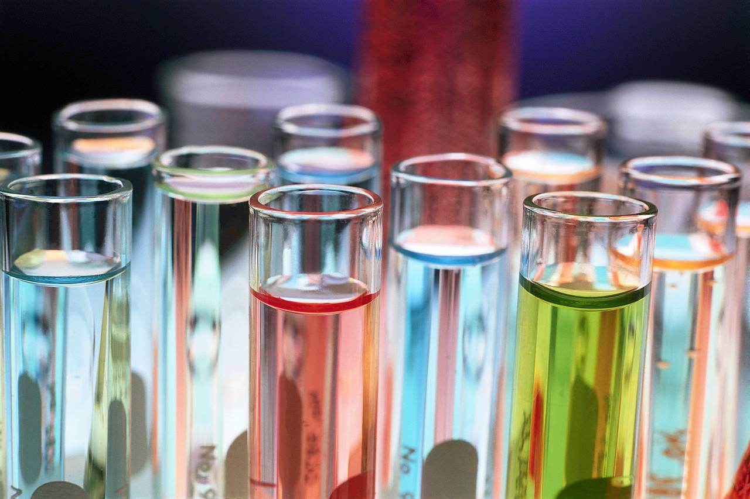
Chemical Science

Slide 2
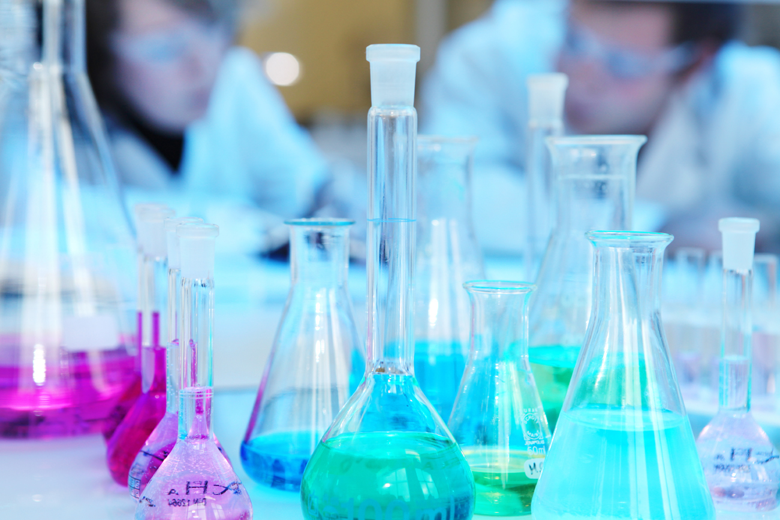
Chemistry
The study of MATTER
The study of what things are made of
(matter & composition)
The study of how matter undergoes reactions

Slide 3
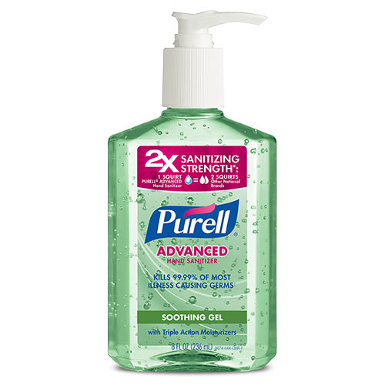
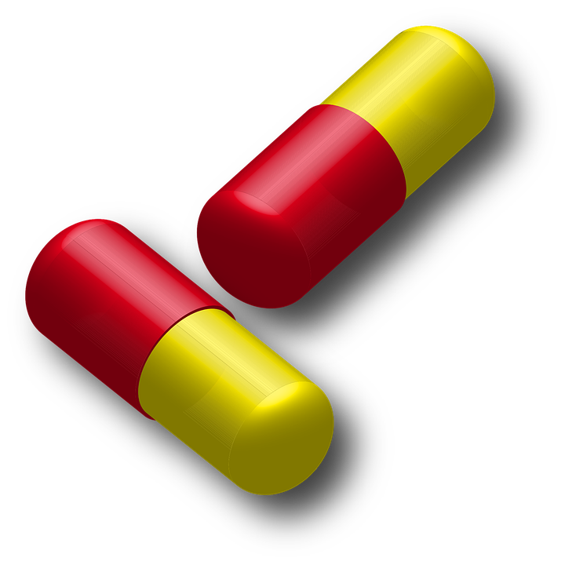
Pharmacology
Drugs, medicine, cleaning solutions

Slide 4
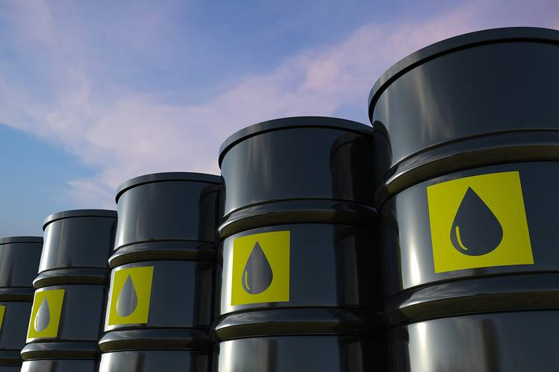
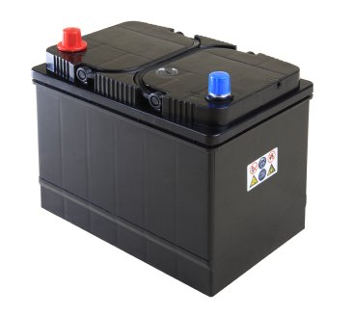
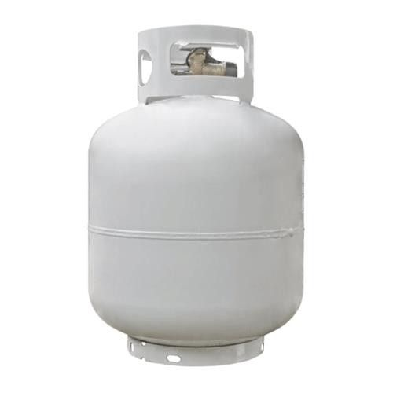
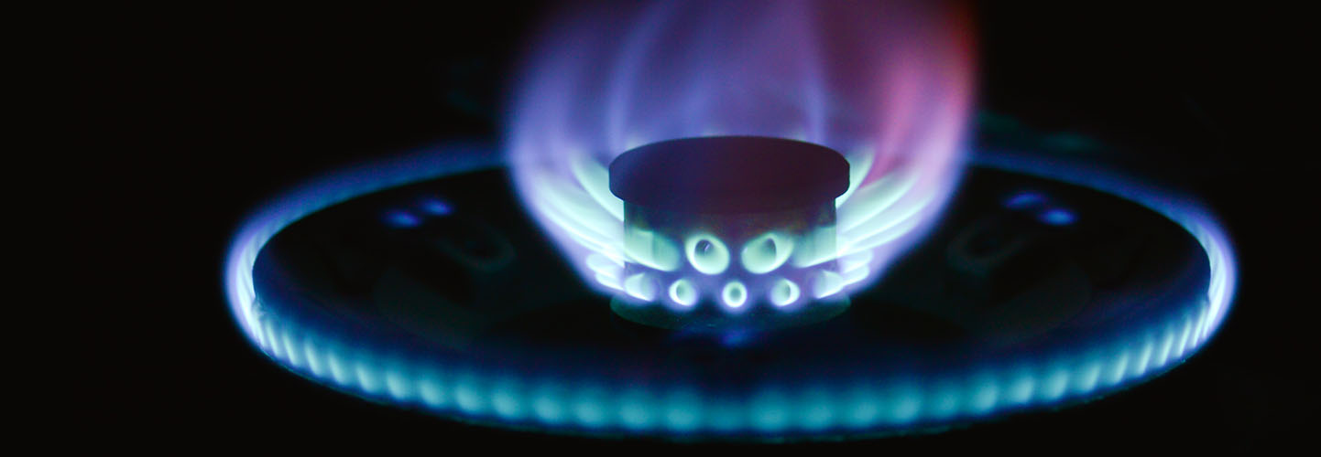
Fuels
Petroleum, gasoline, methane, propane

Slide 5
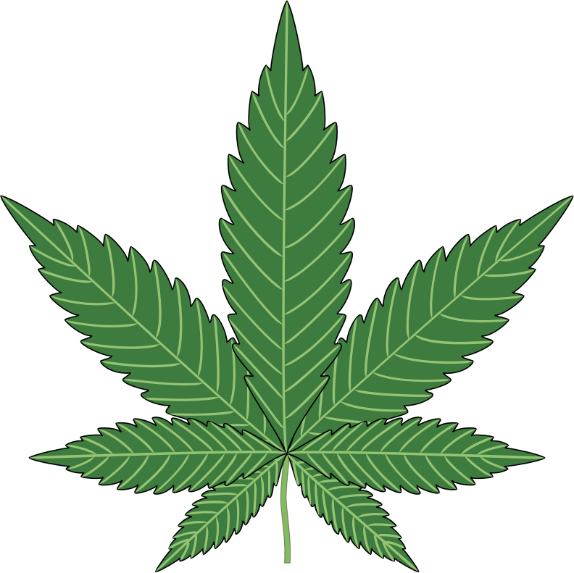
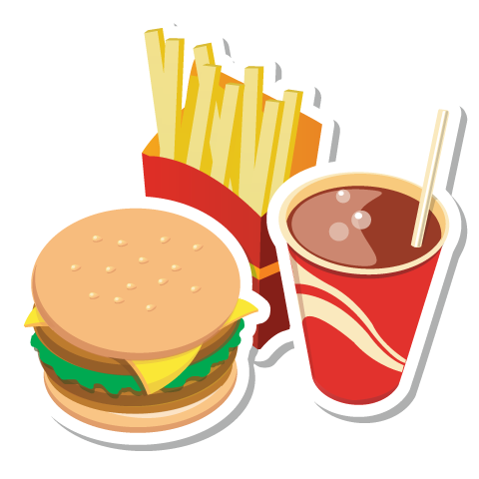
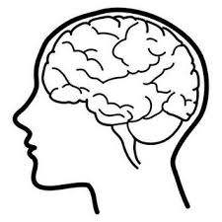
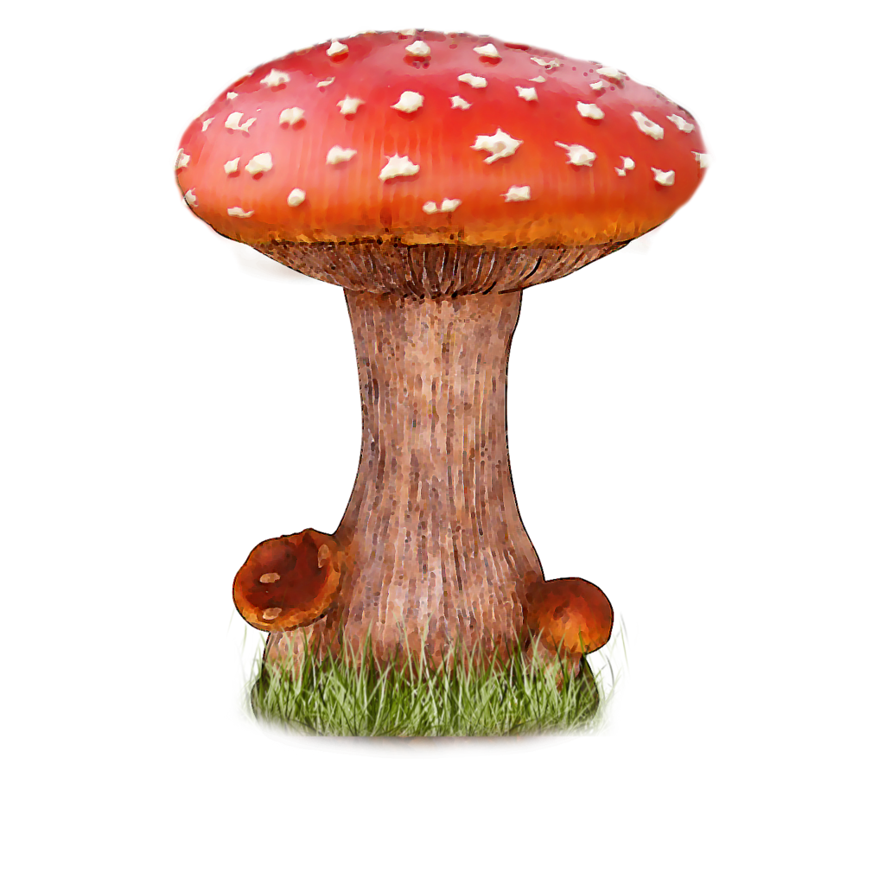
Biochemistry
Hormones, food, diet, plants, fungi

Slide 6
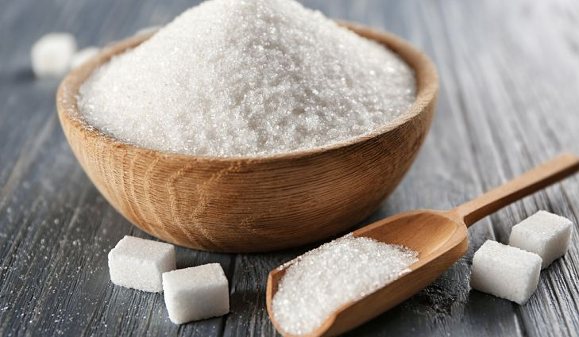
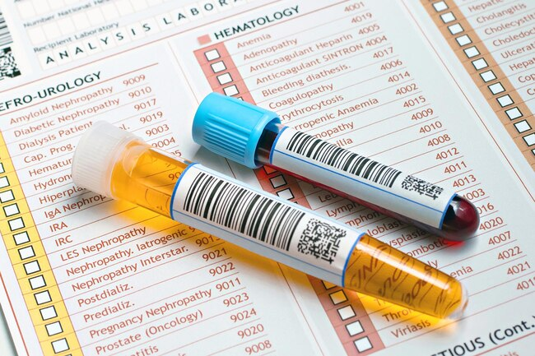
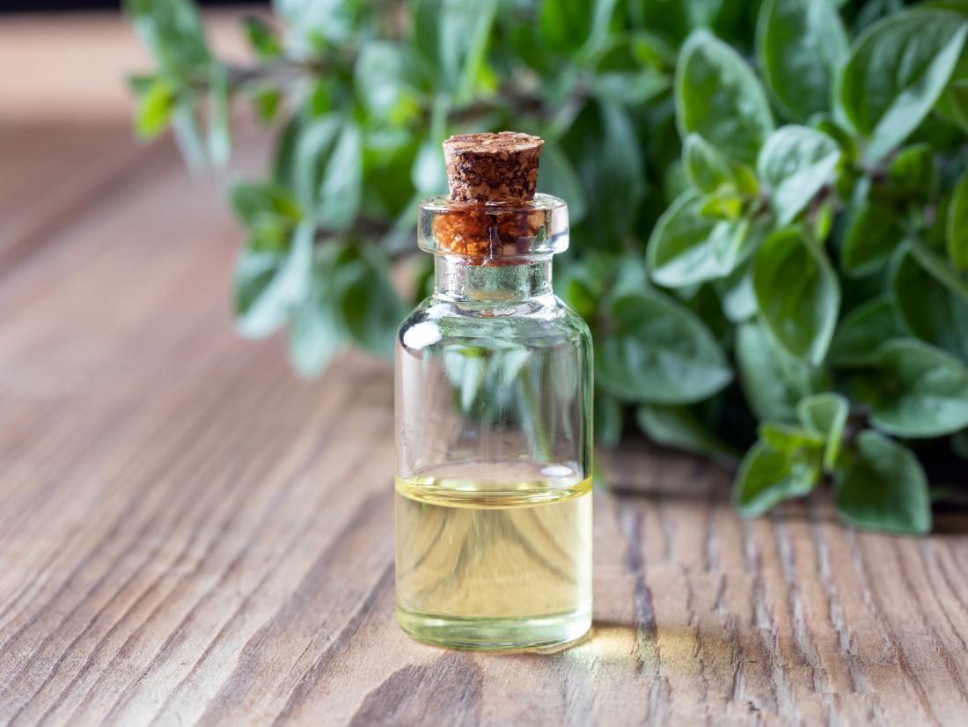
Biochemistry
Forensics & macromolecules

Slide 7
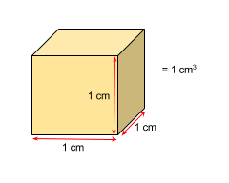
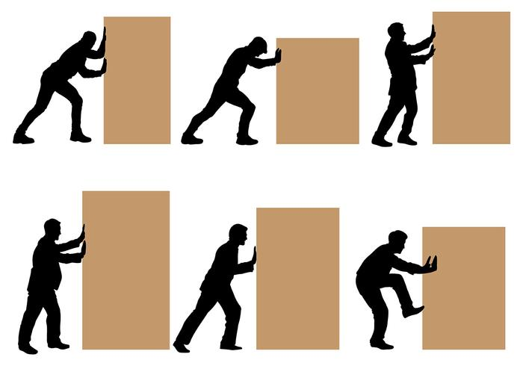
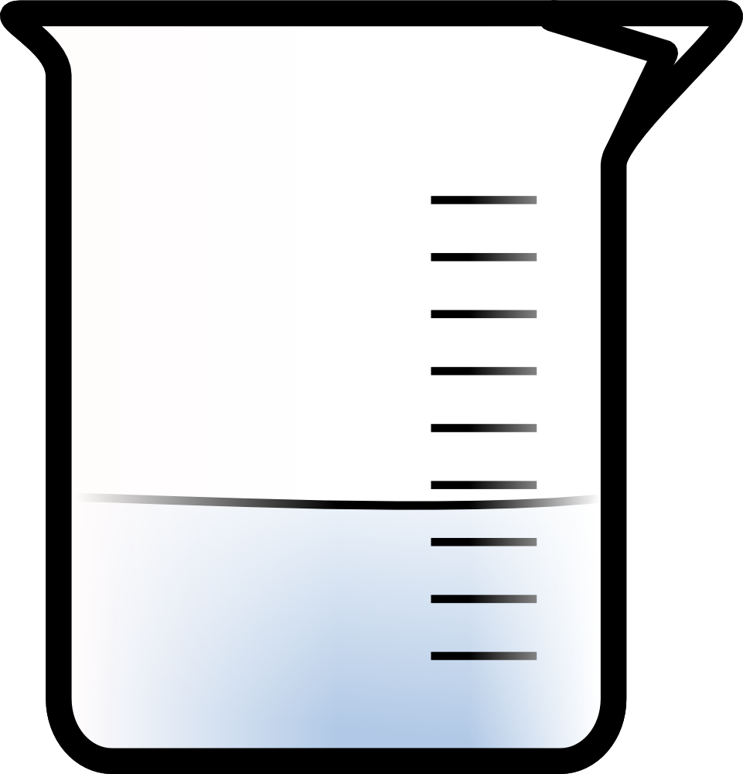
MATTER
Anything that takes up space and has mass
SPACE = has measurable volume
MASS = resistance to movement

Slide 8
MATTER
MIXTURE
SOLUTION
Things mixed together and are NOT UNIFORM
Things mixed together and are ARE UNIFORM

Slide 9
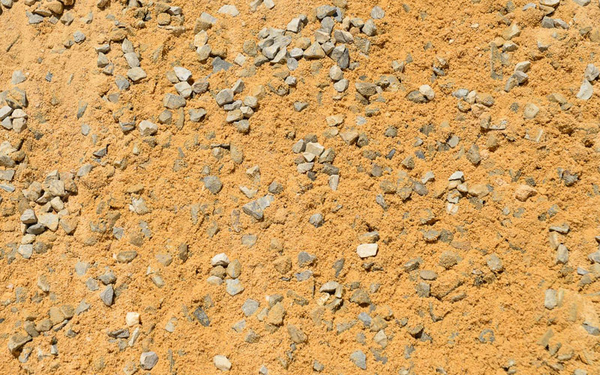
MIXTURES

Slide 10
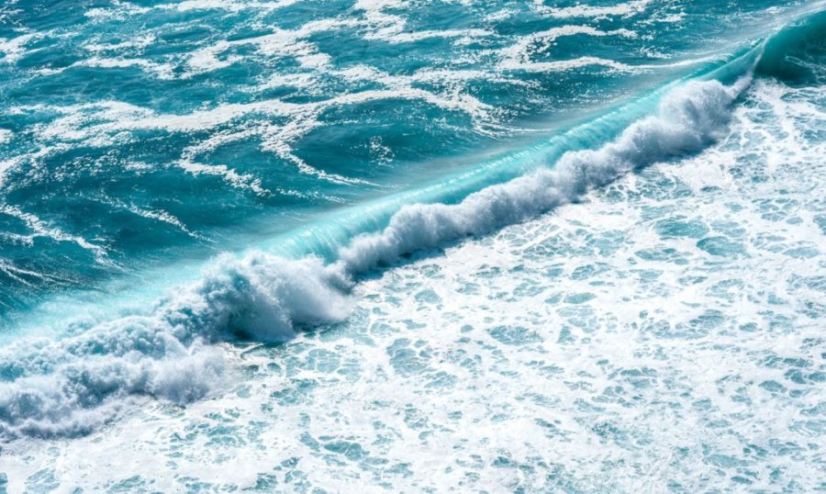
SOLUTIONS

Slide 11
SOLUTIONS

Slide 12
SOLUTION
MOLECULES
ATOMS
Several atoms bonded together
Basic building block of molecules

Slide 13
MATTER
A beach
MIXTURE
SOLUTION
Sand & Saltwater
Saltwater
MOLECULES
ATOMS
Salt
Na + Cl
Water
H + O

Slide 14
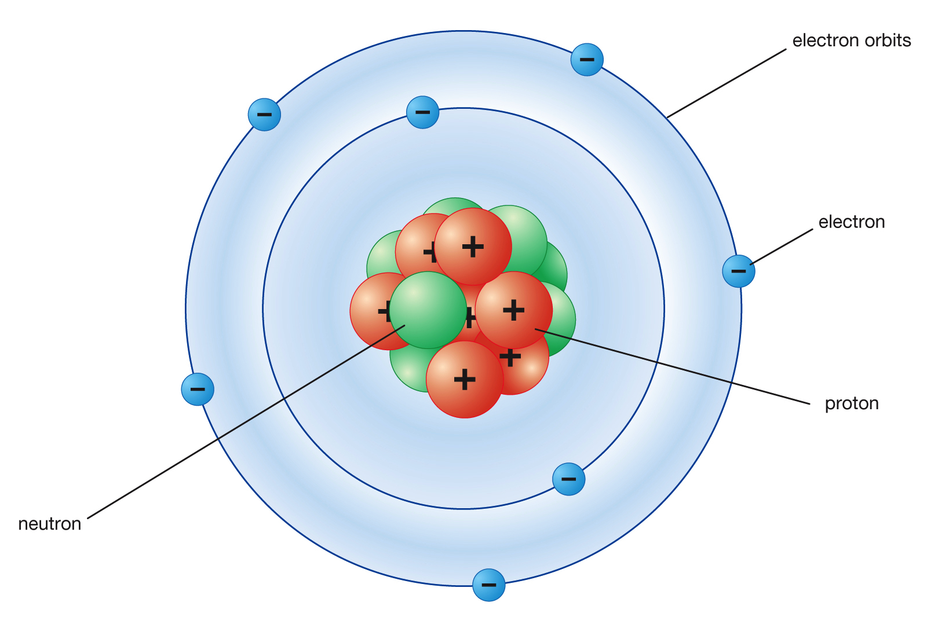

Slide 15
ATOMS
Consists of three parts:
Proton
Positively charged particle
Neutron
Neutral particle
Electron
Negatively charged particle

Slide 16
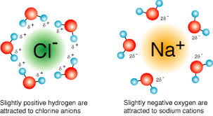
IONIC BONDING
An atom with a positive charge bonds to an atom with a negative charge.
When together, they must EQUAL ZERO

Slide 17
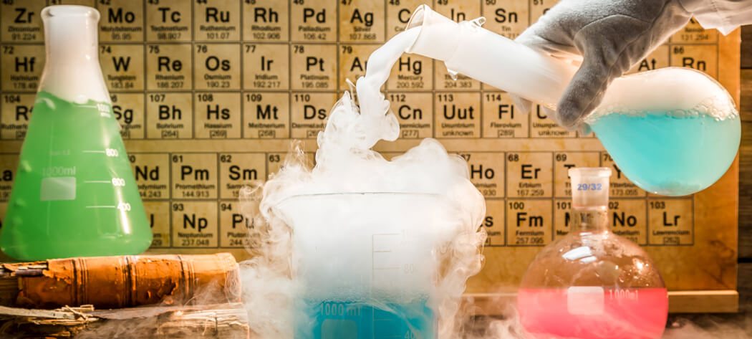
Chemical Reaction
A chemical reaction is an interaction of molecules that causes changes in substances

Slide 18
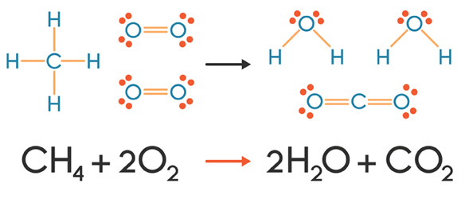
Chemical Reaction
A chemical reaction is a rearrangement of molecules in substances

Slide 19
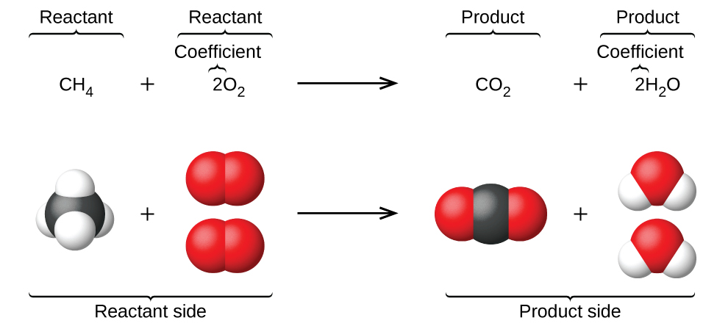
REACTANTS
Start the chemical reaction

Slide 20
PRODUCTS
What is formed in the chemical reaction

Slide 21
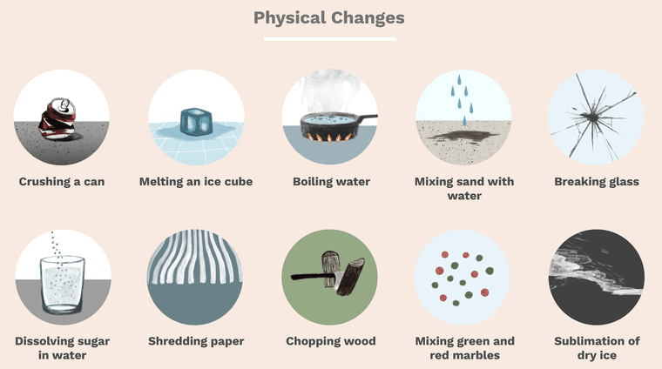
PHYSICAL CHANGE
A change in how a substance looks / physical nature
Melting
Vaporization
Color change
Size change
Shape change
Mixing

Slide 22
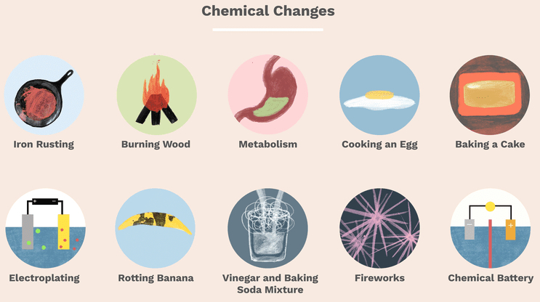
CHEMICAL CHANGE
A transformation of a substance into a new one
Burning
Rusting
Rotting
Foaming
Clumping

Slide 23
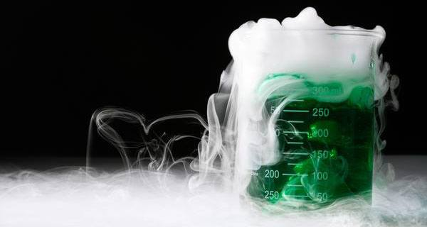
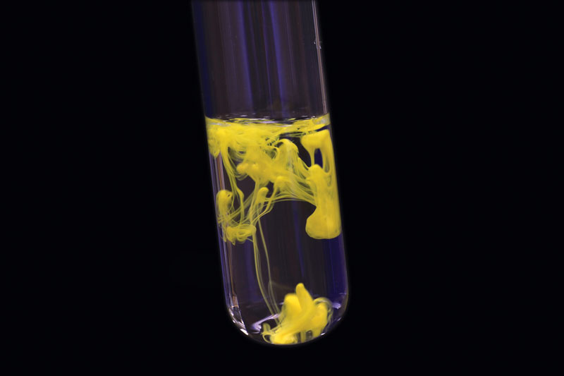
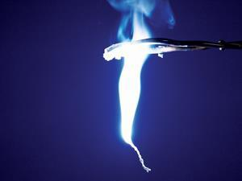
Evidence of chemical reactions occurring
Heating or cooling
Odor change
Gas production
Precipitate
Light production

Slide 24
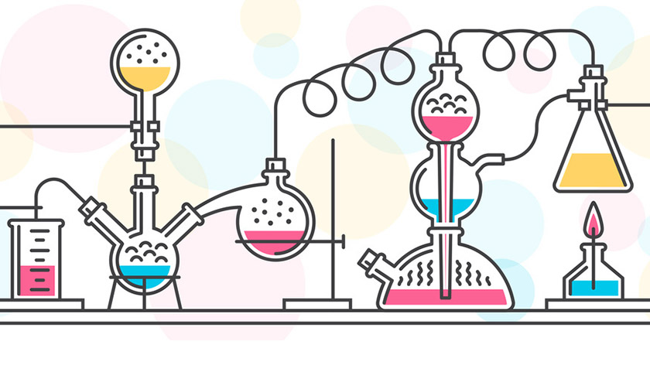
Types of Chemical Reactions

Slide 25
TYPES of Reactions

Slide 26
COMBINATION Reaction
Substances combine to make a new substance

Slide 27
DECOMPOSITION Reaction
A substance breaks apart to make new substances

Slide 28
RECOMBINATION Reaction
Two substances rearrange with each other to make two new substances

Slide 29
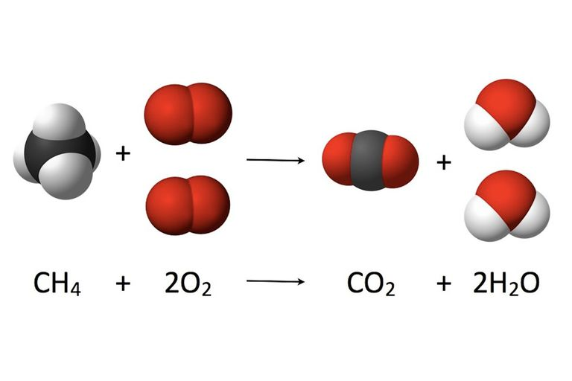
COMBUSTION Reaction
One or more substances are burned to form carbon dioxide and water

Slide 30
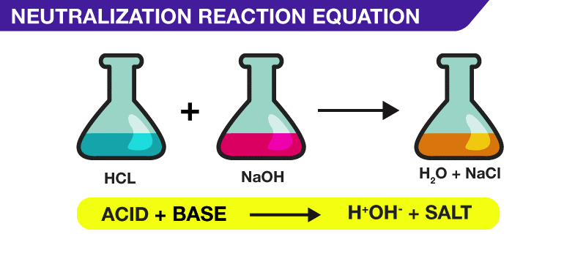
NEUTRALIZATION Reaction
Acids and bases combine to form salt and water

Slide 31
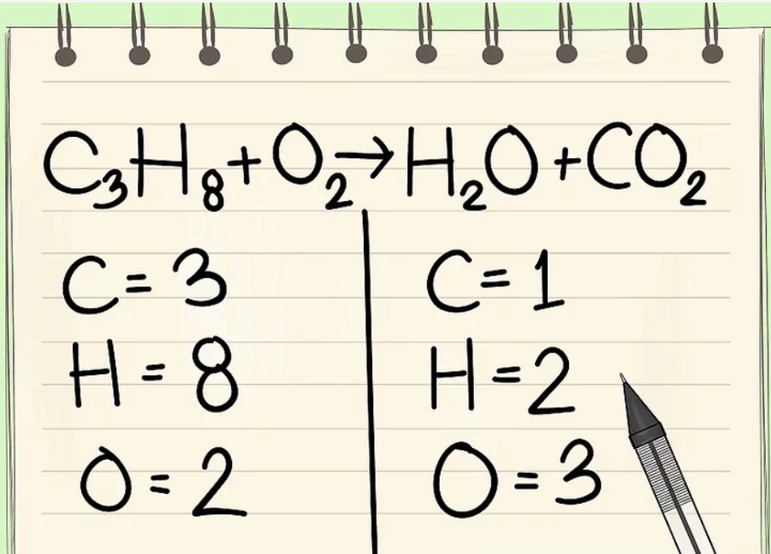
BALANCING equations

