Slide 1
Welcome to the falcon perch library!

Slide 2
Basic Information
I’m Ms. Amy Whiting, your librarian.
I’m passionate about stories because I believe they can help us feel less alone, encourage empathy, and enhance our interests.
My favorite YA books are Persepolis, Anne of Green Gables, Inkheart, Book Thief, and so many more!
Library Hours:
Monday-Thursday 7:45am-3:15pm
Friday 7:45am-2:00pm
You are also welcome during lunch. You can check out books, read, hang out with friends, or participate in whatever fun activity I have going on that day!

Slide 3
Library Rules
Your teacher’s rules apply when you are in here as a class.
Be respectful, responsible, and safe.
Follow all school rules, including our Electronic Device Policy.
Put the materials back where you found them when you are finished using them.
IMPORTANT: If you decide you do not want a book after taking it off the shelf, PLEASE give it to me so I can wipe it off, quarantine it, and then put it away in its correct location.
Students will pay for any damage or loss.

Slide 4
COVID-19 Adjustments
Everyone is required to use hand sanitizer before entering the library.
Sanitize or wash your hands before you touch a book, even if you’re reading at home.
When we check in books, we wipe them down and “quarantine” them for at least 24 hours before re-shelving them.

Slide 5
REMEMBER:

Slide 6
How can I locate a book in the library?
Go to the library website, click on “Destiny Discover” and then search your book title or keyword.
There are 2 main sections in our library:
Dewey Decimal books
Wrapped around the wall
These are almost all non-fiction except for the graphic novels!
Organized by Dewey number (see chart for subjects)
Fiction books
On the free-standing shelves.
Organized by author’s last name

Slide 8
How do I check out books?
Bring your book to the front desk.
Tell me your name or student number.
I will scan the book to check it out under your name.
You will get a receipt so you can keep track of the due date.

Slide 9
My receipt printer is broken, so you will receive a handwritten bookmark receipt instead. It looks like this:
You do not need to return the receipt to me when you return your book.

Slide 10
If you have any late books, you will not be able to check out any more books until the late titles are returned.
If you want to keep your book past its due date, you can renew it. Please call the library or visit me and I will help you out.
Remember, you can only have 5 books at a time!

Slide 11
How do I return books?
You will not be coming to the library with your class every week.
You can come down on your own time or, if you have your teacher’s permission, with a hall pass during class time.
Three ways to turn in a book:
Drop in box in the hall (the door sometimes blocks it, though)
Drop in box in library
Hand it to me (or the person behind the desk)

Slide 12
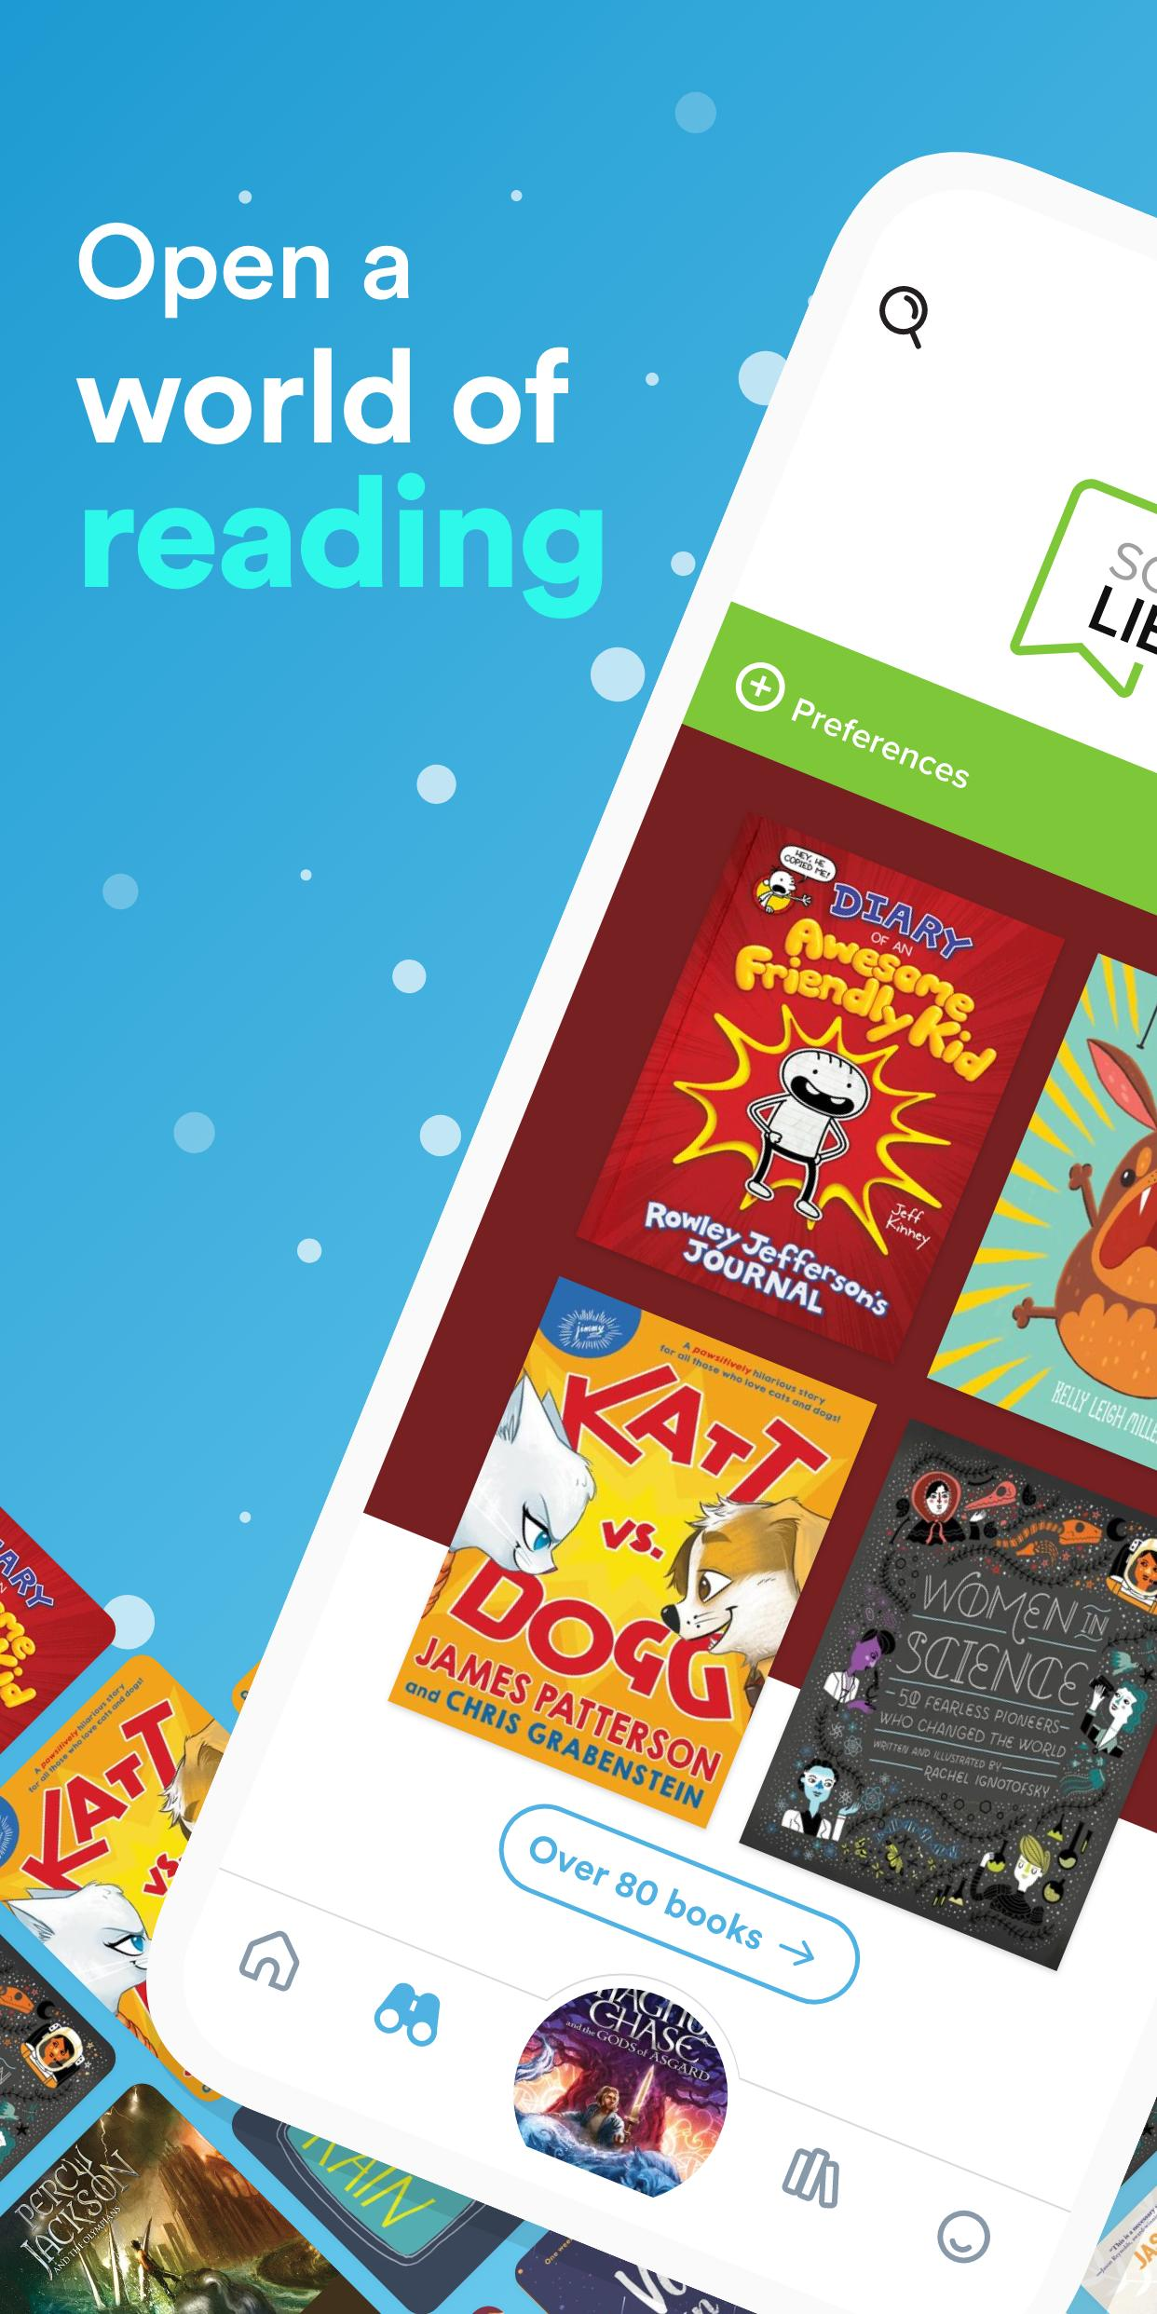
What is available online?
You can use the website/app Sora to read and listen to books on your phone, laptop, or other device!
Just like a physical library, Sora lets you put a book on hold or check it out for a period of time—all for free!

Slide 13
https://help.overdrive.com/en-us/9709.html

Slide 14
Need a good book recommend?
To find a good book, use:
Book recommendations wall
(from staff and students)
Monthly theme books, displayed on shelves
Destiny Discover (keyword search)
GoodReads

Slide 15
Coming soon:
Movie/TV Club
Gaming Club
These will be the same format as book club: Join us to eat lunch, talk about what you’ve been watching or playing, and make friends with similar interests!
Please note that we will not be viewing or playing anything during this time, just talking about it.

Slide 16
Check out our library website!

Slide 17
Any questions?

