Slide 1
How to Avoid Plagiarism

Slide 2
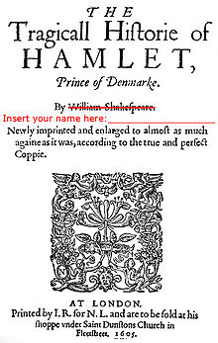
What is plagiarism?
This Photo by Unknown Author is licensed under CC BY-SA

Slide 3
What is plagiarism?
Plagiarism is the use of the words and ideas of others as if they were your own. This is dishonest and unethical and usually results in serious consequences.
Bainbridge State College, 2010

Slide 4
OTHER TYPES OF PLAGIARISM:
ACCIDENTAL PLAGIARISM: Not citing your sources properly. (We’ll talk about this later)
SELF-PLAGIARISM: "Recycling" your own work but pretending it is new work is plagiarizing yourself, because it is not a new creation for the current assignment. It’s not okay, unless authorized by your instructor.
Allowing someone else to copy your work or copying someone else’s work and presenting it as your own is COLLUSION. It’s a crime.
This Photo by Unknown Author is licensed under CC BY-SA
This Photo by Unknown Author is licensed under CC BY-NC-ND

Slide 5
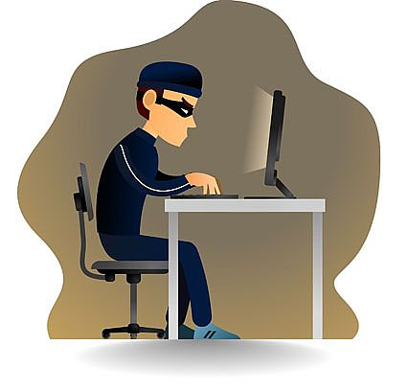
Why should you avoid plagiarism?
This Photo by Unknown Author is licensed under CC BY-SA

Slide 6
What are the consequences of plagiarism?
1. Loss of credit for the assignment.
2. “U” in citizenship.
3. Loss of respect /destroyed reputation.
4. At college level, you can be expelled.
5. At work, you can lose your job.
6. Depending on the situation, there may be legal repercussions.
This Photo by Unknown Author is licensed under CC BY

Slide 7
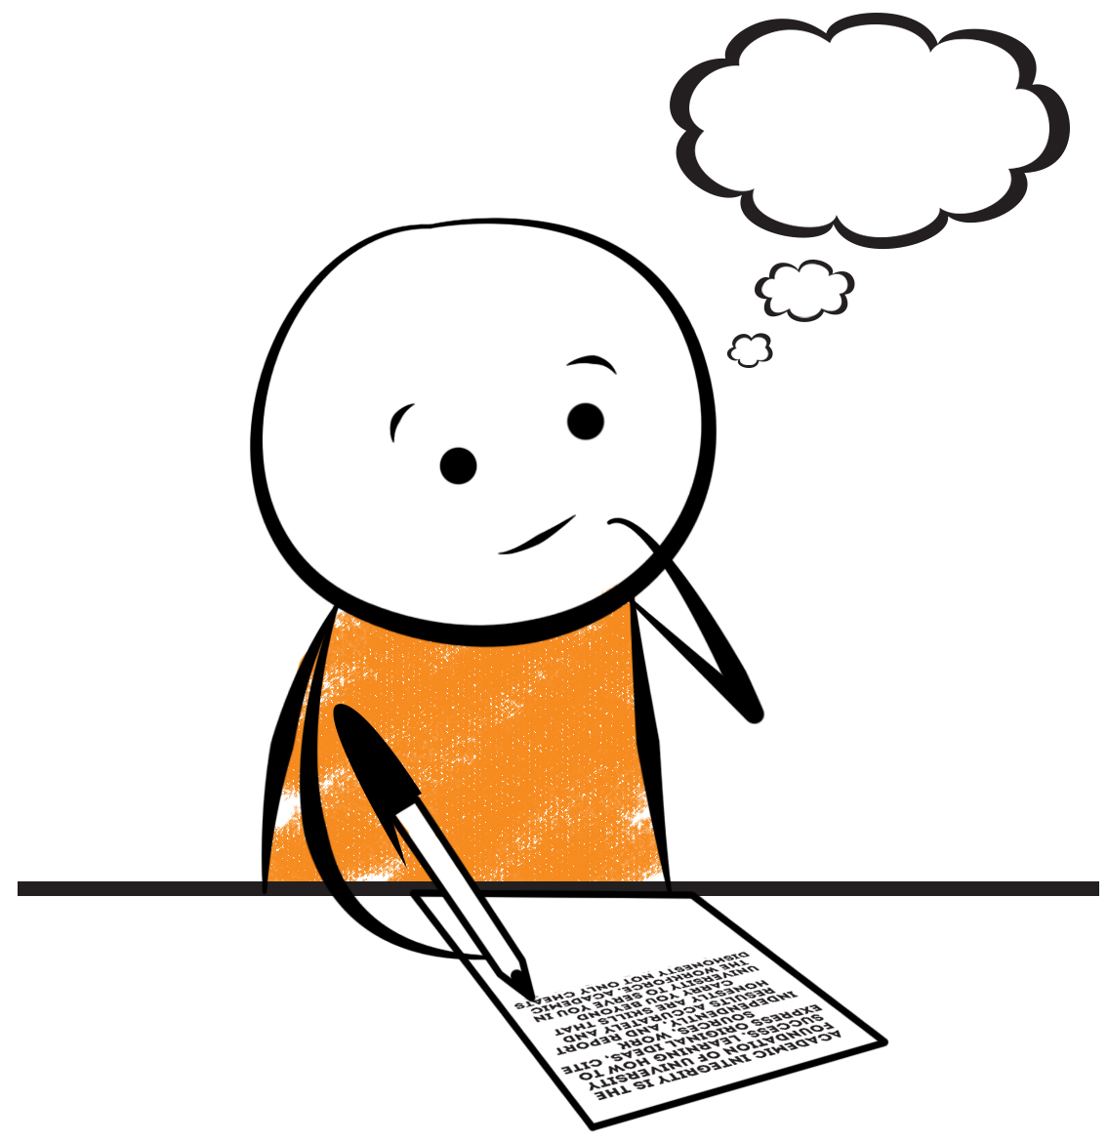
So how do I avoid plagiarism while still using sources?
This Photo by Unknown Author is licensed under CC BY-SA

Slide 8
Anything that is not your own original idea or content requires a References/Bibliography/Works Cited. These go at the very end of your paper and give credit to the original creator.
That includes ideas, pictures, text, etc!

Slide 9
NOTE: References = Bibliography = Works Cited These three different words essentially mean the same thing — a page at the end of your paper specifically to give credit to your sources. If you quote someone in your paper, you must list that on a Works Cited page at the very end, along with any other sources you used, in MLA format.

Slide 10
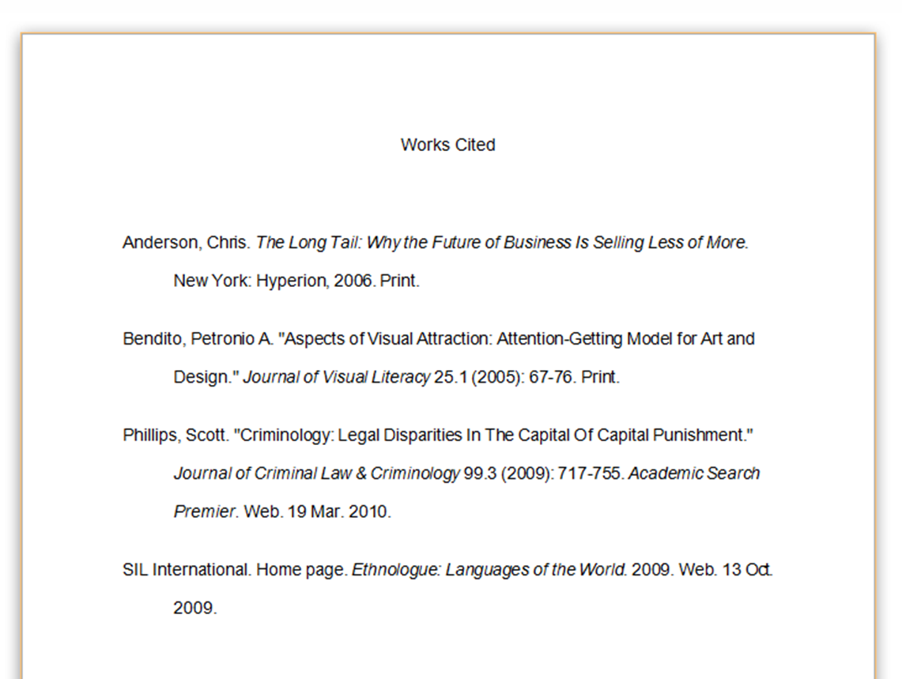
WORKS CITED (or Bibliography, or References)
Check with your teacher to see where you will be listing your sources, what you should title the page, and which format to use.
(Different formats can include MLA, APA, Chicago, etc. Each requires different information about the source and has you put them in a different order than another format.)
Nelson Poynter Memorial Library 2016
https://www.citationmachine.net/

Slide 11
How to give credit to avoid plagiarism:
OR,
“I have my Works Cited page…. Now what?”

Slide 12
Three Options for Using Sources:
Direct quote with parenthetical citation
“Don’t fight unless you want to. You don’t have to prove your bravery in Minecraft. Fighting when you are close to death, don’t have good gear, are far from home or otherwise unprepared, leads to death” (Talmage 41).
Paraphrase
Talmage believes that you don’t need to fight in Minecraft unless you really want to. Fighting when you are unprepared leads to death (41).
Summary
Fighting in Minecraft when you are unprepared is not a good idea (Talmage 41)

Slide 13
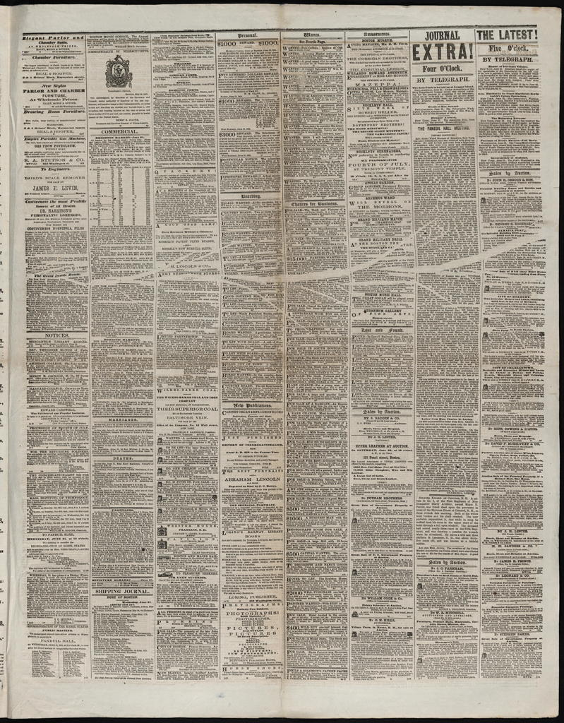
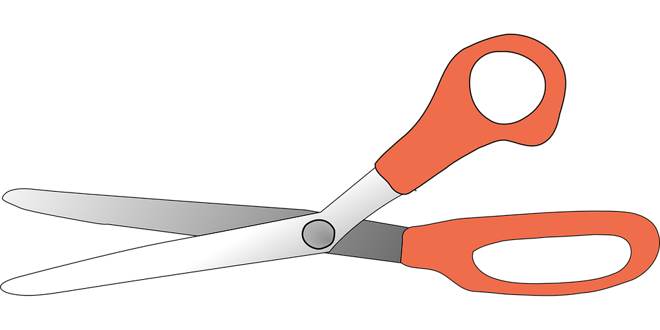
Be careful: don’t quote huge passages
Avoid quotes longer than 1-2 lines. Paraphrase and quote some of it (“blending”), and remember to use a parenthetical citation.

Slide 14
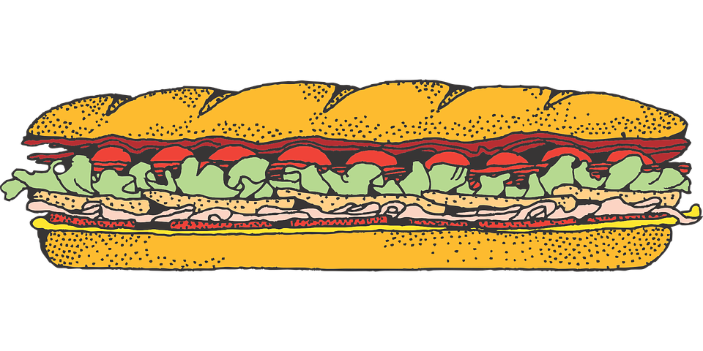
USING DIRECT QUOTES: In-text citations & parenthetical citations
THE GOAL: tell which source it comes from, so the reader can easily find it on your Works Cited page -- that’s why you use what comes first AND why you alphabetize!
Refer to the source by whatever comes first on its entry on your Works Cited. Usually that is the author’s LAST NAME.
If there is no author, use the first few words of the article title.

Slide 15
Examples of parenthetical citations:
Desk cleanliness may affect a student’s health. A specialist in school health writes, “When desks have too much gum on them, students may become ill more often” (Chavez 54). This is significant because the desks at CCHS have more gum on them than most schools in the district.
Gum on desks is not only a problem in high schools. According to research, “Many middle schools report an increasing problem with gum” (“Gum Hazards”). As a result, intervention programs may need to be put in place earlier than 9th grade.
Another problem with the desks at CCHS is their size. As one writer discusses, “Students are able to do better work when they have enough room to work well” (Jones). This suggests that the small desks at CCHS may be impacting the students’ success in their classes.

Slide 16
Example Works Cited (to go with the previous parenthetical citations)
Works Cited
Chavez, Rosa. “The Impact of Gum on Student Health.” Education Reports. 2016. www.edreports.com/impact_gum. 2016. Accessed 6 Dec. 2018.
“Gum Hazards in Middle School.” Education Reports. 2017. www.edreports.com/gum_hazards. Accessed 15 Nov. 2018.
Jones, Mike. “Desks and Grades.” School Studies. 2017. www.edreports.com/desks_grades. Accessed 30 Nov. 2018.

Slide 17
Use the anti-plagiarism checklist (see handout)
RESEARCH
1. Keep a list of all the books, articles, websites, and other sources you use.
2. Keep track of which information came from which sources (and what page, etc).
WRITING
3. Put quotation marks around direct quotes.
4. Give credit to the original source, even if you summarize.
5. If you are unsure of how or if to list a source, check with your teacher or Ms. Whiting
6. Use in-text citations to refer to your Works Cited.
FINAL PAPER
7. Include a Works Cited page containing all books, articles, websites, and other sources.
8. Make sure your Works Cited page is in the correct format. (Your teacher will tell you if they want MLA, APA, etc)

Slide 18
Let me introduce you to your new best friend: www.citationmachine.net

Slide 19
Be honest Plagiarism has serious consequences Use Citation Machine to create your Works Cited and credit the sources
SUMMARY:

Slide 20
Works Cited (for this presentation)
Bainbridge State College. “Plagiarism: How to avoid it.” Online Video Clip. YouTube. January 5, 2010. Web. November 16, 2016.
Whoishostingthis.com/blog. “The Deep Web, The Dark Web & Tro: How to Surf the Secret Internet.” September 14, 2019.
Nelson Poynter Memorial Library, “Avoiding Plagiarism: MLA Citation Style”,
http://decade.it.usf.edu/stpete/lib_modules/AvoidPlagiarismMLA/AvoidPlagiarismMLA_print.html, February 22, 2016.
Pirillo & Fitz, shared on Grammarly.com.
http://www.grammarly.com/blog/2015/5-most-effective-methods-for-avoiding-plagiarism/, 2016.
Preuss School: Website Evaluation. CSU Chico CRAAP Test for the UC San Diego Library. 2019.
Zimdars, Melissa. More Tips for Analyzing News Sources. James C. Enochs High School. 2019
Thank you to the following for information adapted for this presentation: Wendy Haws, Natalie Whiting, Amy Whiting

