Slide 1

7th Grade
CCR Introduction
Shoreline Junior High

Slide 2

Starfish Breathing

Slide 3


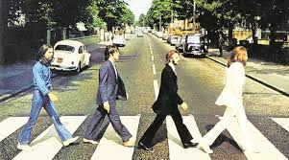

Introduction Song

Slide 4



Two Truths and a Lie

Slide 5



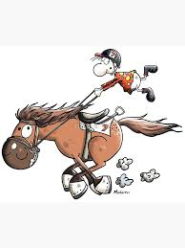
Who am I?
I won a car on the Price is Right
When I was 12, I delivered news papers on my Horse.
I taught 1st and 2nd grade for many years before becoming a counselor.

Slide 6



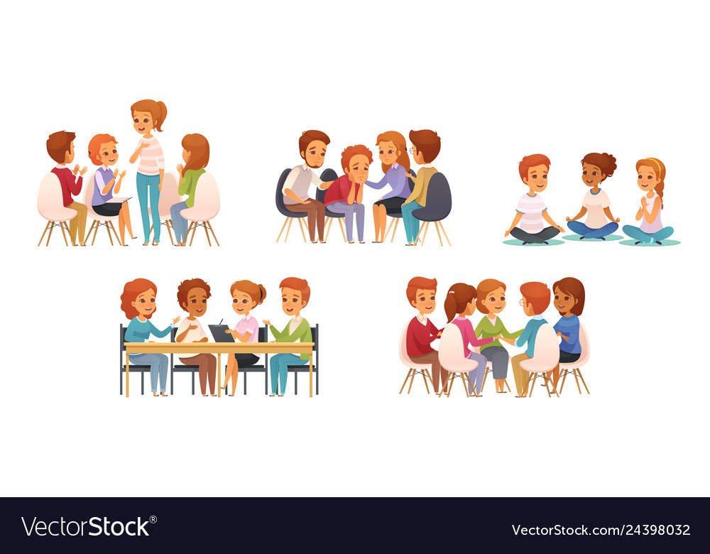
Who am I?
I have lived in France.
I used to be a drug and alcohol counselor.
I am the oldest of eight children.

Slide 7


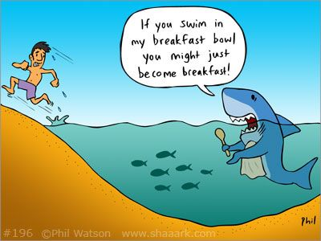
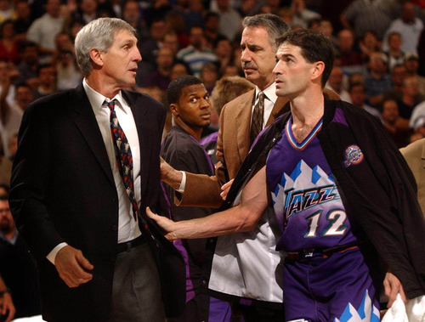
Who am I?
I shot my brother’s tooth out with a bb gun.
I went swimming with sharks.
I went bowling with Jerry Sloan (former coach of the Jazz).

Slide 8

8 Steps for Success in Junior High
Think of it as a new beginning
Stay organized
Attitude check
Relax
Get familiar with Canvas and myDSD
Stay on top of your schoolwork
Get into the “night before” habit
ASK FOR HELP

Slide 10

Role of the Counselor
Individual Student Planning
Responsive Services
Guidance Curriculum
Academic progress
Course Selection
Four-year plan
Goals
College and career options
A-G- Mr. Rosenberg- arosenberg@dsdmail.net
Friends
Family
Grief/loss
Personal/social issues
Suicidal thoughts
Bullying
H-O- Mrs. Powell- lispowell@dsdmail.net
CCA lessons
Shark time lessons
Junior Achievement City
Mock interviews
Layton high, Davis high and DTC Presentations
College I-wearness/college week
P-Z- Mrs. Sheridan- ssheridan@dsdmail.net

Slide 11

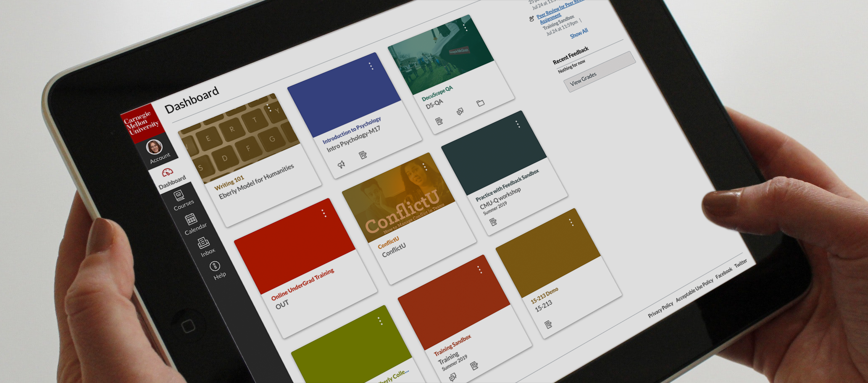
Canvas Run Through
Link for Canvas: https://dsd.instructure.com/courses/1132870

Slide 12

Q&A

